Slide 1
OTN Collaboration
Naomi Tress, Data Acquisition Coordinator
Jonathan Pye, Director of Data Operations
Bruce Delo, Programmer
Kim Whoriskey, PhD Candidate/ideasOTN Co-Chair

Slide 2
ABOUT OTN
Global aquatic research, data management and partnership platform headquartered at Dalhousie University in Nova Scotia, Canada.
Since 2008, OTN has been deploying state-of-the-art ocean monitoring equipment and marine autonomous vehicles (gliders) in key aquatic locations.
OTN has established partnerships with a global community of stakeholders to document the movements and survival of aquatic animals in the context of changing ocean environments.
Knowledge generated by OTN is used by scientists, managers, policy-makers, industry, Indigenous and coastal communities and the general public.
OCEAN TRACKING NETWORK

Slide 3
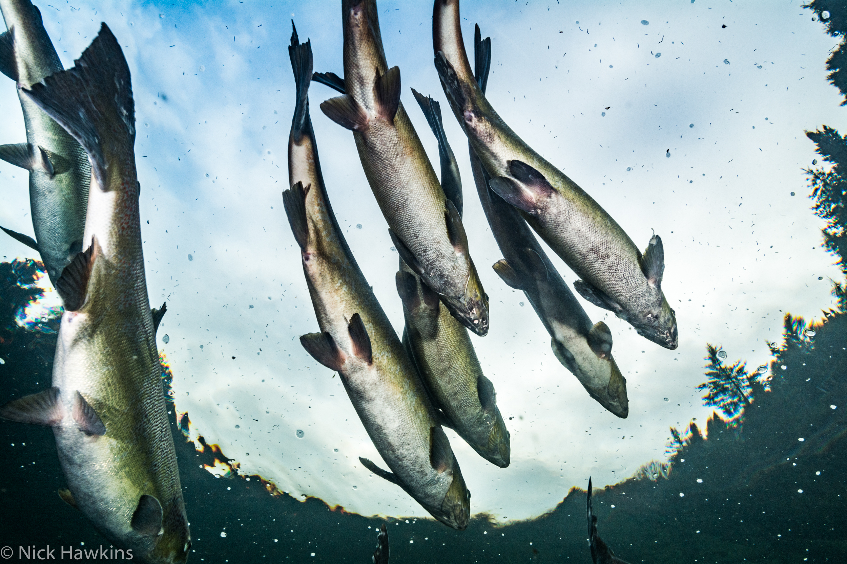
MISSION & VISION
To inform the sustainable management of aquatic animals by providing knowledge on their movements, habitats and survival in the face of a changing global environment
Sustainable management and use of ocean resources
Engaged and informed stakeholders
Sharing resources, abilities and data
OCEAN TRACKING NETWORK

Slide 4
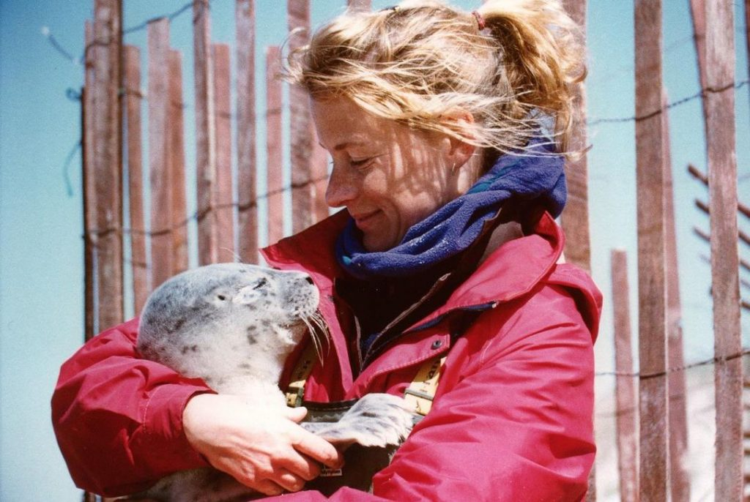
WHY TRACK?
Filling knowledge gaps in the animal telemetry index
Fisheries management (equitable quotas; monitoring)
Design of Marine Protected Areas
Impact assessment for coastal/offshore (Maritime Link; tidal power)
Endangered species research (white shark, Atlantic salmon)
Wild fish interactions with farmed fish
Environmental conditions and the prediction of future animal distributions
Assess habitat repairs and fate of hatchery fish
Engagement of the public
OCEAN TRACKING NETWORK

Slide 5
HOW OTN TRACKS
Acoustic tags are small transmitters that allow researchers to track aquatic animals underwater.
Larger animals can carry Vemco Mobile Transceivers (VMTs), which act as both transmitters and receivers.
Wave Gliders float on the ocean’s surface. They are emission free, propelled by wave energy and solar powered.
Slocum Gliders dive up and down collecting information underneath the waves.
Acoustic receivers capture animal movement data.
OCEAN TRACKING NETWORK

Slide 6
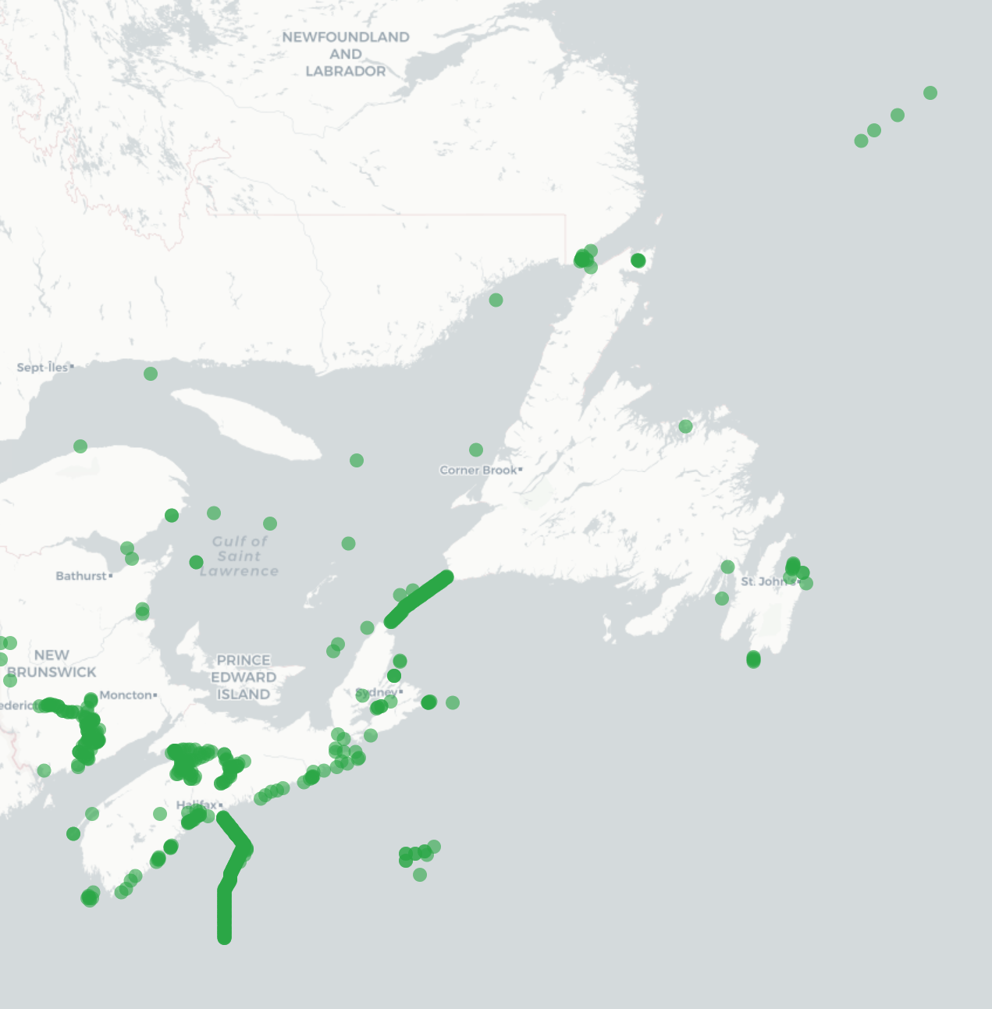
ACOUSTIC RECEIVER LINES
Recovery timelines
Rollovers
Offloads
OCEAN TRACKING NETWORK

Slide 7
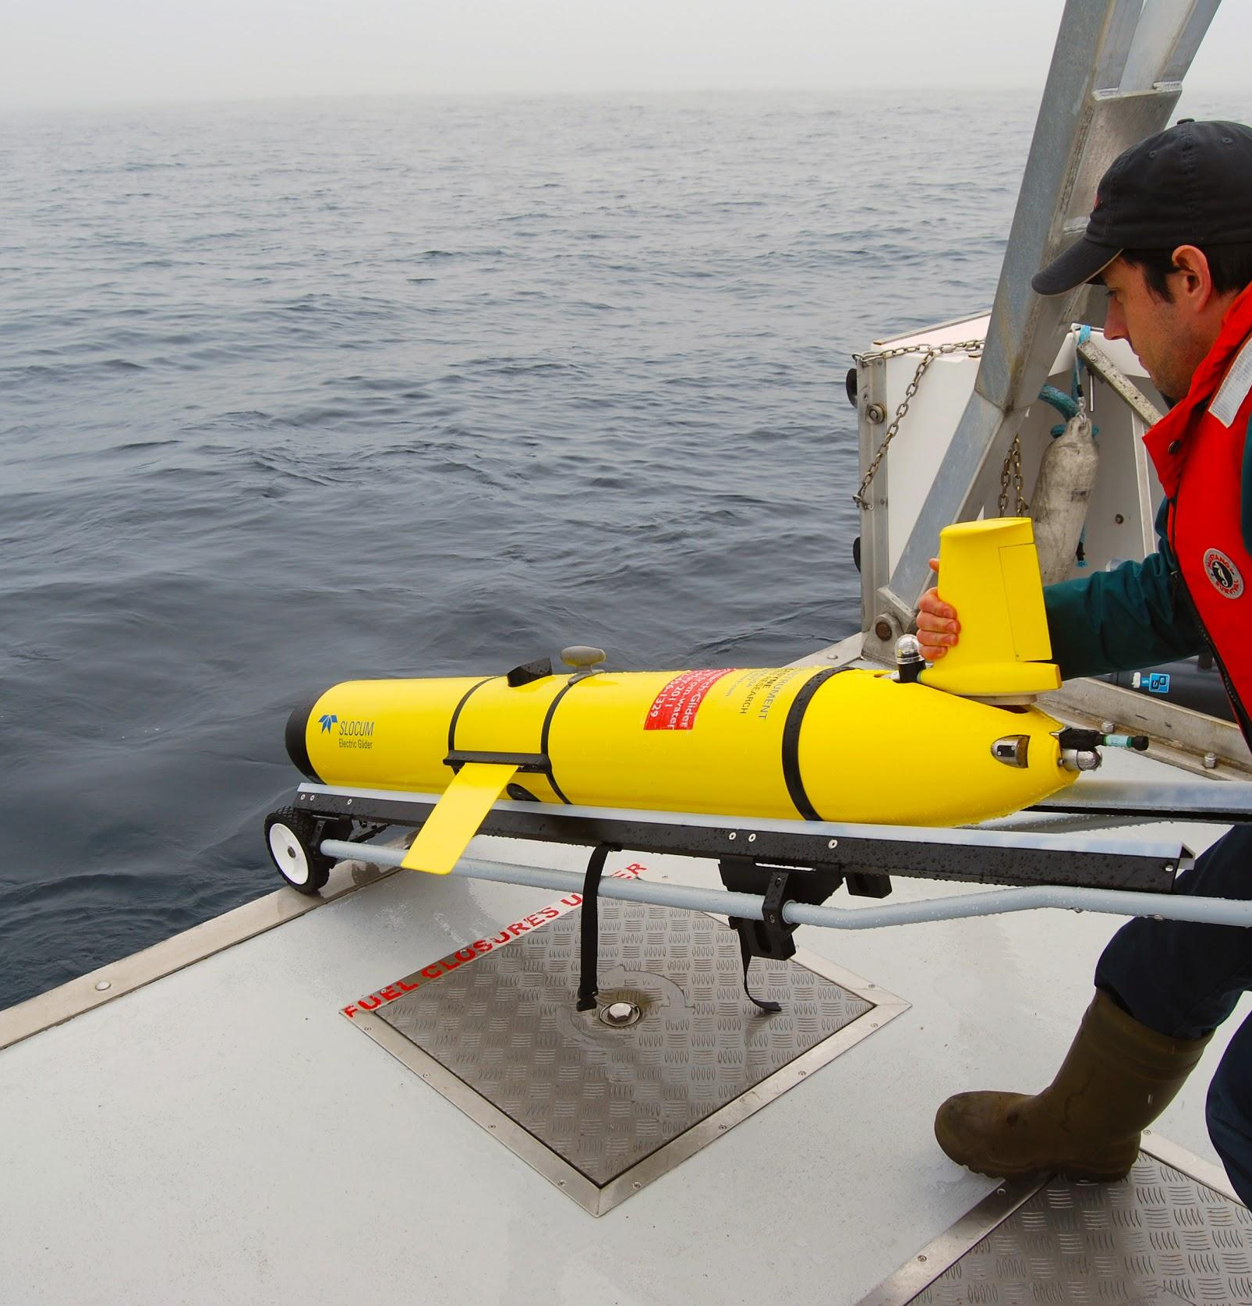
GLIDERS
Changing the way we study the ocean
Emission-free, cost-effective, and autonomous
Remotely offloads fixed tracking stations
Provides oceanographic context and equipment to track animals
Doesn’t get sea sick!
Wave glider: wave driven, powered by solar energy
Slocum glider: buoyancy driven, powered by lithium battery
More than____ km travelled since…
OCEAN TRACKING NETWORK

Slide 8
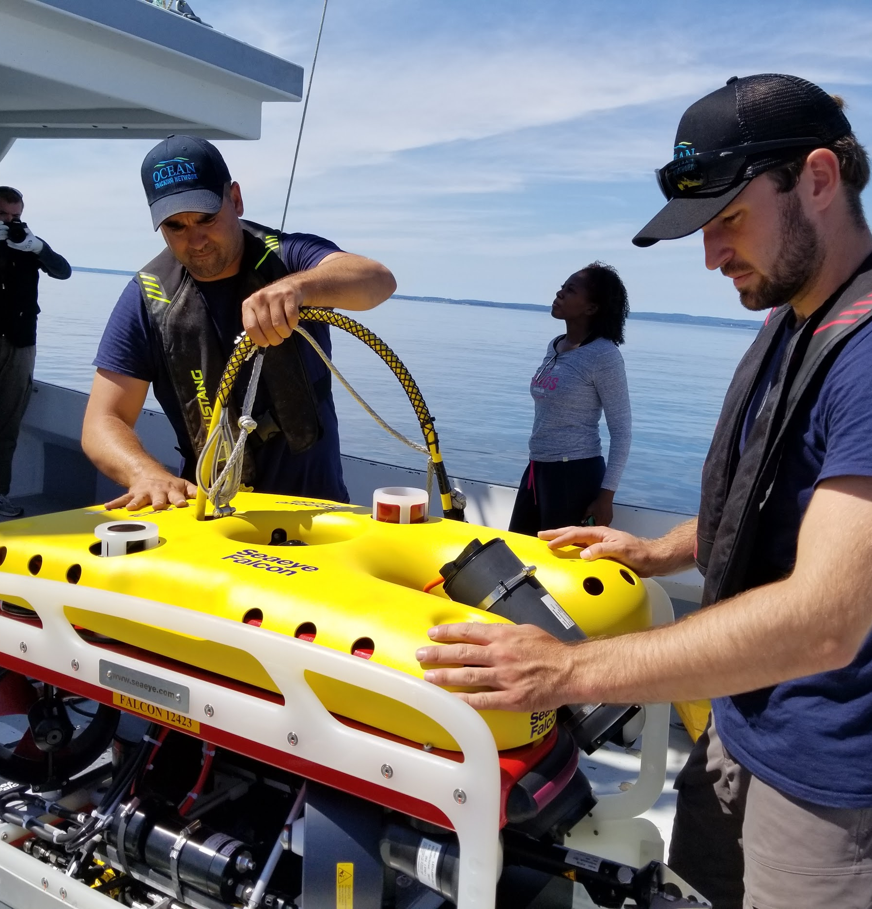
ROV: REMOTELY OPERATED VEHICLE
Saab Seaeye Falcon
Depth Rating up to 300 metres
Alternative recovery method
Film footage
Other projects
OCEAN TRACKING NETWORK

Slide 9
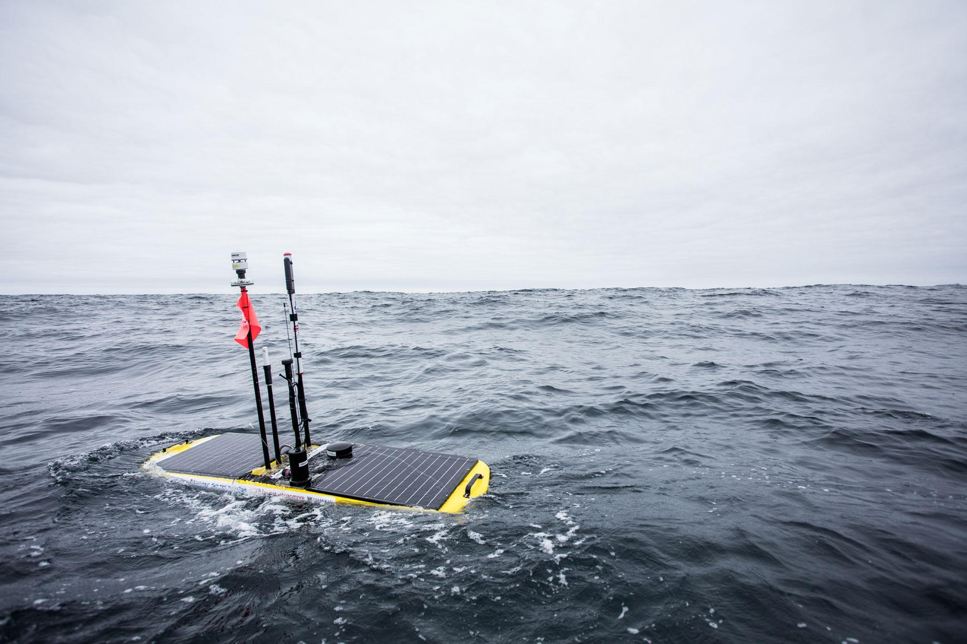
DAMOS collaboration
140+ VR4s in the Grand Banks, NFLD starting 2020
2 autonomous surface gliders to be purchased for work as part of the Development of Autonomous Marine Observation Systems (DAMOS) program in Newfoundland, to be used for oceanographic observations and in offloading 140 VR4s deployed across the Grand Banks
More info:
https://bit.ly/2rQvNeA
OCEAN TRACKING NETWORK

Slide 10
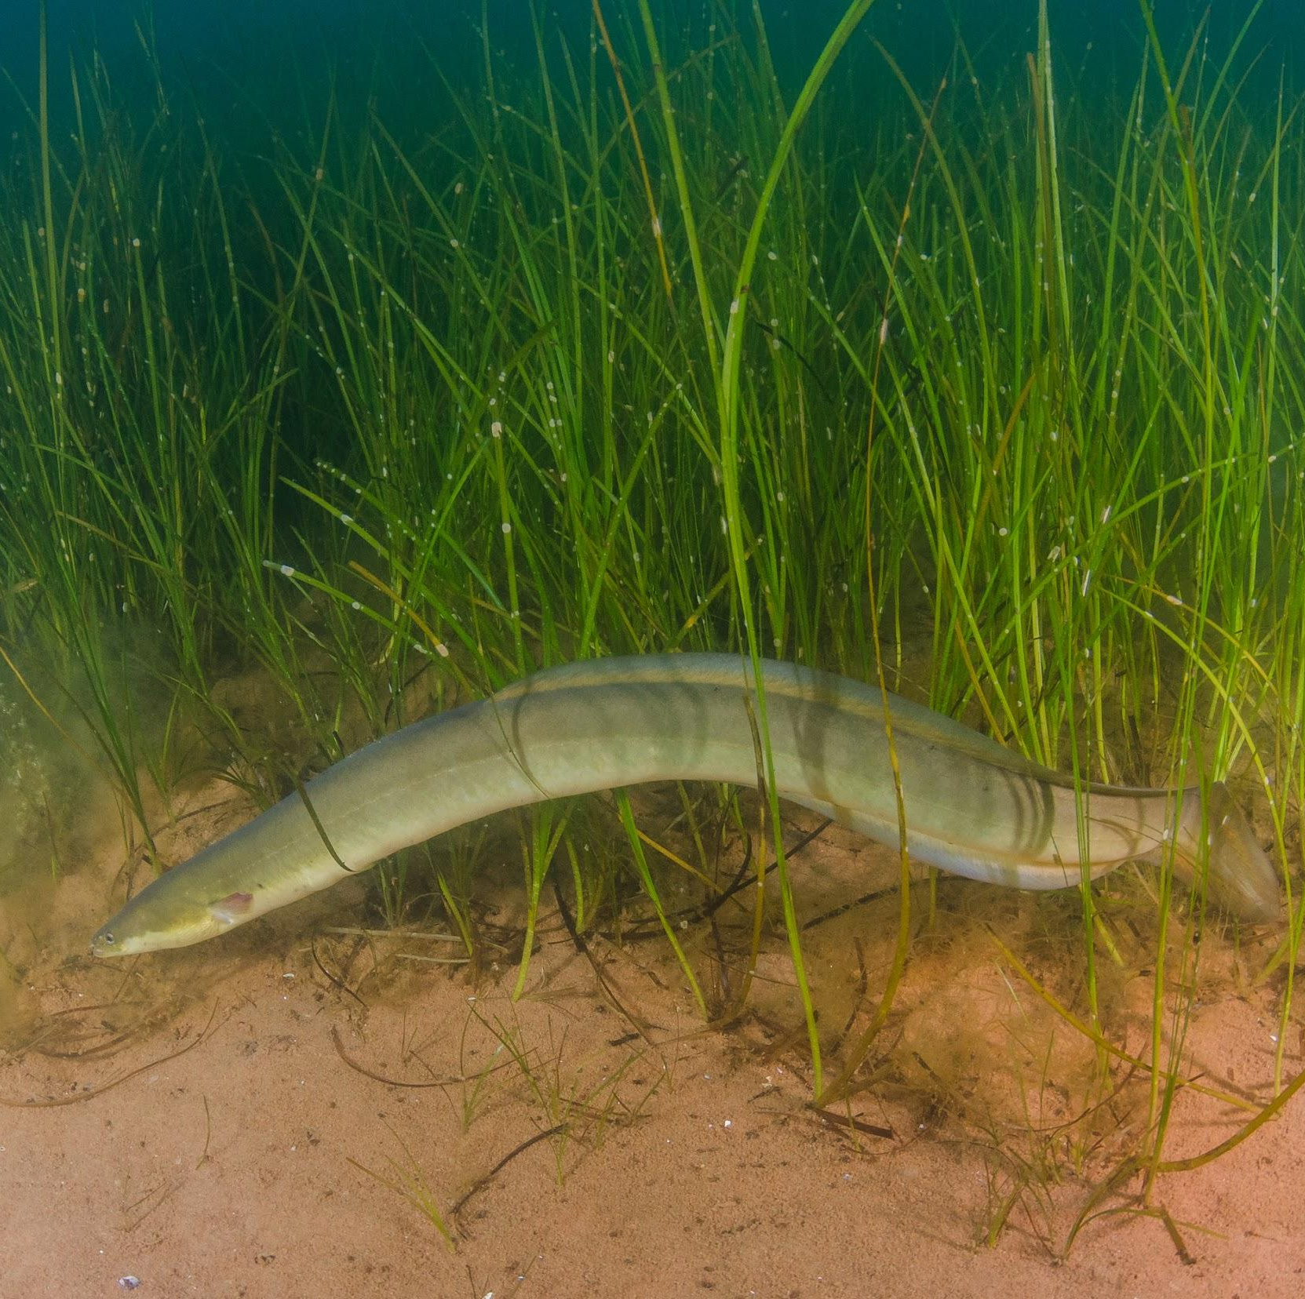
Collaborations
Many projects that require cooperation between multiple groups.
American Eels travel from hatching grounds in Great Lakes, through the Gulf of St.Lawrence, out to the North Atlantic
Highlights need for high level of collaboration.
OCEAN TRACKING NETWORK

Slide 11
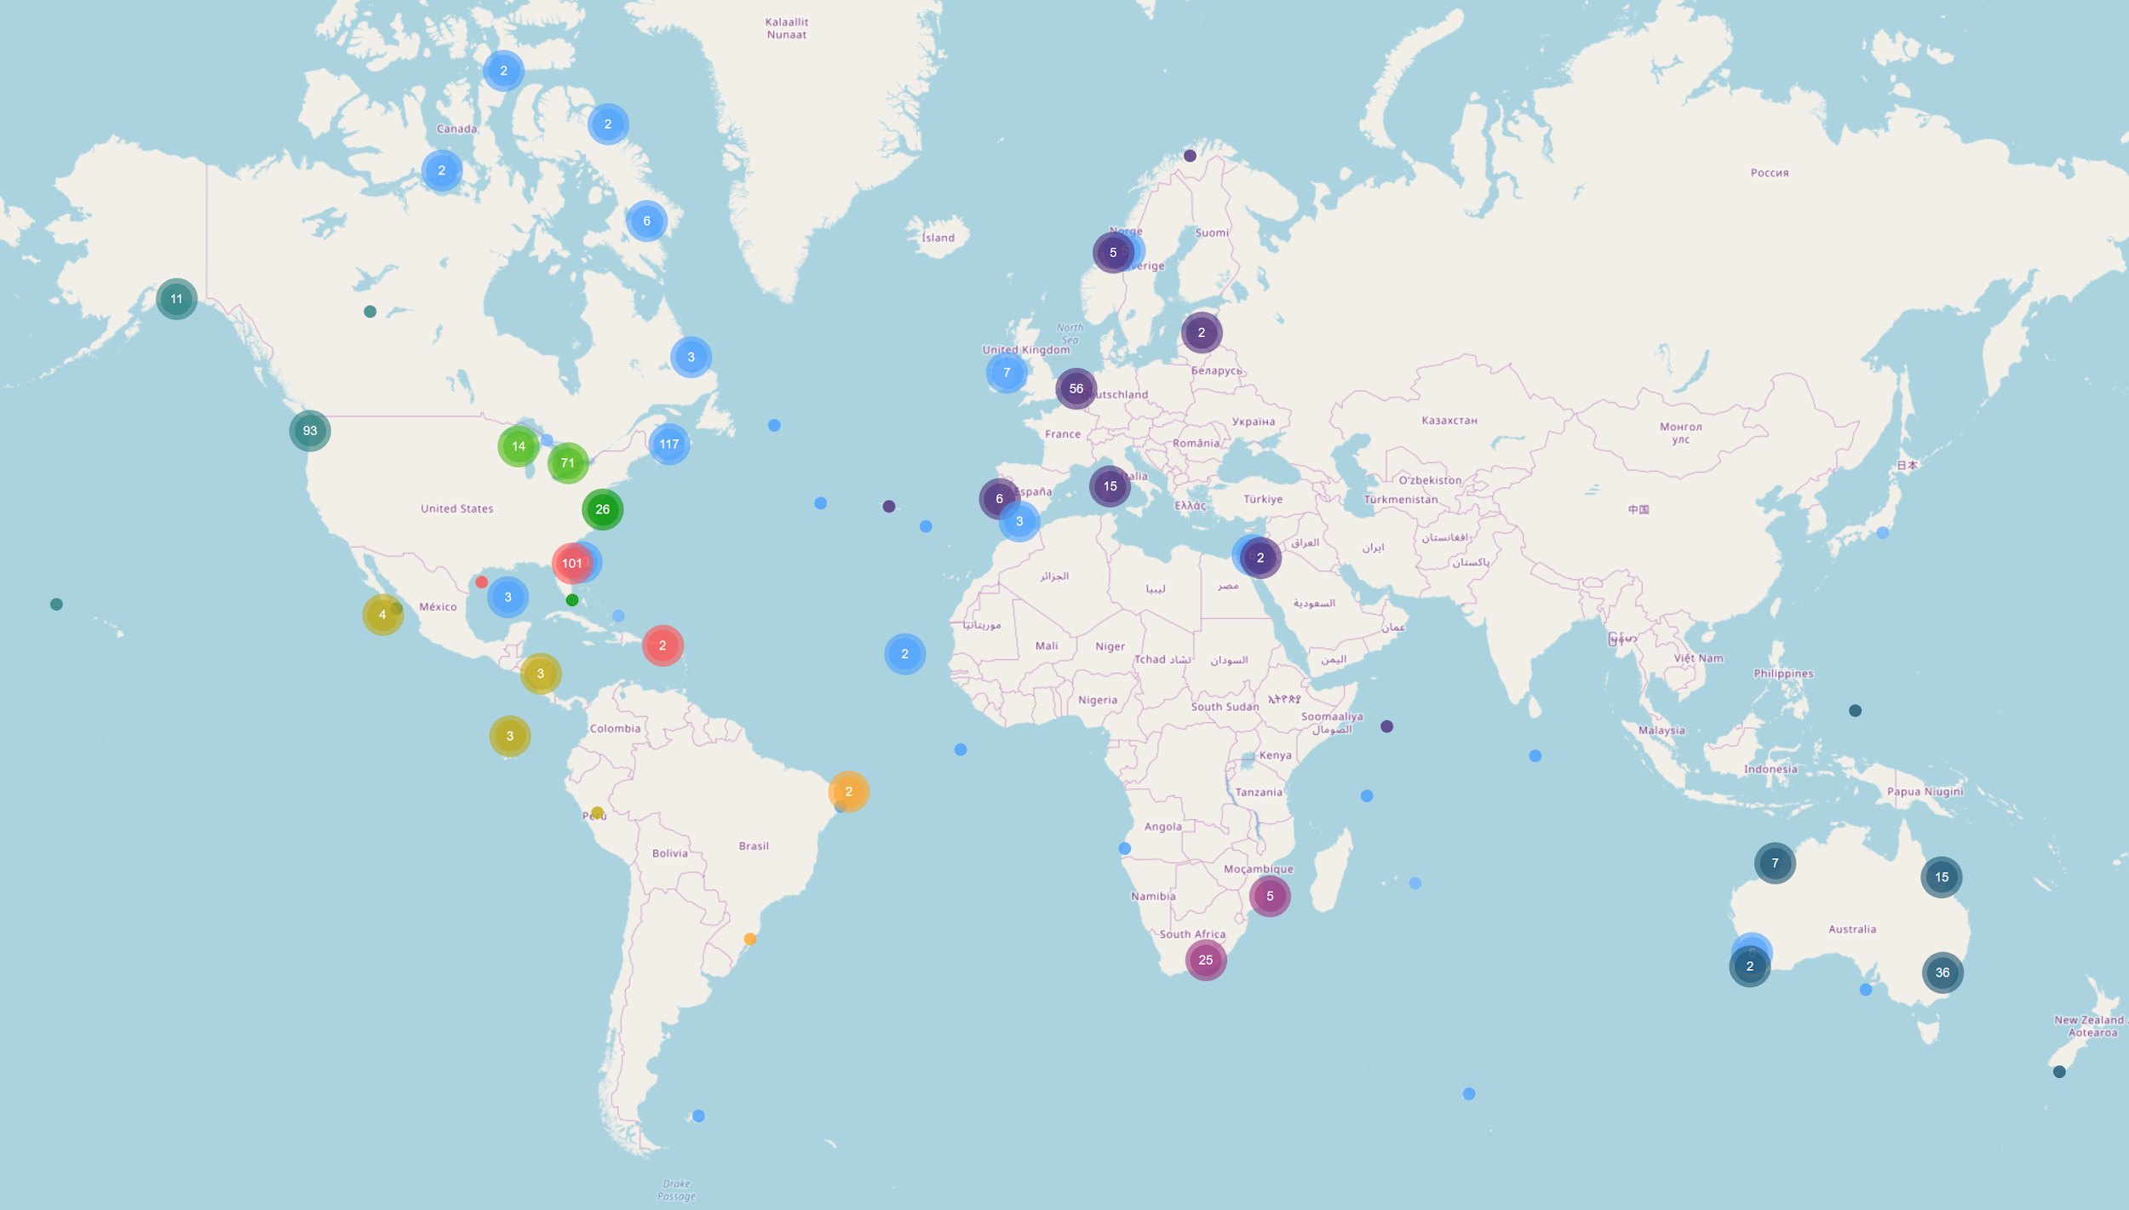
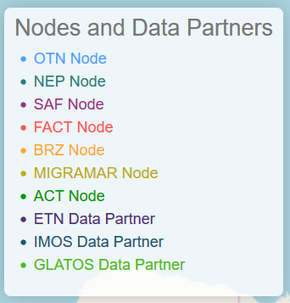
Partnerships and Collaborations
So many people in the neighbourhood
Partner Nodes can match tags to detections as part of conventional record processing
Data crosswalk work with GLATOS, ETN, IMOS ongoing and positive – GLATOS node online.
Allows for matching of tags and detections from disparate datasystems
OCEAN TRACKING NETWORK

Slide 12
Training
Fall 2019 OTN Node Manager Training
Ongoing Training for Students
Python and R (lunch and learn) extending beyond what is taught in the undergraduate biology curriculum.
analysis tools - glatos, v-track, bespoke tools - shared as often as possible
https://github.com/ocean-tracking-network/jb-acoustic-telemetry
OBIS training - biodiversity information system
OCEAN TRACKING NETWORK

Slide 13
OTN IN NUMBERS
47,500
614
239
67,000
TAGGED ANIMALS TRACKED
SENIOR SCIENTISTS
SPECIES TRACKED
GLOBALLY
KM COVERED BY GLIDERS
OCEAN TRACKING NETWORK

Slide 14
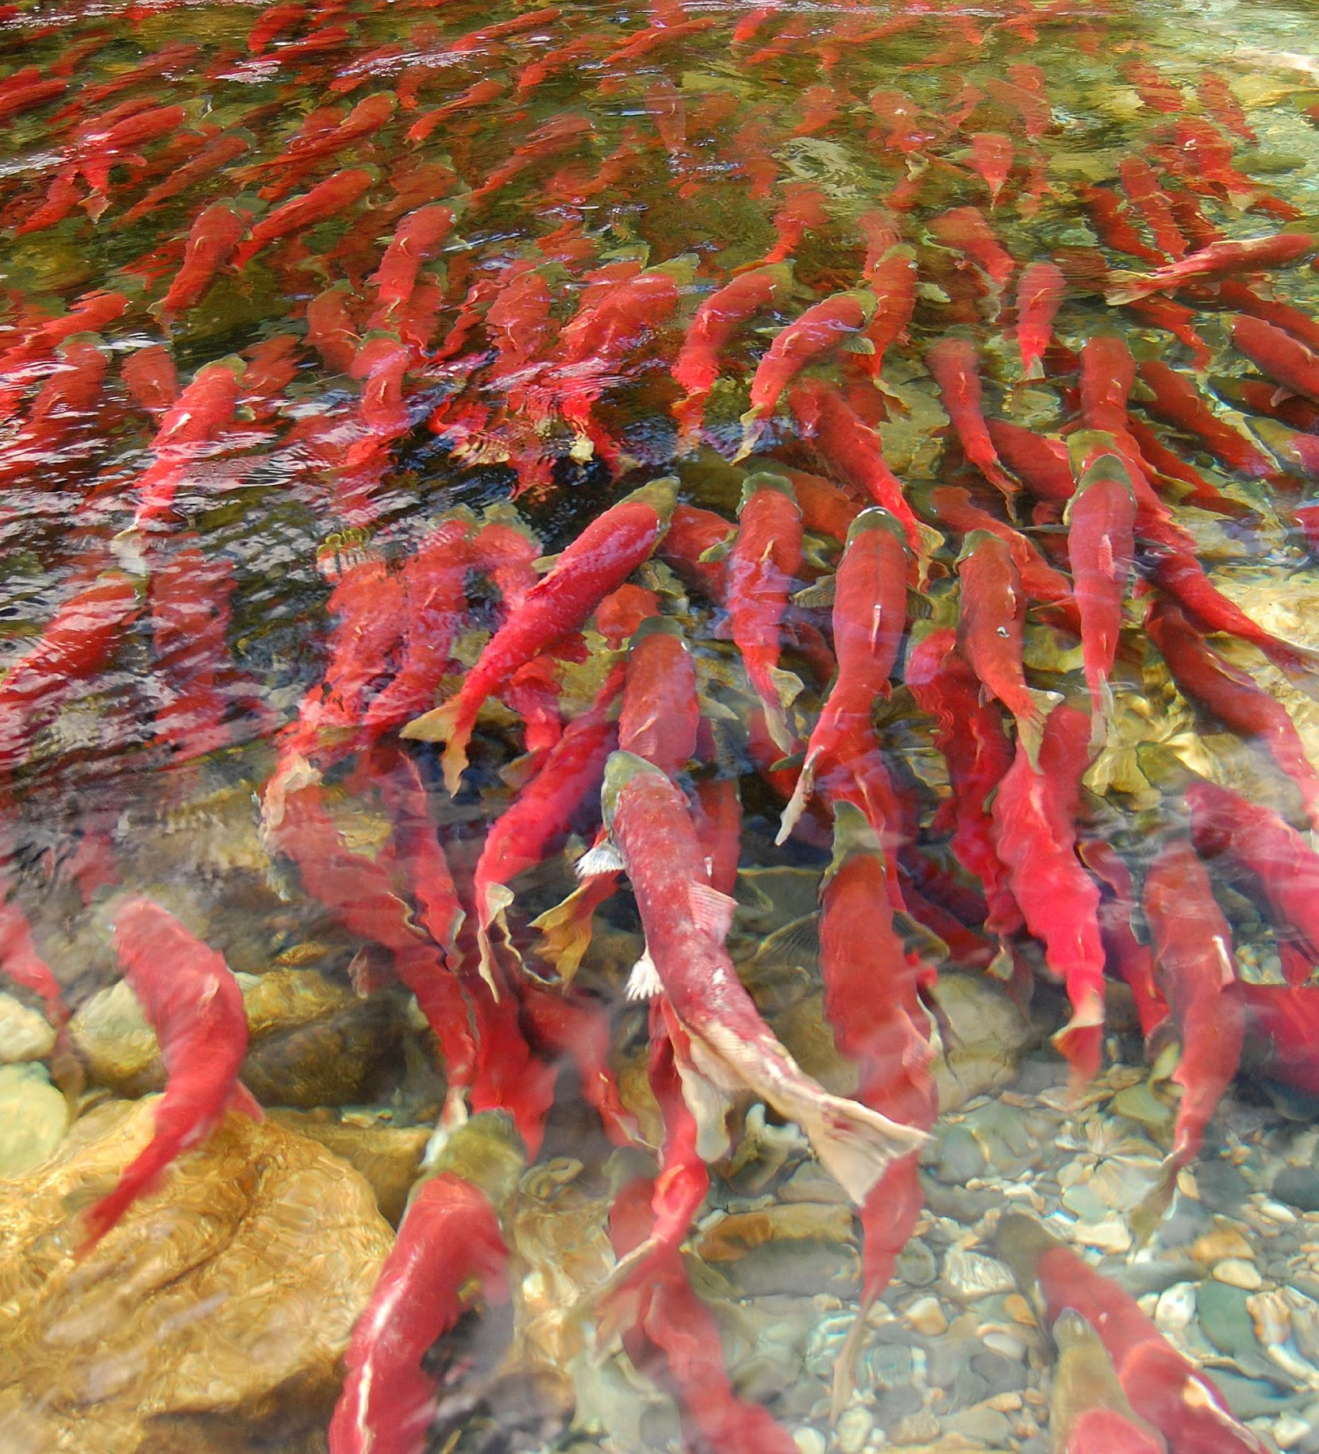
TYPES OF DATA
Detection Data
Detection Event
Tagging Activity
Receiver Deployment
OCEAN TRACKING NETWORK

Slide 15
TYPES OF DATA
Detection Data
Receiver metadata: Which receivers are where and when. Provides location context to detections.
Detection data: Tag IDs and times in .VRL format.
Tagging metadata: Which tags are in which animals including where and when. Provides biological context to detections.
Detection Event
Tagging Activity
Receiver Deployment
OCEAN TRACKING NETWORK

Slide 16
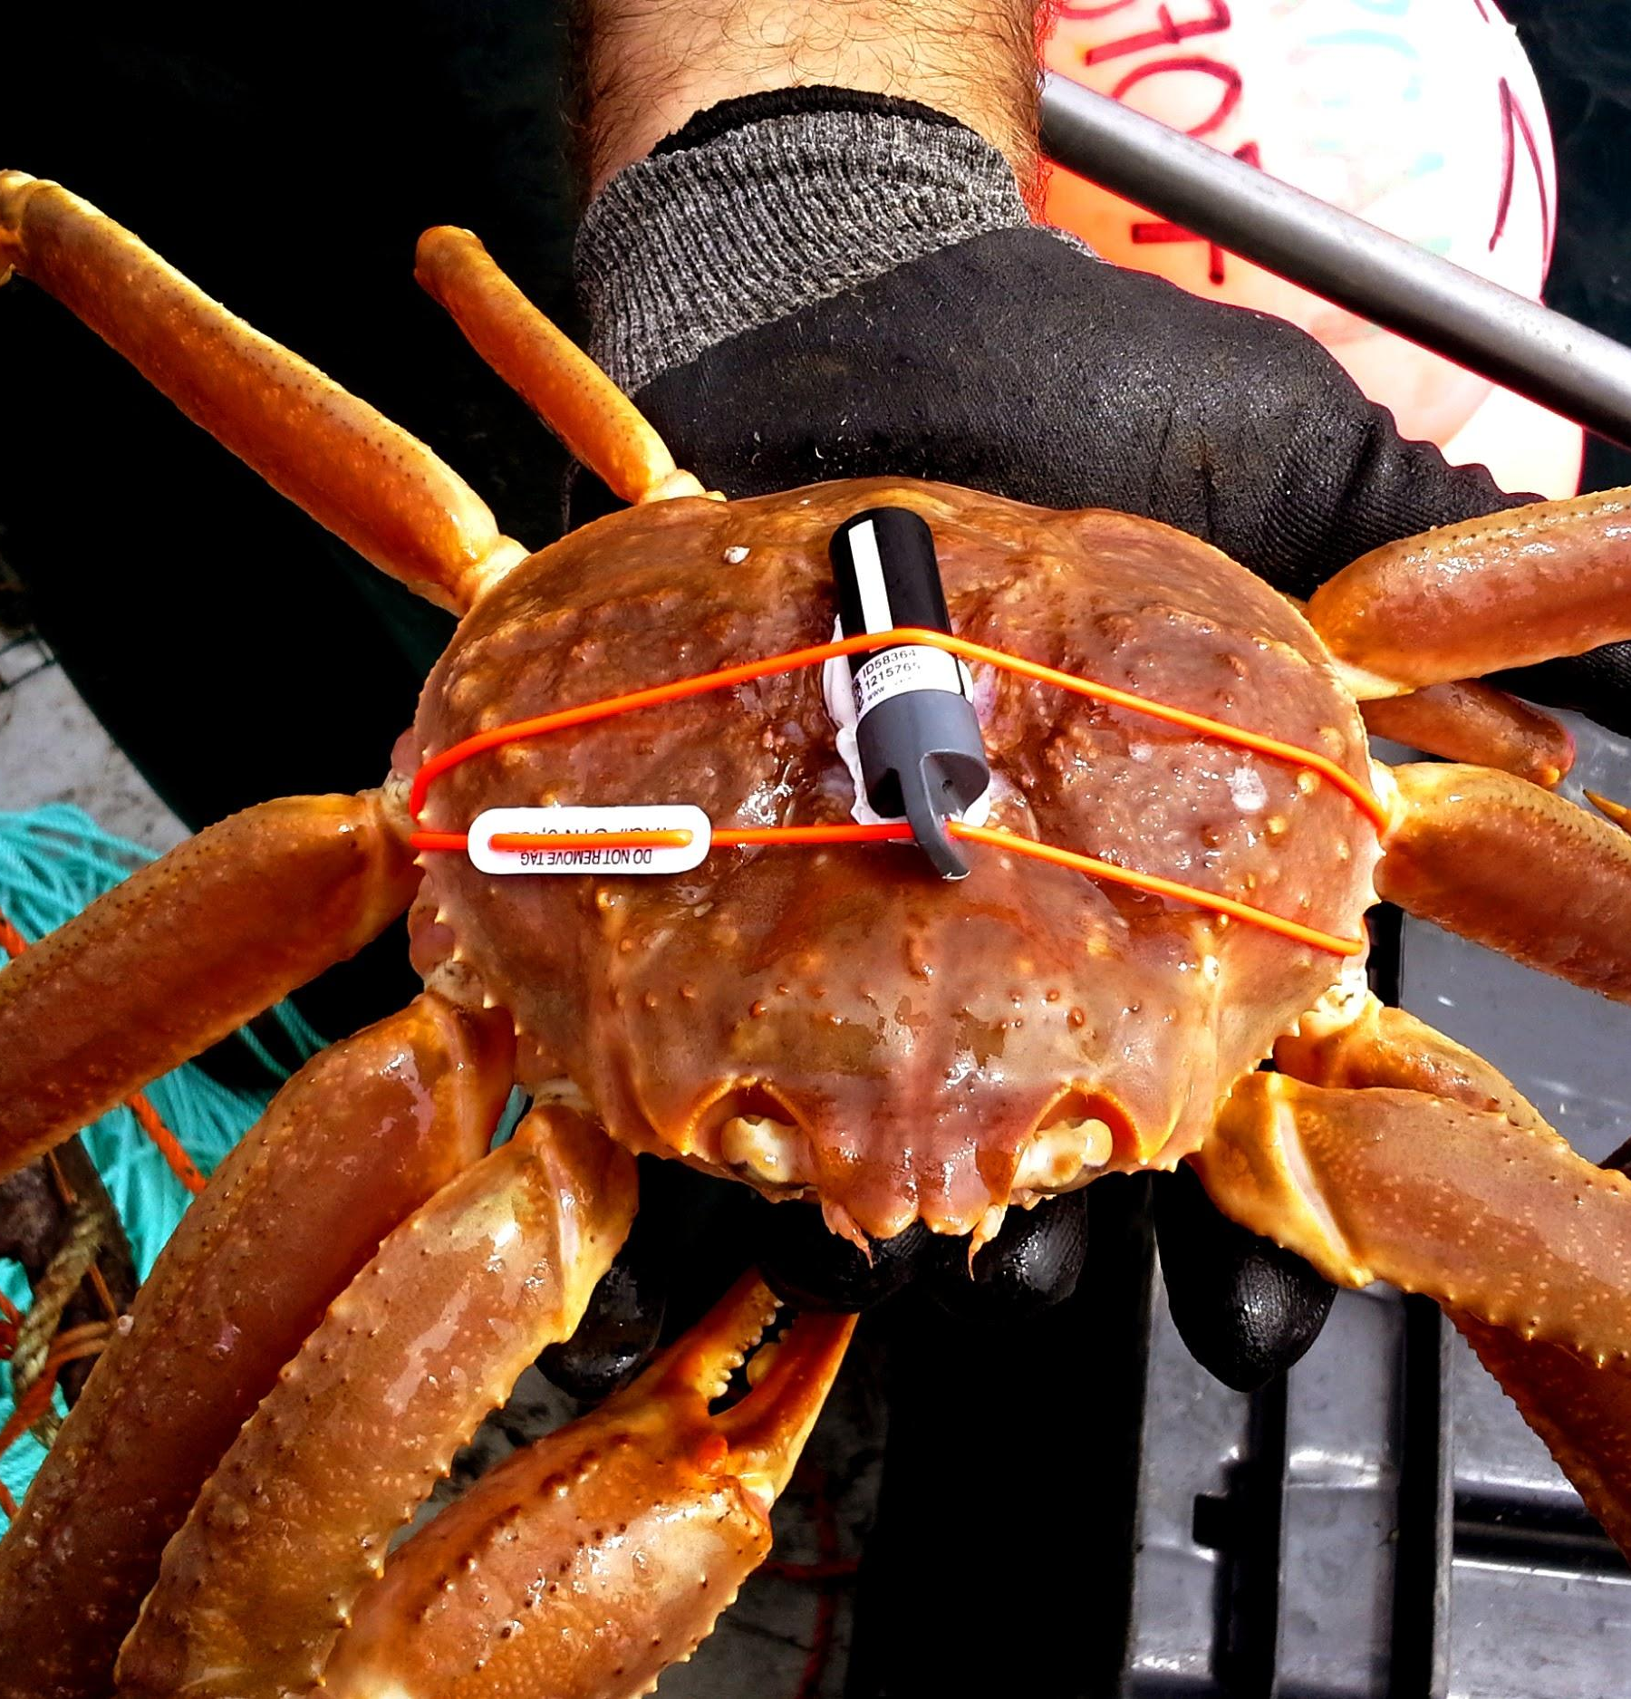
LIMITS OF DATA
Important pitfalls of acoustic telemetry
Only presence data – NOT absence
Tag collisions and false detections
Environmental impacts on detection range
Array design impacts what questions can be answered
Migrations
Spawning sites
Intra- or inter-specific interactions
OCEAN TRACKING NETWORK

Slide 17
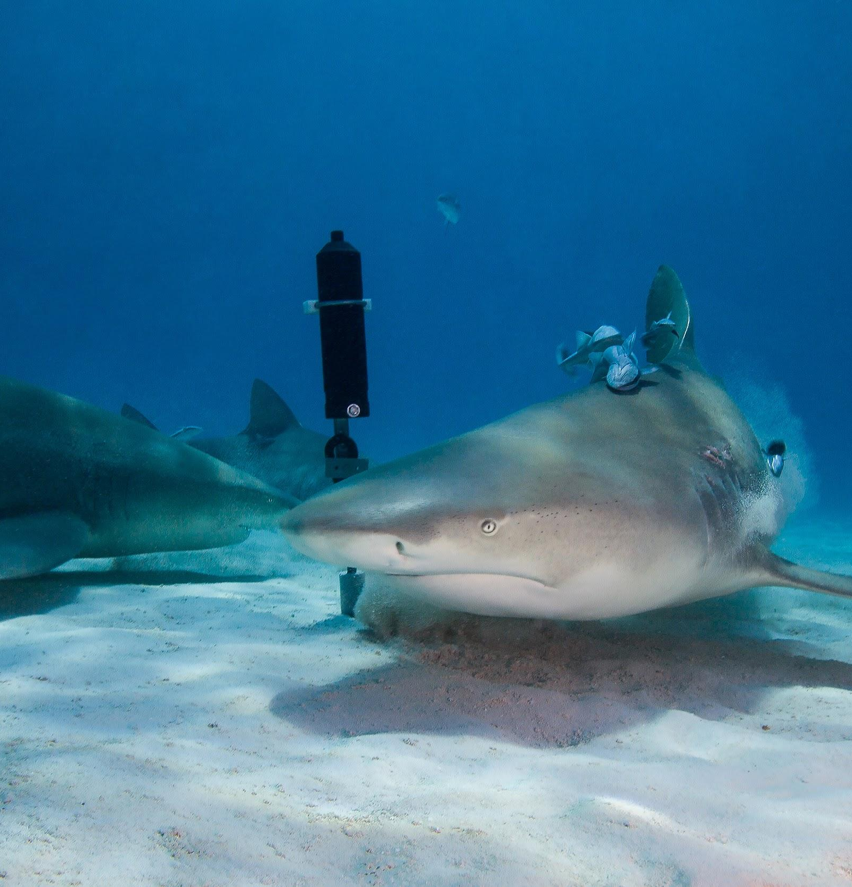
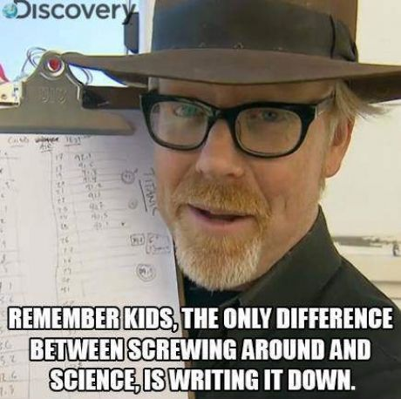
RECORD KEEPING
Metadata is really, really important!
As researchers you should follow some key guidelines to ensure useful records are kept.
FAIR Data Principles — making data findable, accessible, interoperable and reusable.
OCEAN TRACKING NETWORK

Slide 18
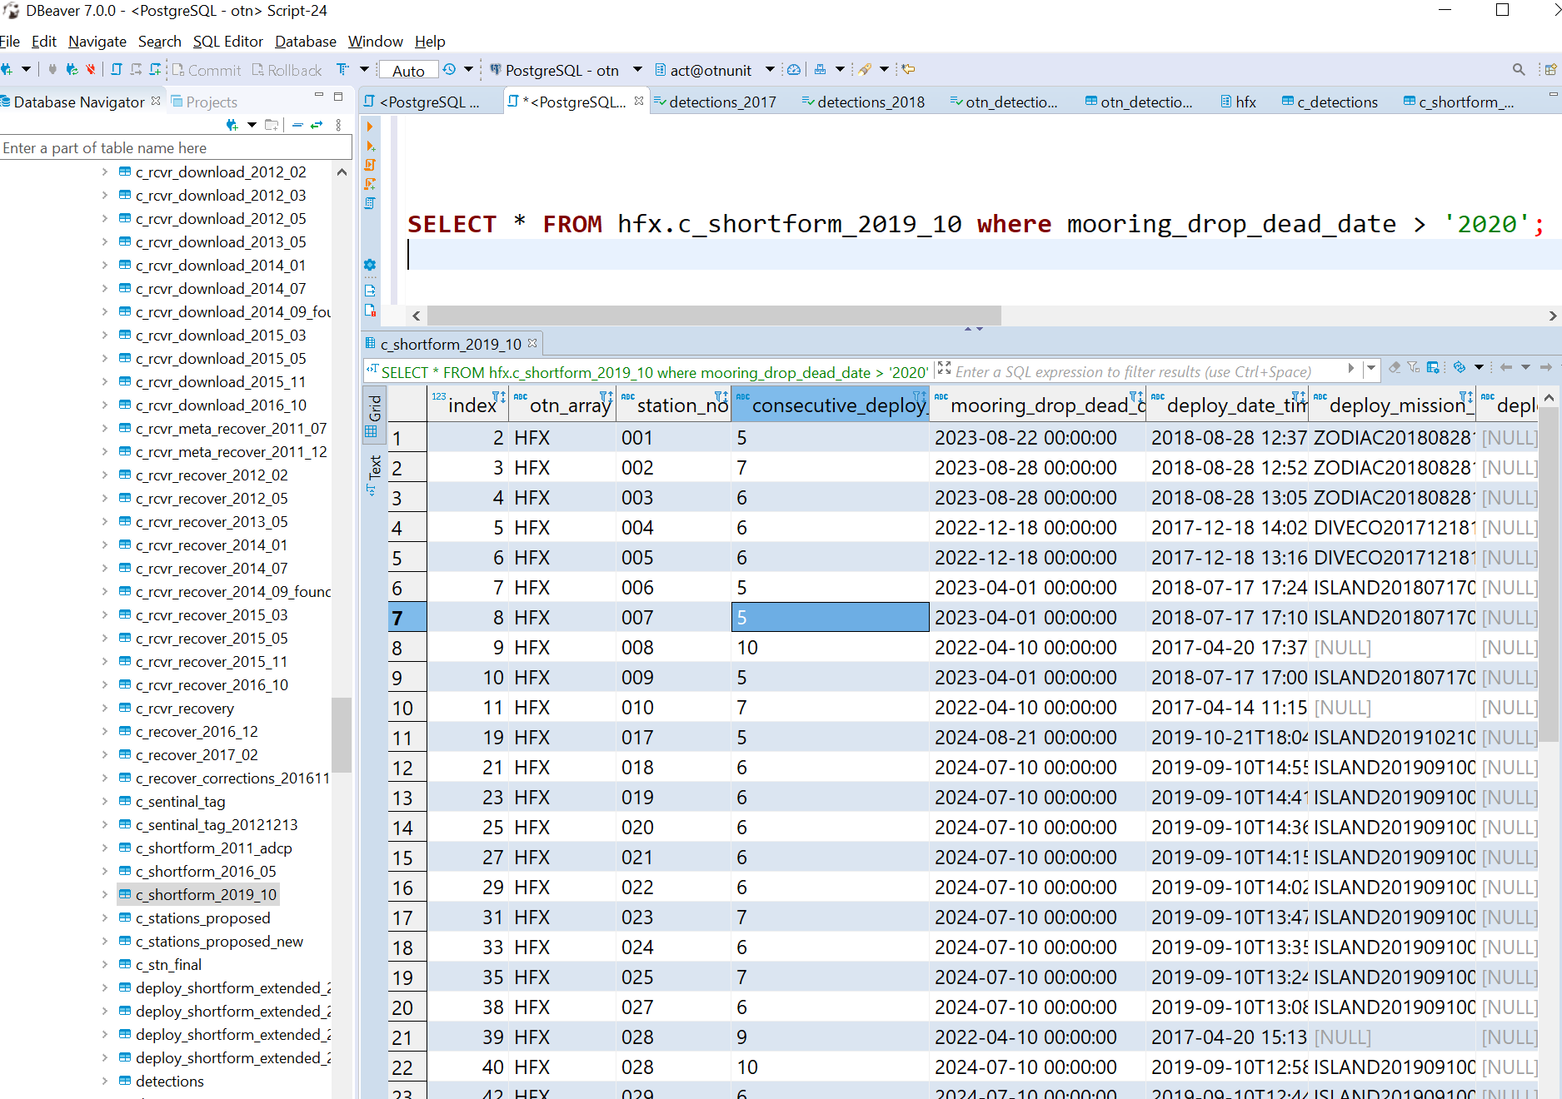
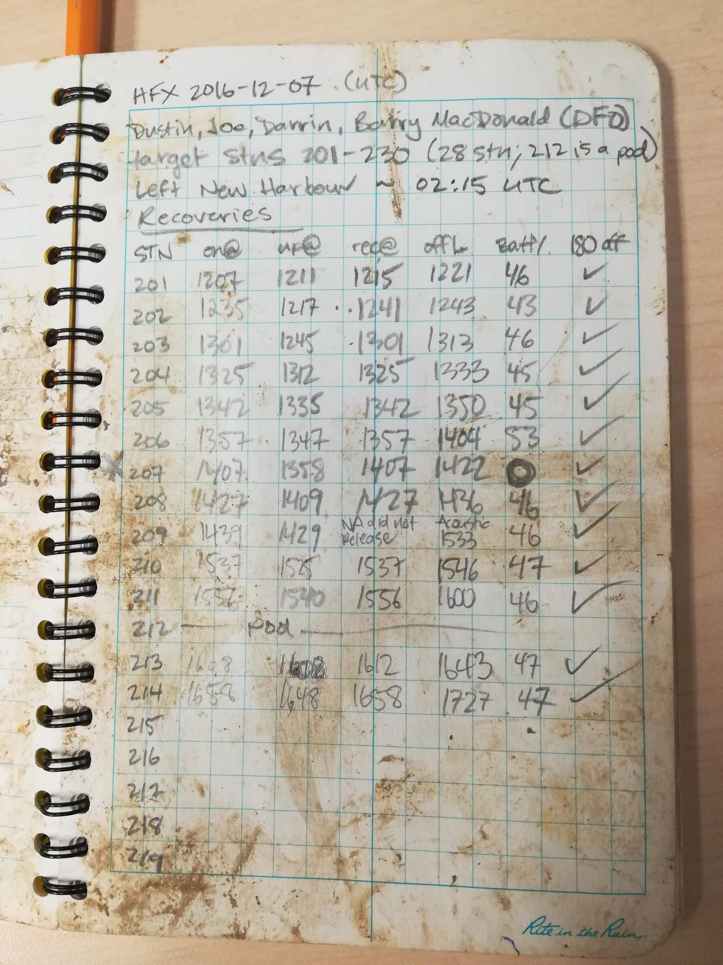
COMMON SPREADSHEET ERRORS
Computers are only so smart…seriously
Null values vs. zeros
Multiple data type per cell
Datetime formatting
Excel vs CSV editor
Time zones
“Pretty” formatting
Column naming
Transcription, autofill and other errors
https://datacarpentry.org/spreadsheet-ecology-lesson/
OCEAN TRACKING NETWORK

Slide 19
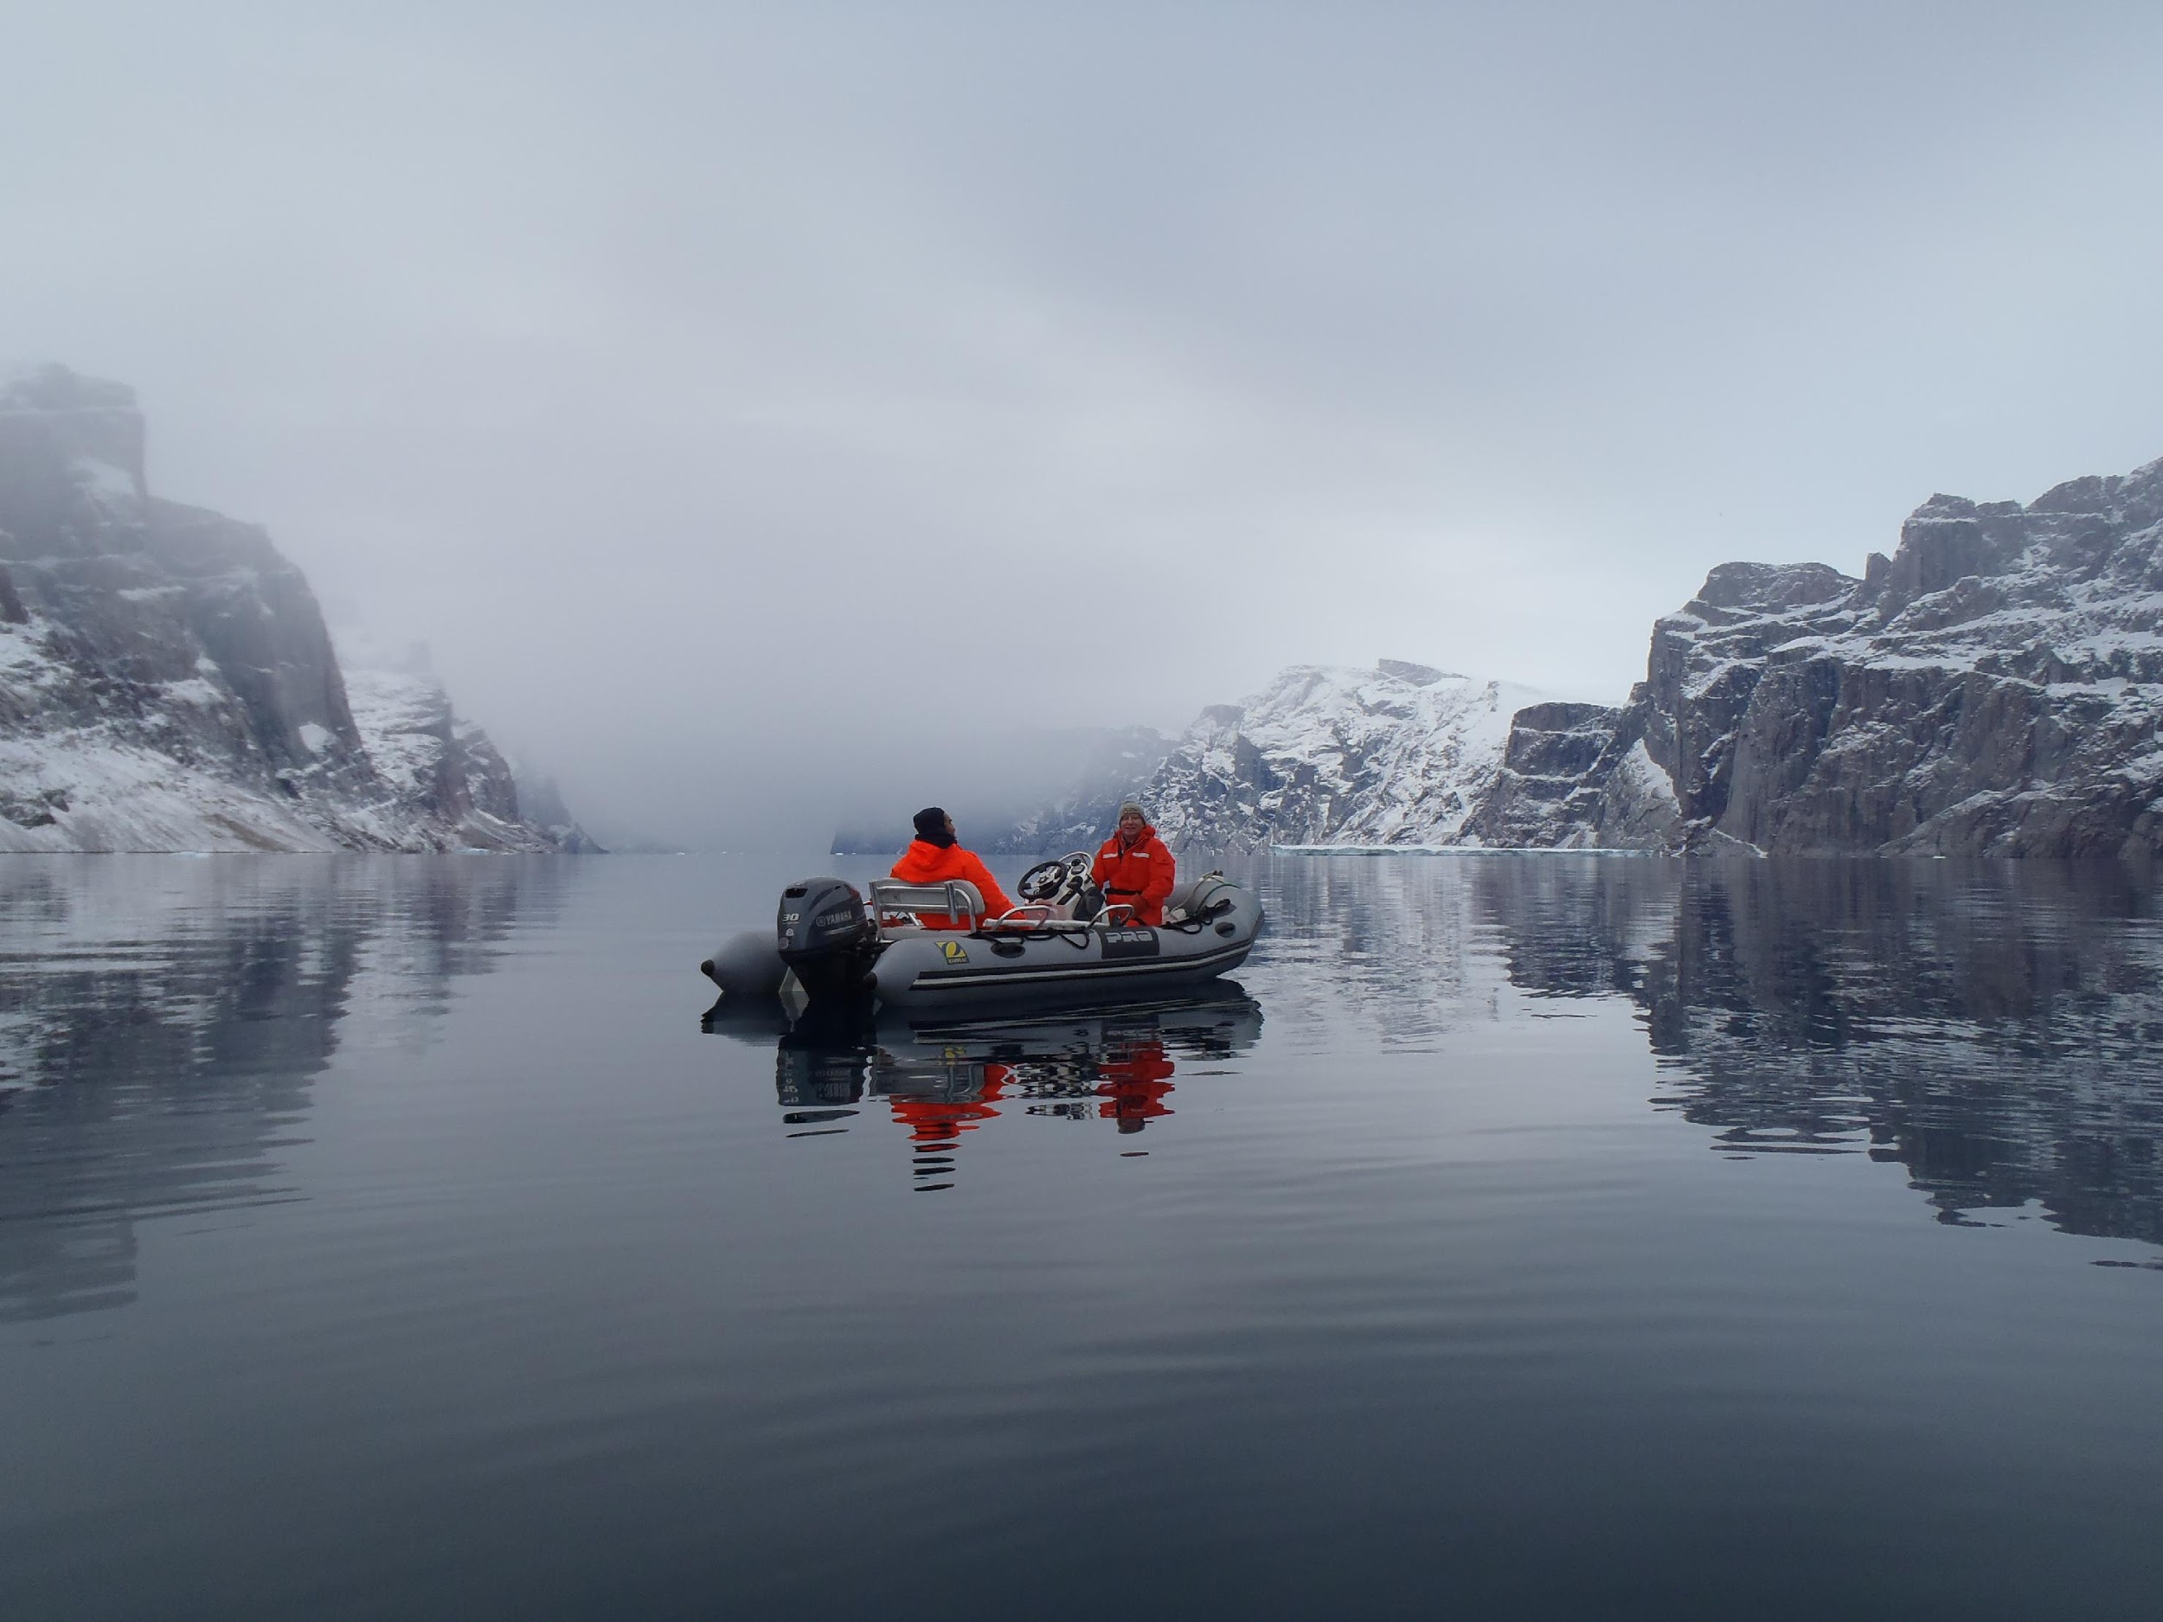
DEPLOYMENT METADATA
Excel spreadsheet with receiver deployment information, requires:
Your project code, and receiver serial number
Location and time of deployment of that receiver
Location and time of recovery of that receiver
Optionally:
When you downloaded the data, if it succeeded
Station ‘name’, bottom depth, technicians on the job, output VRL filenames, comments on the station deployment/recovery
XLS sheet available on OTN Data Portal
OCEAN TRACKING NETWORK

Slide 20
Always consult with the “Data Dictionary” tab to see the accepted format for each column!
We run coding scripts against this sheet to load into the database and the computer expects certain types of values
We have robust quality control tests to watch out for typos

Slide 21
TAG RELEASE METADATA
Tag release information, requires:
Vendor specifications
Location and time of tag release
Animal information (use animal id to join two tag records)
Optionally:
Harvest Date: day and time tag was recovered.
Capture and Surgery information
Able to add columns to include other relevant
information
OCEAN TRACKING NETWORK

Slide 22
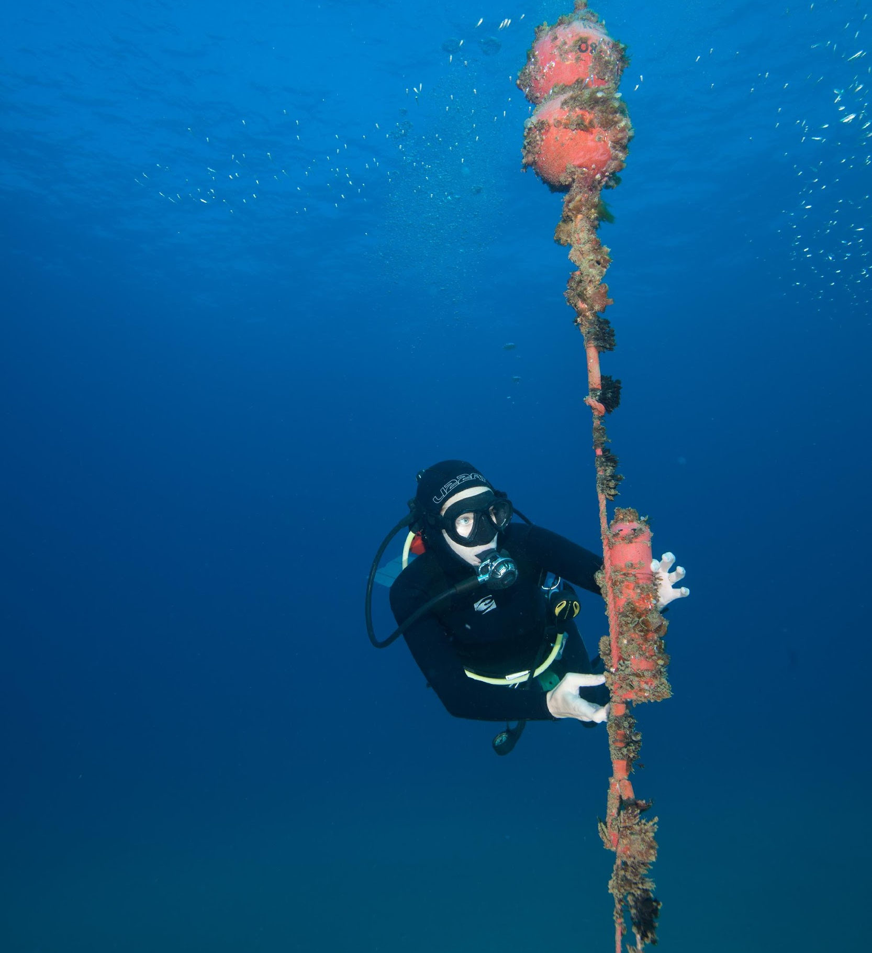
WHEN TO REPORT
Anytime the equipment is moved or downloaded
Important to know when it was out of the water
For “observation effort” statistics
To eliminate false/test detections while on land
OCEAN TRACKING NETWORK

Slide 23
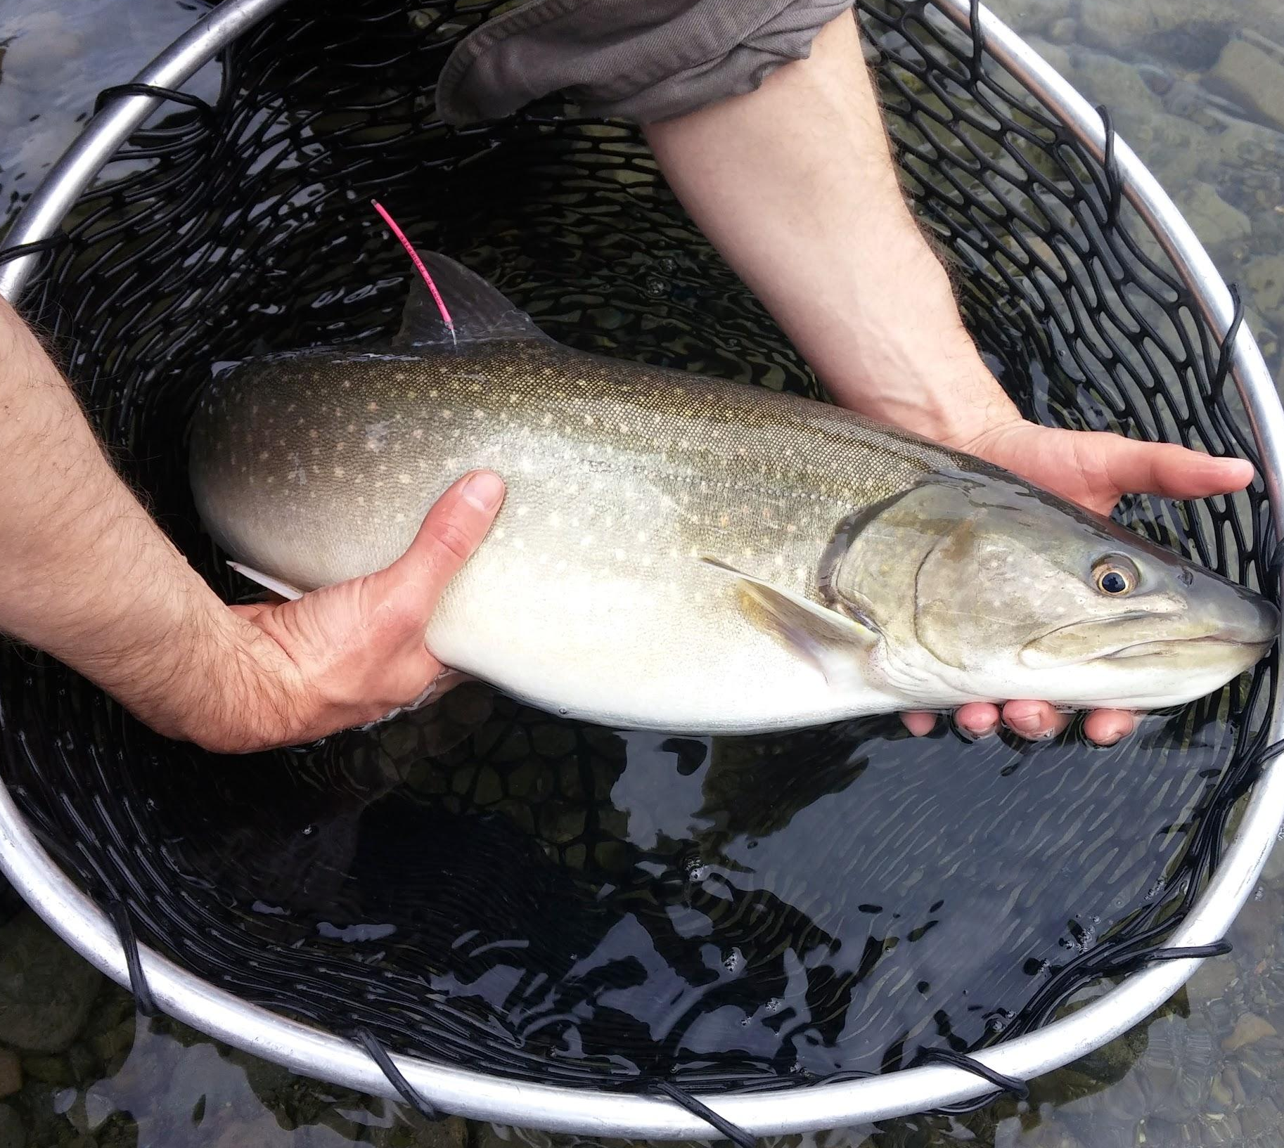
HOW TO REPORT
Contact OTNDC@DAL.CA for help
1. Upload to OTN’s Data Portal
You have a secure document repository folder
2. Email to OTNDC
Two things are needed:
Updated deployment metadata
ZIP folder with all VRLs
OCEAN TRACKING NETWORK

Slide 24
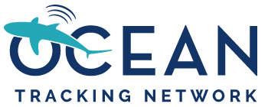
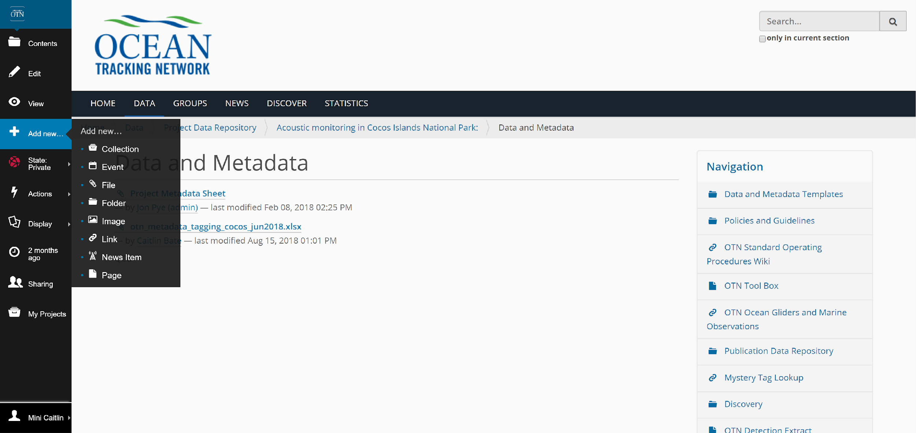
https://members.oceantrack.org/

Slide 25
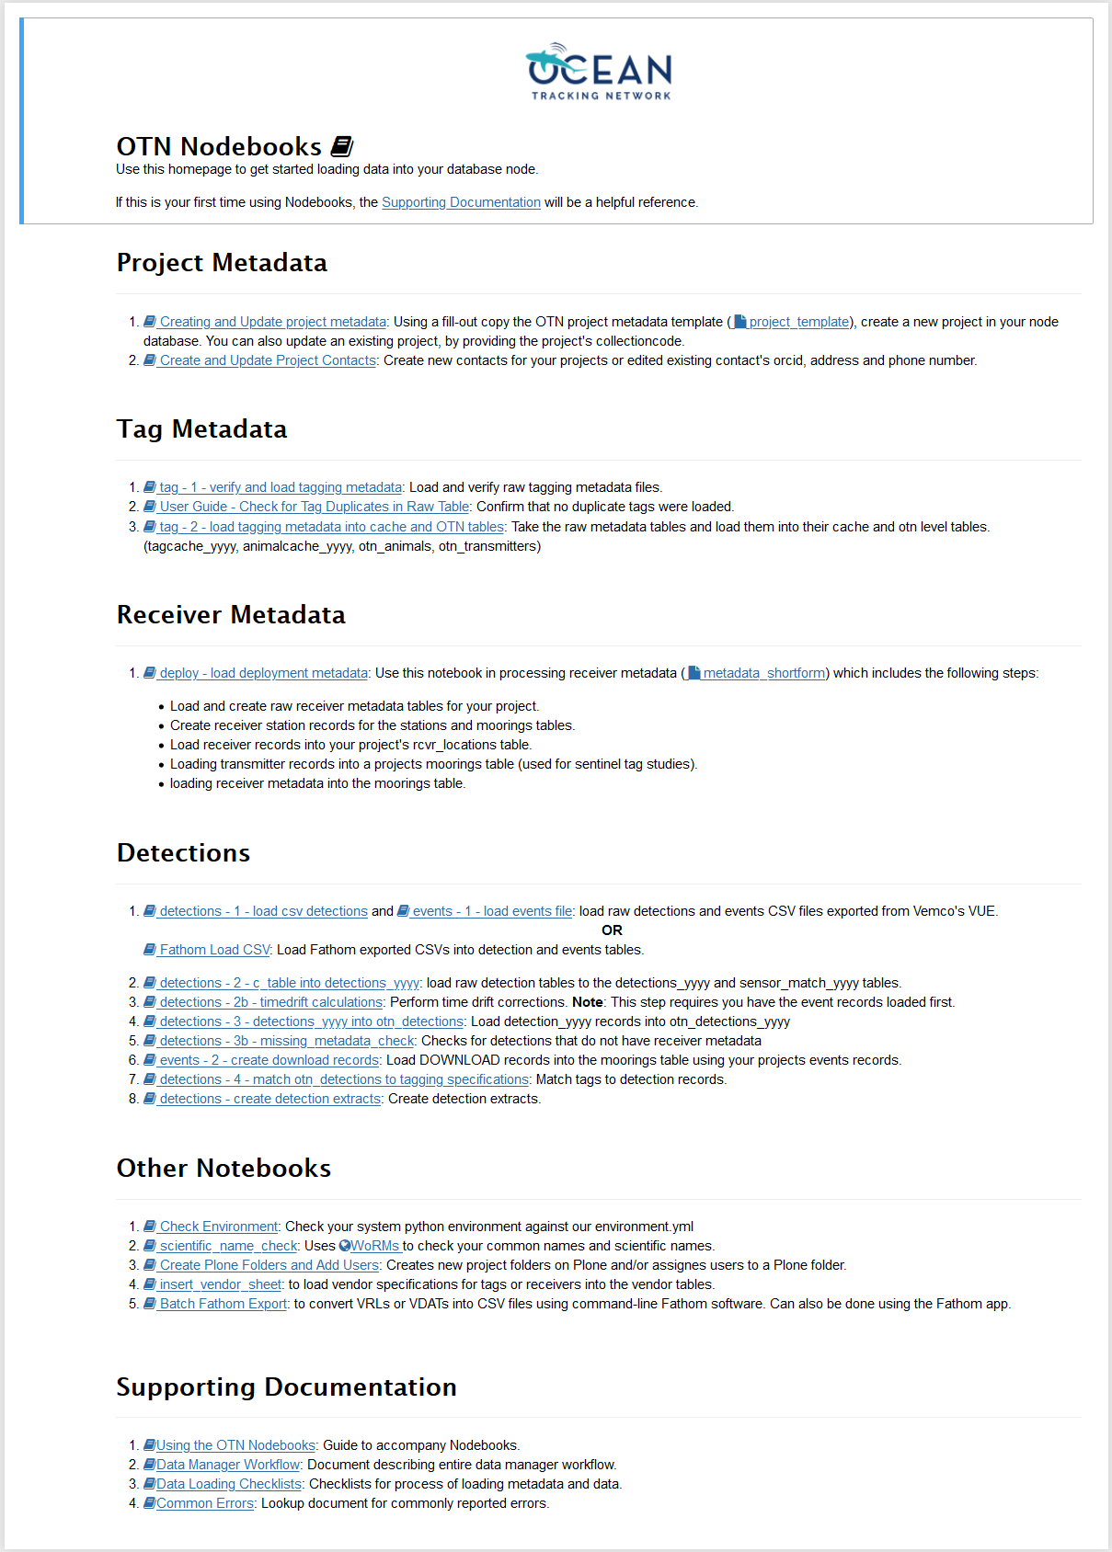
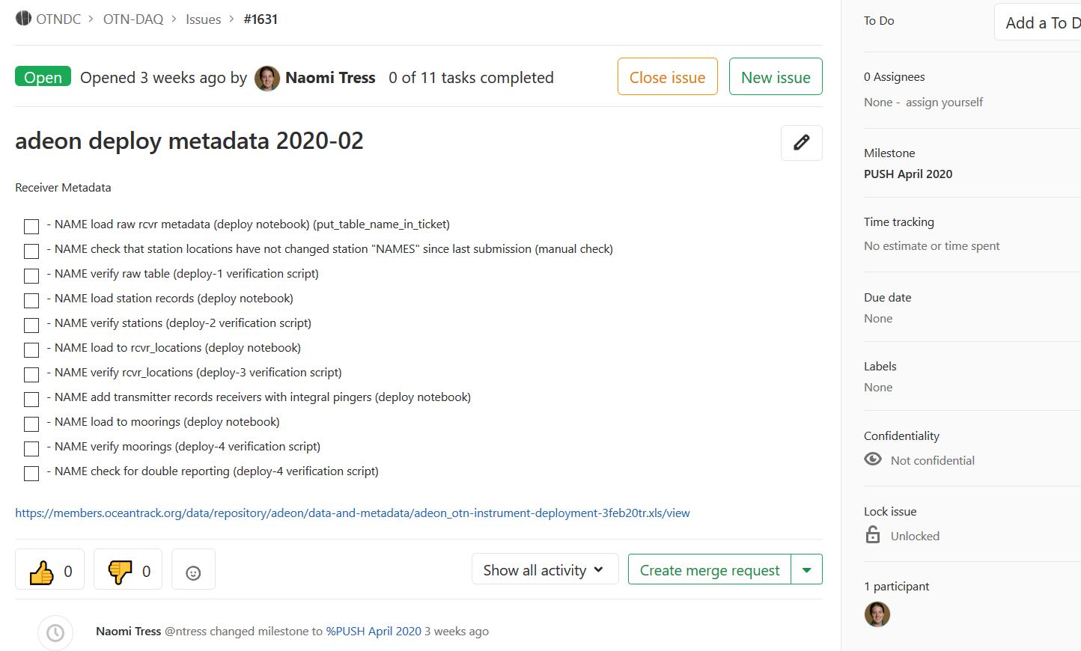
QUALITY CONTROL
Computers are only so smart
Is each receiver deployed in exactly one place at one time?
Are detections from when receiver was actually wet?
Are tags in no more than 1 animal at a time?
Is the detection from after a tag was released, and before the tag battery died; was the tag still in the fish?
OCEAN TRACKING NETWORK

Slide 26
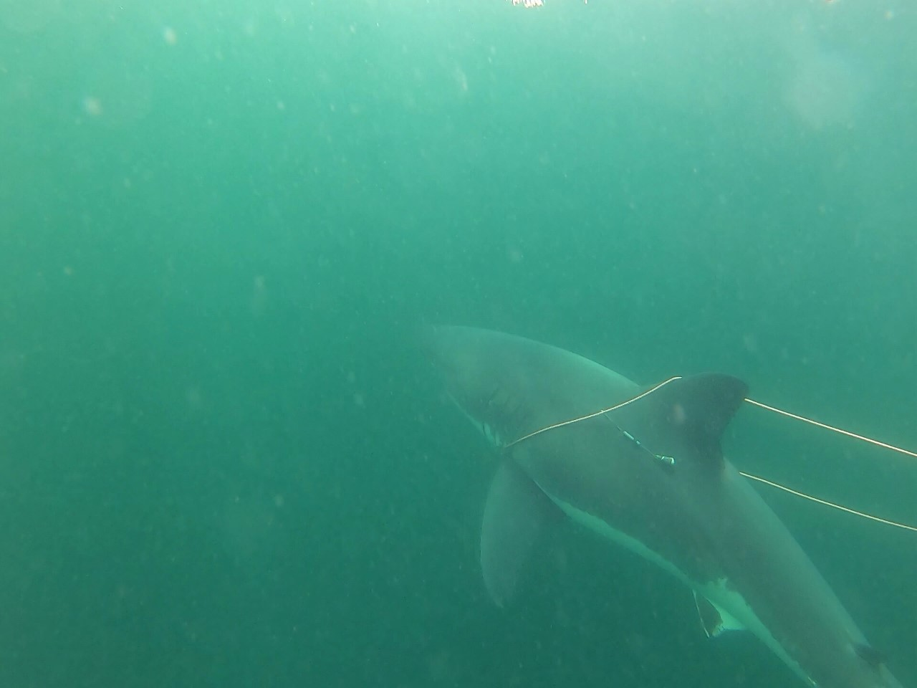
OUTPUT
OTN will match any tags detected to their “owners”
You get to know which project and researcher released the tag
You get “Detection Extracts” – .CSV files showing all matched (qualified) and mystery (unqualified) tags you’ve detected
These .CSVs can be huge – open directly in coding software - not in excel!
OTN supports R and Python packages which can directly intake these files for analysis!
OCEAN TRACKING NETWORK

Slide 27
@oceantrackingnetwork
@oceantracking
oceantrackingnetwork.org

