Slide 1
OTN and ONC: a Collaboration

Slide 2
Notes:
https://ceotr.ocean.dal.ca/gliders/

Slide 3
INTRODUCTION TO OTN
OCEAN TRACKING NETWORK
Notes:
OTN helps researchers around the world track animals in the number of ways​
​
1) we loan tracking equipment to researchers in order to support the costs of using this technology​
2) to connect researchers through our global database of acoustic animal detections. This is particularly important because it's impossible to cover the entire ocean with equipment all by yourself so researchers rely on neighbouring collaborators to let them know if their fish swims into their Neighbours study area! We facilitate this data sharing at a global scale so everyone can know where their fish go when they leave the area.​
3) we provide logistical and technical support for grant applications, field work and data analysis.

Slide 4
HOW OTN TRACKS
Acoustic tags, small transmitters that allow researchers to track aquatic animals underwater.
Larger animals can carry Vemco Mobile Transceivers (VMTs), which act as both transmitters and receivers.
Wave Gliders float on the ocean’s surface. They are emission free, propelled by wave energy and solar powered.
Slocum Gliders dive up and down collecting information underneath the waves.
Acoustic receivers capture animal movement data.
OCEAN TRACKING NETWORK

Slide 5
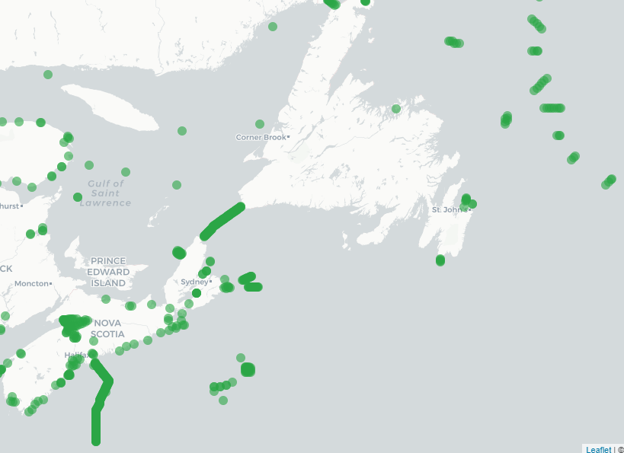
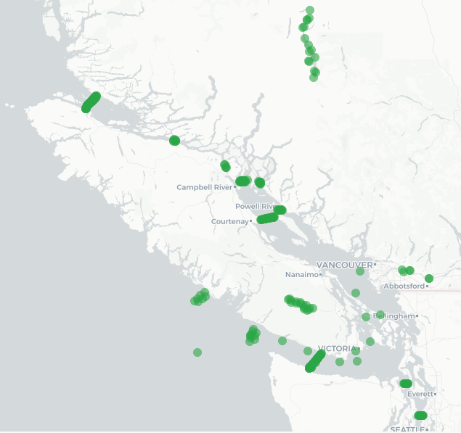
ACOUSTIC RECEIVER LINES
OCEAN TRACKING NETWORK

Slide 6
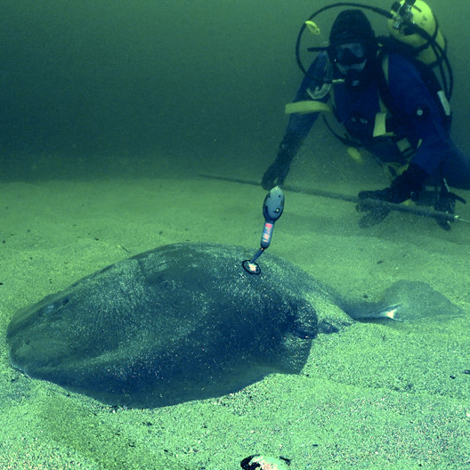
OTN’s DATABASE
OTN's relational database is built on PostgreSQL/PostGIS
Hosted on OTN hardware at Dalhousie University
All tags get matched to all detections across in the database
When your fish swim outside of your study area you can find out automatically, as long as everyone has registered
The reason we exist! To connect researchers and support research goals
OCEAN TRACKING NETWORK

Slide 7
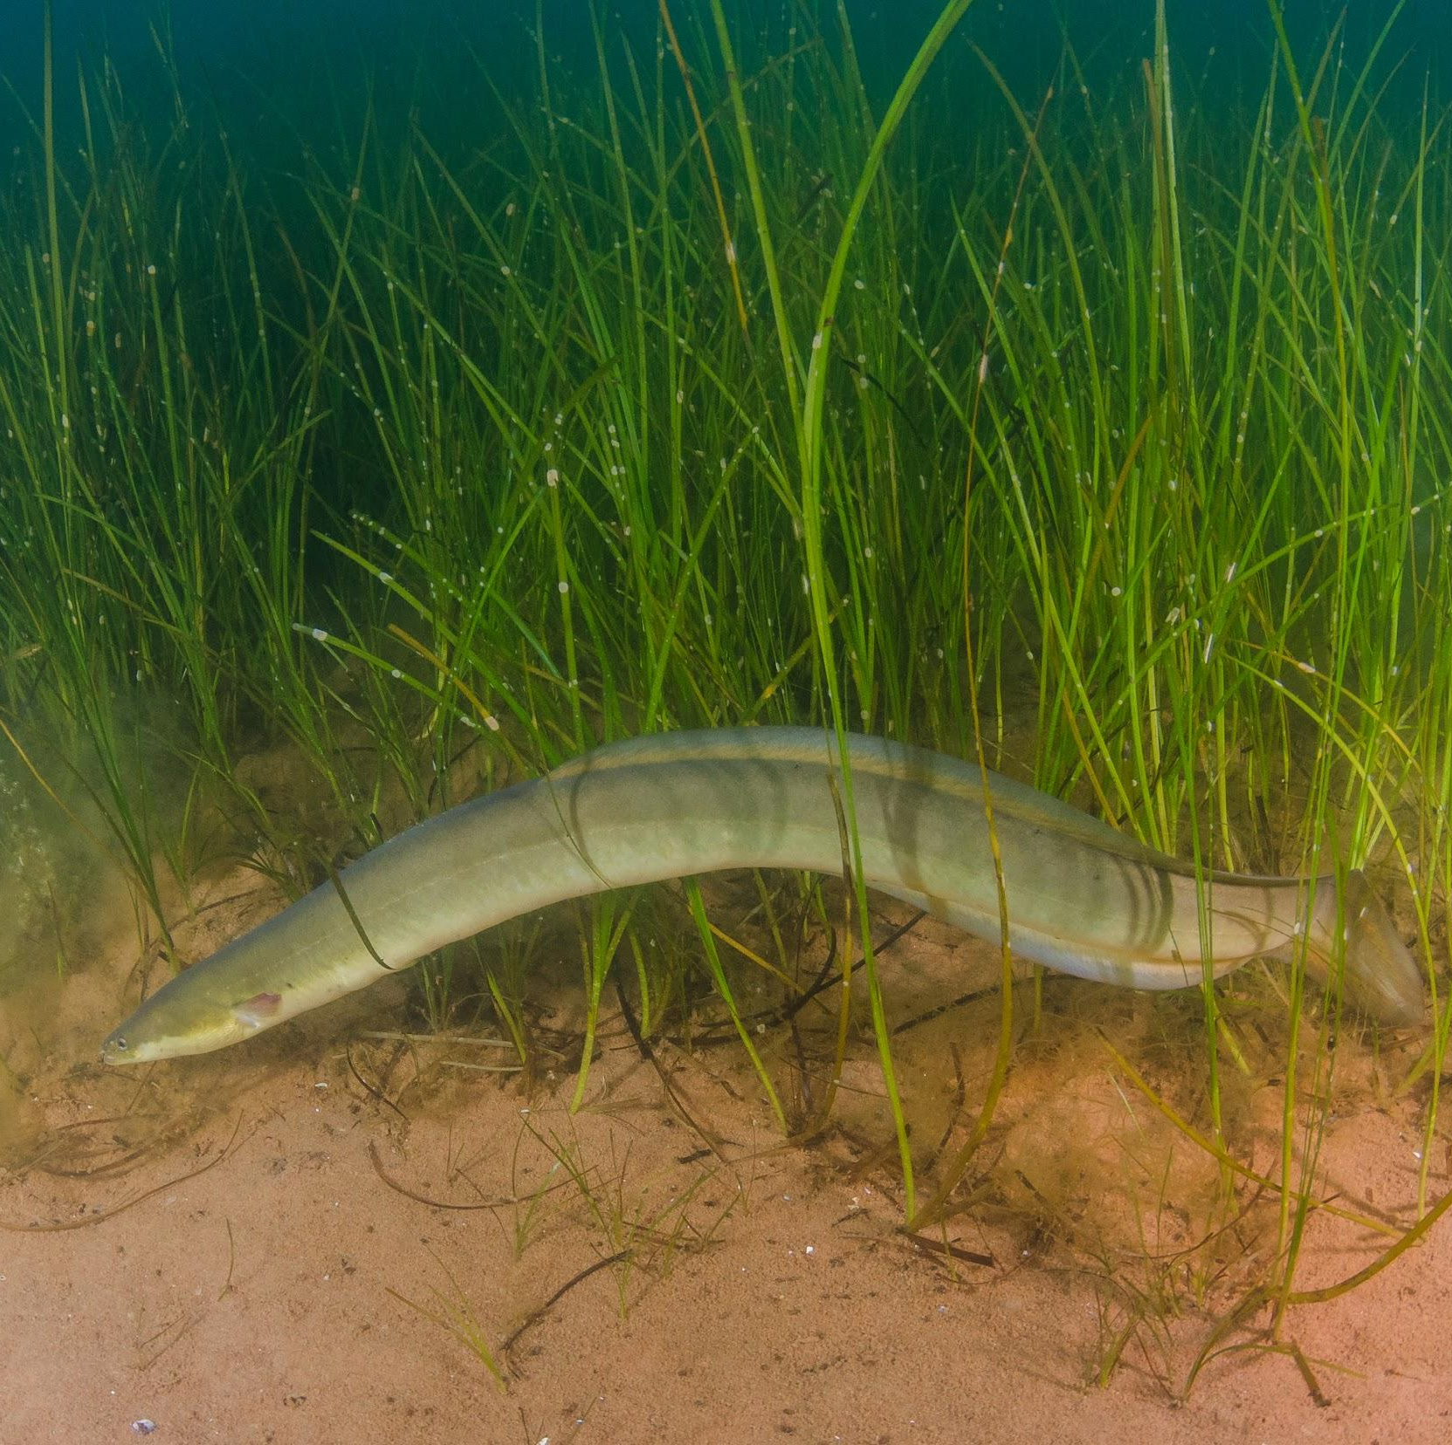
OTN NODES
Copy of the OTN database structure and front-end software
Allows cross-referencing of data w/ OTN & other nodes easily
Automatic cross-node detection matching!
Our way to join the global network of telemetry communities and support groups who do not have the tech support
OCEAN TRACKING NETWORK

Slide 8
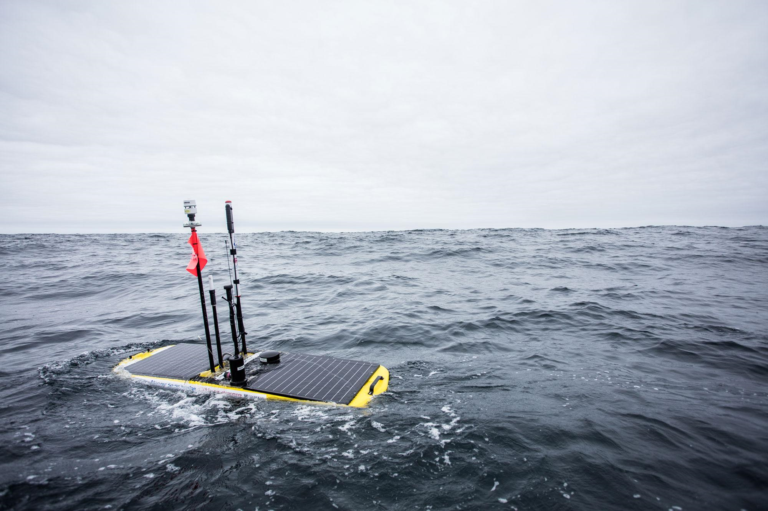
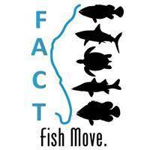
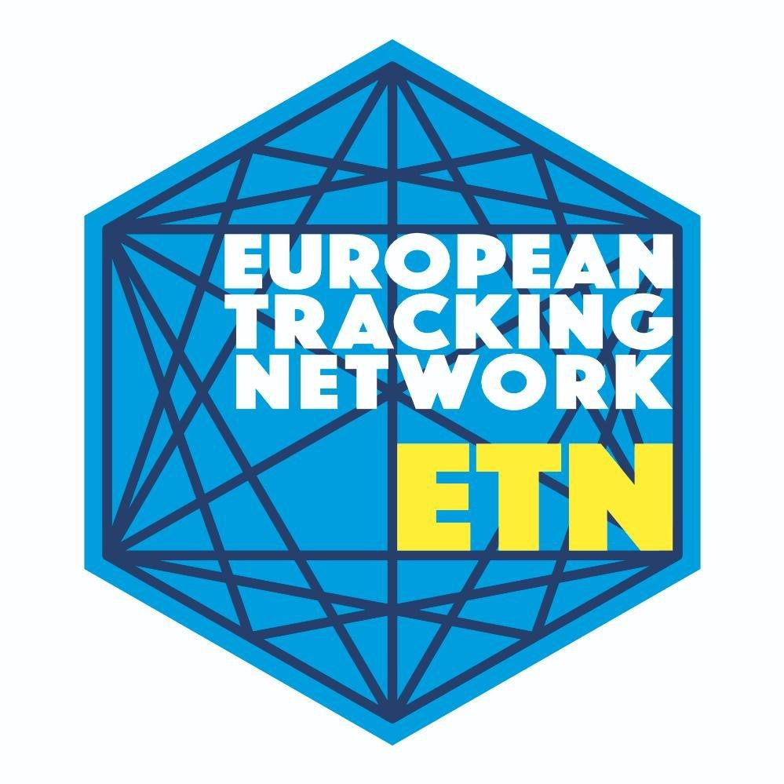
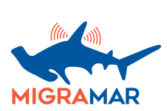
FULLY COMPATIBLE NODES
OTN-GLOBAL
Catch-all for global partners and equipment loans
OTN-NORTHEAST PACIFIC
Historically the POST array, hosted at OTN
MIGRAMAR
Eastern Tropical Pacific research - http://migramar.org/hi/en/
Hosted at OTN, in process of training a data manager
ATAP (Acoustic Tracking Array Platform)
Managed by SAIAB (South African Institute for Aquatic Biodiversity), hosted at OTN https://www.saiab.ac.za/atap.htm
Other partners
FACT
Hosted at SECOORA, managed by FACT data manager
https://secoora.org/fact/
ACT/MATOS
Newest OTN node! Hosted by RPS, managed by ACT manager
https://matos.asascience.com/
OTN-BRAZIL
Managed and hosted at FURG - http://otn.furg.br/
GLATOS
IMOS-ATF
ETN
iTag
Proposed Bahamas node
Pacific Islands node (PIRAT)
UC Davis node (PATH)
More west coast Nodes?
OCEAN TRACKING NETWORK
Notes:
You will be interested in our newest nodes on the pacific coast of the US - coming online later this year. One is the Pacfic Islands Region Acoustic Telemetry group, based in hawaii. The other is the Pacific Acoustic Telemetry Hub based out of uCDavis. Soon all these datasets will be available for matching in the OTN system.

Slide 9
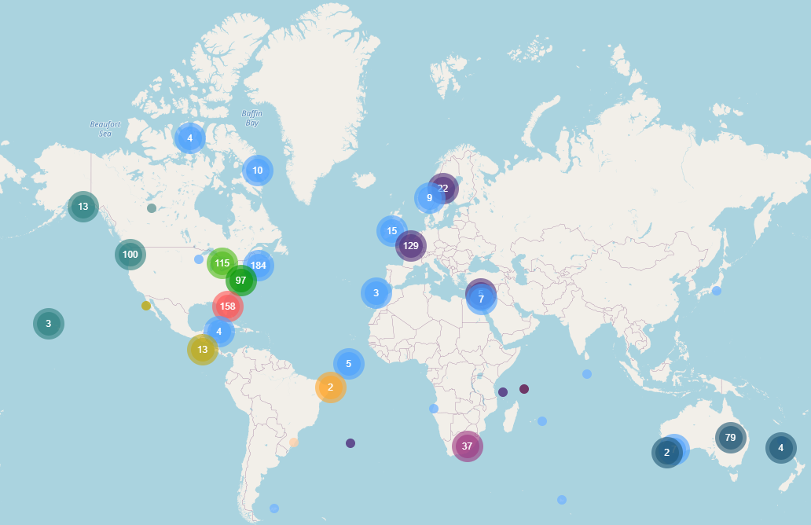
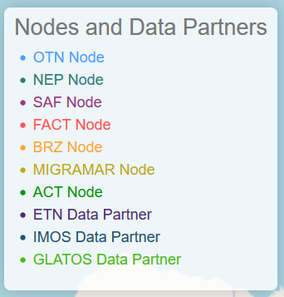
OCEAN TRACKING NETWORK
Notes:
Our map at https://members.oceantrack.org/ is frequently updated, but here you can see all the partner networks and nodes across the globe for which we have some level of connectivity. Each dot is a project and the map is interactive. Notice the gap through Asia? We’re always looking to expand and connect new partners

Slide 10
LESSONS LEARNED
Regional vs. Global-scale data systems
Every region has a unique data-sharing “culture”
Regional data management allows for better trust and communication
Hard to infiltrate collaborations as an outsider
Better to support groups as they exist naturally
Take the current data-collaborations that exist and formalize them into Data Policies and partnership agreements
Local “representatives” to your global network are essential!
OCEAN TRACKING NETWORK

Slide 11
REPORTING TO THE NODE
OCEAN TRACKING NETWORK

Slide 12
REGISTERING WITH THE NODE
STEP 1 - tell us about your project
Project metadata is required to set up your project
Contact info, title, abstract, etc
Used to create a private folder on our Data Portal website for you
Used to set the permissions for who can view the dataset
Will be used to create your Public Summary Page
Can be edited at any time!
OCEAN TRACKING NETWORK
Notes:
Available here https://members.oceantrack.org/data/data-collection

Slide 13
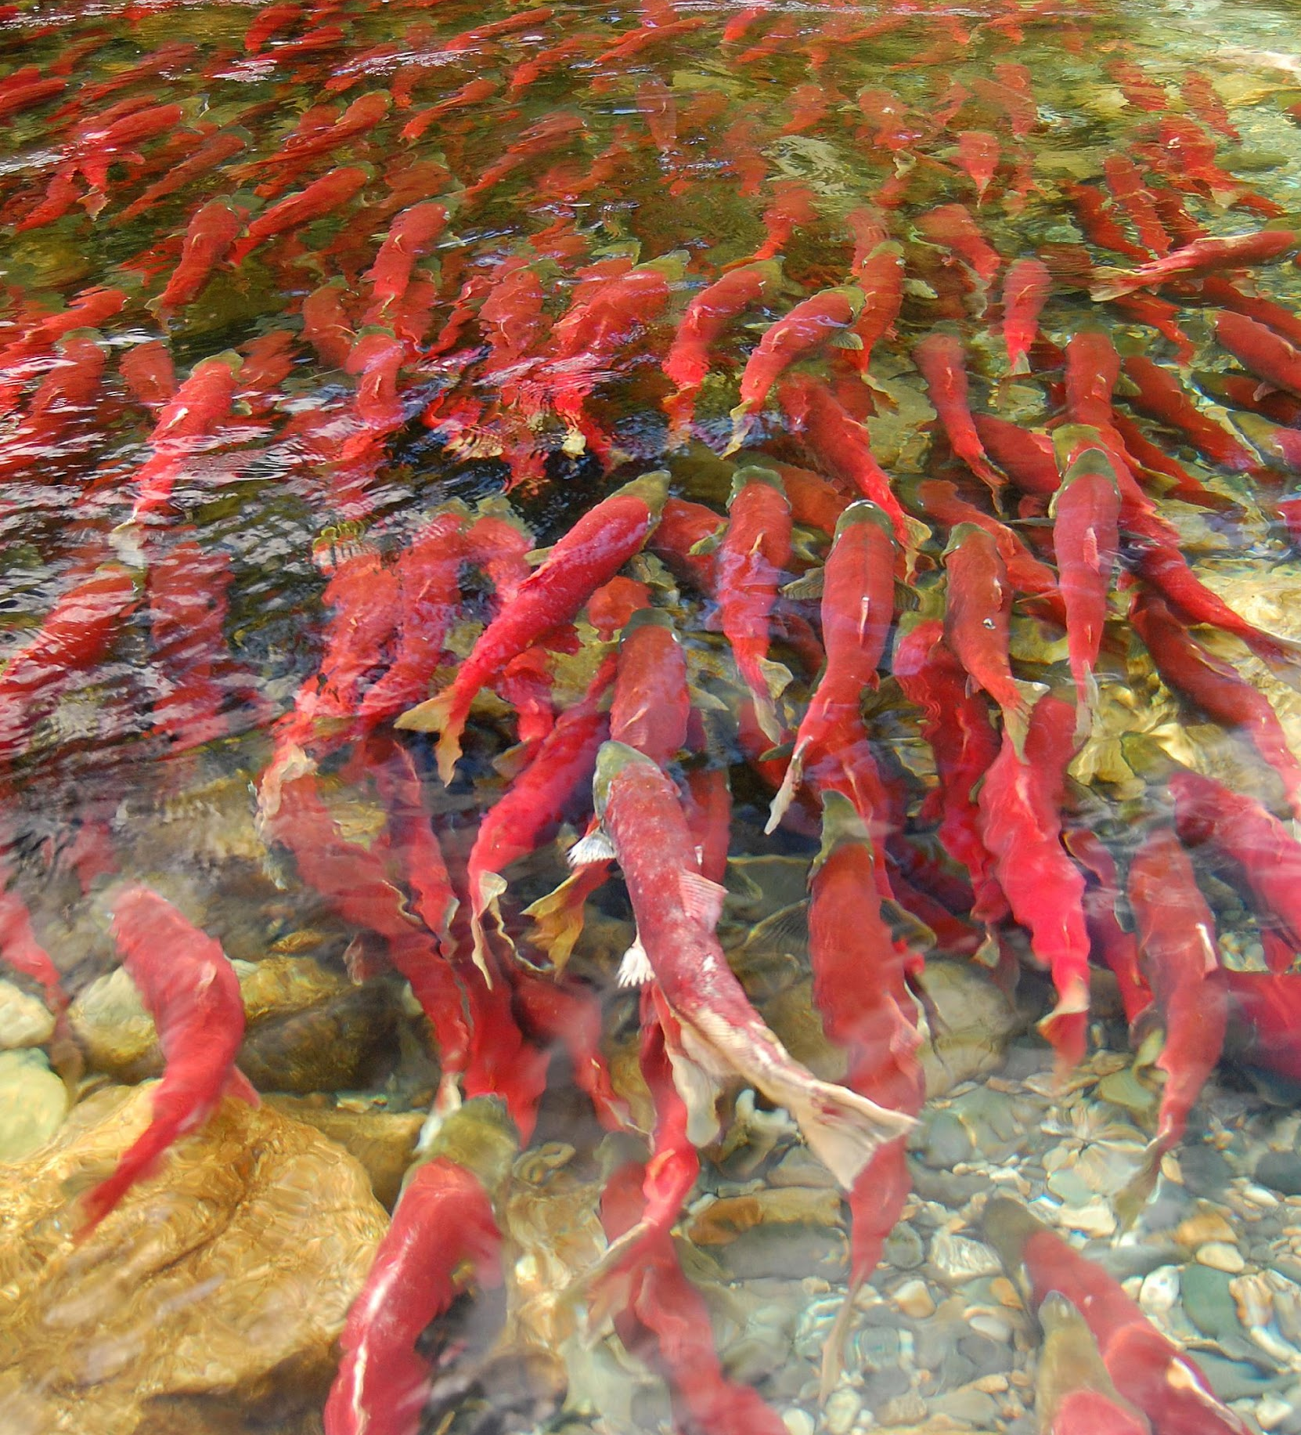
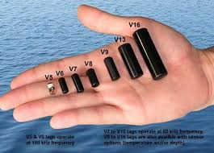
TYPES OF DATA
Detection Data
Detection Event
Tagging Activity
Receiver Deployment
OCEAN TRACKING NETWORK
Notes:
Once we have registered your project, we need to put your data into it.

Slide 14
TYPES OF DATA
Detection Data
Receiver metadata: Which receivers are where and when. Provides location context to detections.
Detection data: Tag IDs and times in .VRL format.
Tagging metadata: Which tags are in which animals including where and when. Provides biological context to detections.
Detection Event
Tagging Activity
Receiver Deployment
OCEAN TRACKING NETWORK
Notes:
Basically, we needall 3 different pieces of information to make the full picture. Receiver metadata; geolocation. Detection data: tag ID and datetimes. Tagging metadata: biological context.
We have specific templates for our metadata on our website https://members.oceantrack.org/data/data-collection

Slide 15
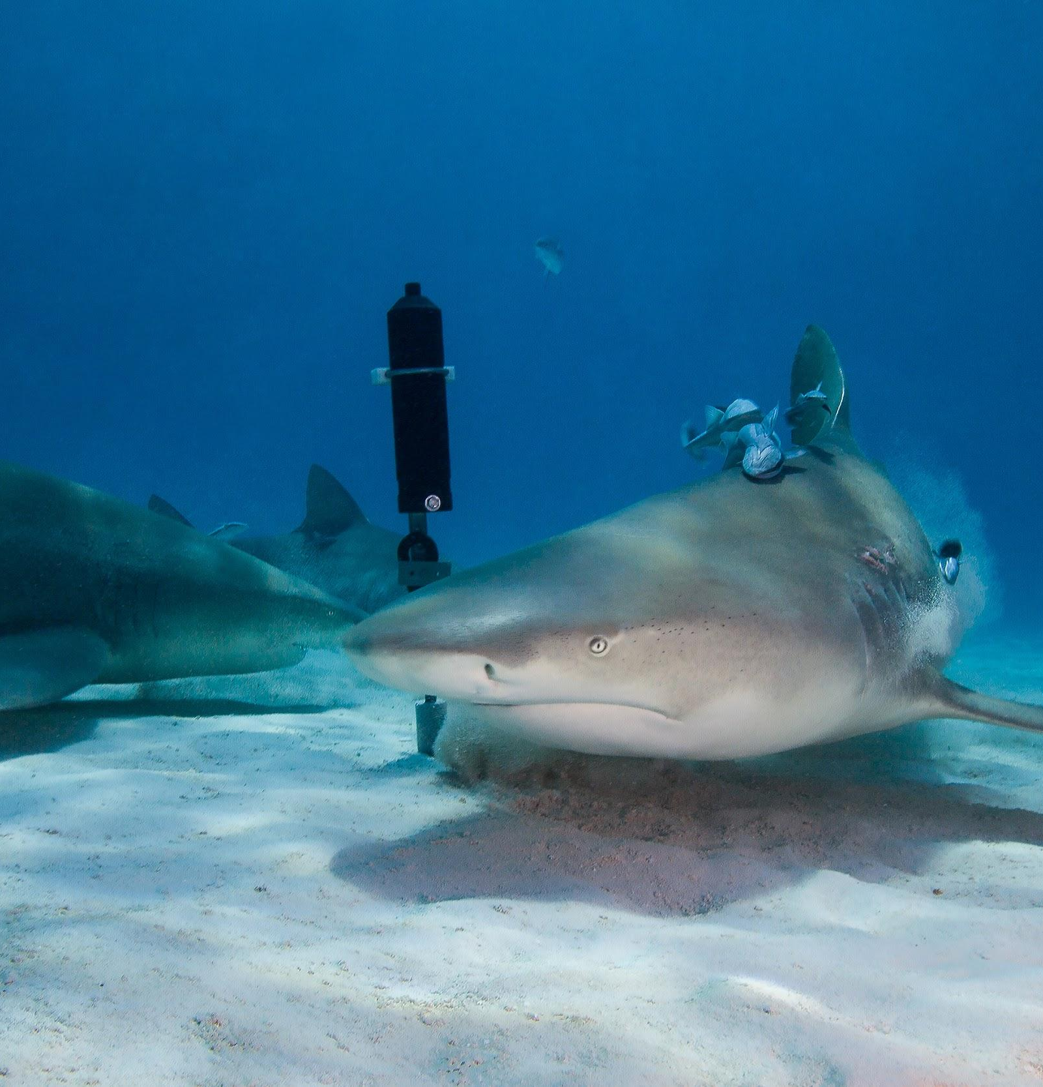
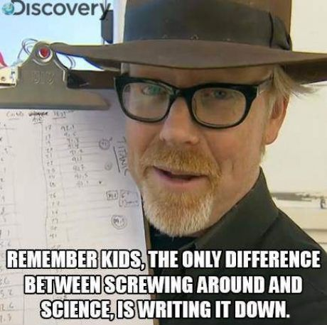
RECORD KEEPING
Metadata is really, really important!
As researchers you should follow some key guidelines to ensure useful records are kept.
FAIR Data Principles — making data Findable, Accessible, Interoperable and Reusable.
Science is more believable when: how the data was collected is clear and trustworthy.
OCEAN TRACKING NETWORK
Notes:
https://www.go-fair.org/fair-principles/
Once you understand the 3 components required for acoustic telemetry reporting, it is essential to ensure they are recorded properly. I recommend designing field sheets ahead of time.
Never modify your raw data. Always make a copy before making any changes.
Keep track of all of the steps you take to clean your data in a plain text file.
The rule of thumb, when setting up a datasheet, is columns = variables, rows = observations, cells = data (values).
This extends to when you are ready to publish based on your research, whether to a scientific journal, white paper, or to another form of public outlet.

Slide 16
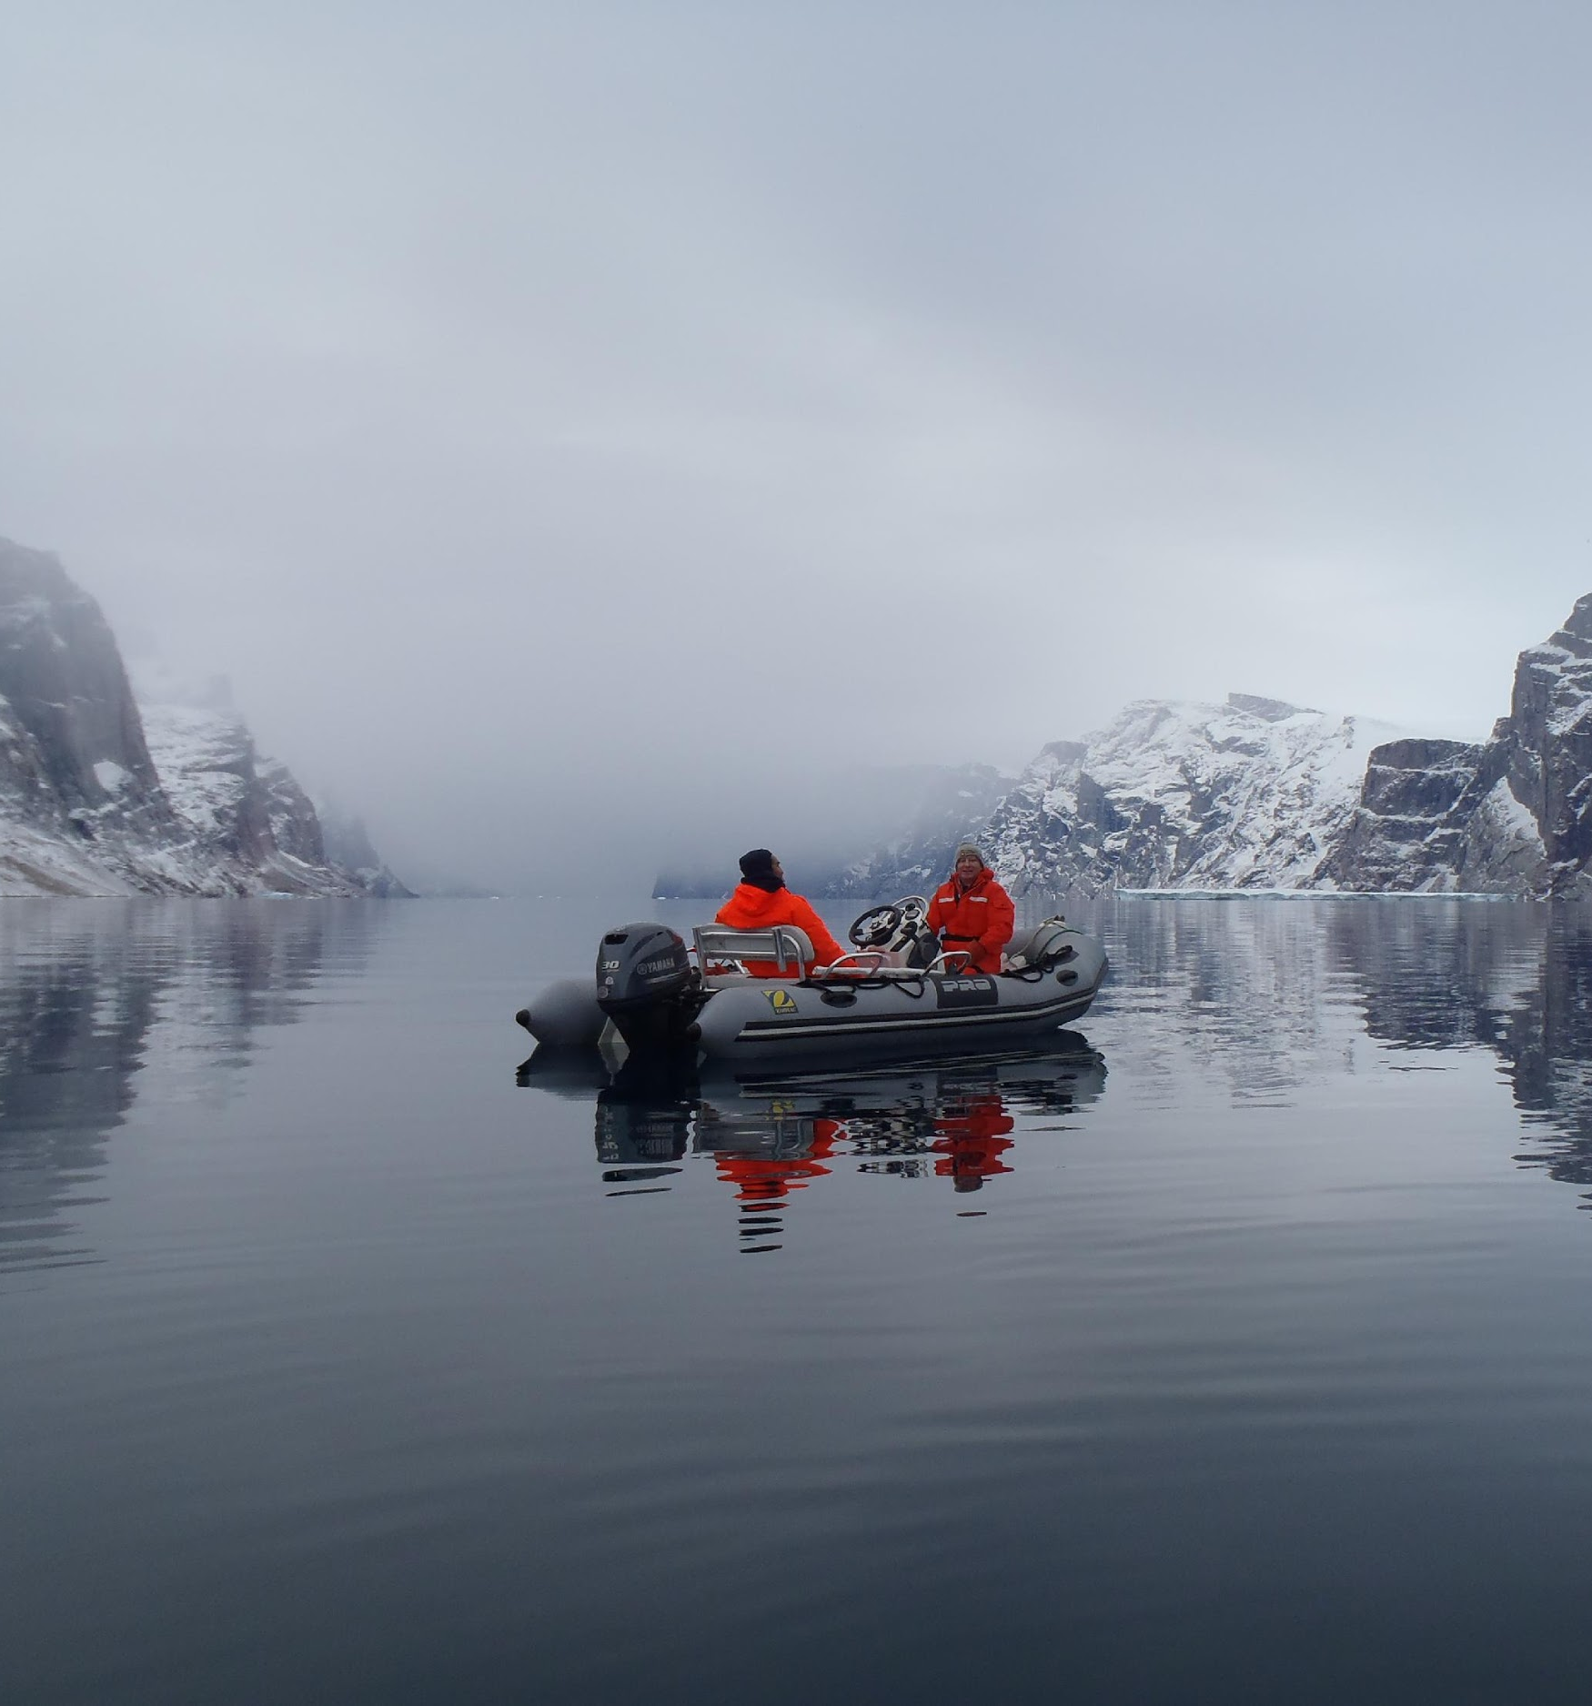
DEPLOYMENT METADATA
Excel spreadsheet with receiver deployment information, requires:
Your project code, and receiver serial number
Location and time of deployment of that receiver
Location and time of recovery of that receiver
Optionally:
When you downloaded the data, if it succeeded
Station ‘name’, bottom depth, technicians on the job, output VRL filenames, comments on the station deployment/recovery
XLS sheet available on OTN Data Portal
OCEAN TRACKING NETWORK
Notes:
Available here https://members.oceantrack.org/data/data-collection

Slide 17
Always consult with the “Data Dictionary” tab to see
the accepted format for each column!
We run coding scripts against this sheet to load into the database and the computer expects certain types of values
We have robust quality control tests to watch out for typos
Notes:
Sentinel tags and non-animal test tags (stationary tags) go into this sheet as well! Available here https://members.oceantrack.org/data/data-collection

Slide 18
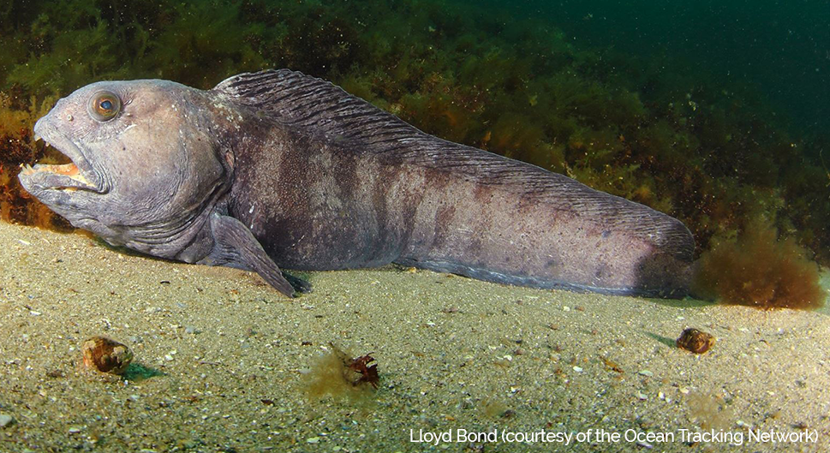
TAG RELEASE METADATA
Tag release information, requires:
Vendor specifications
Location and time of tag release
Animal information (use animal id to join two tag records)
Optionally:
Harvest Date: day and time tag was recovered.
Capture and Surgery information
Able to add columns to include other relevant
information
OCEAN TRACKING NETWORK
Notes:
One line per transmitter, not per animal.
Sensor tags, floy tags, pit tags, dual pingers.
Available here https://members.oceantrack.org/data/data-collection

Slide 19
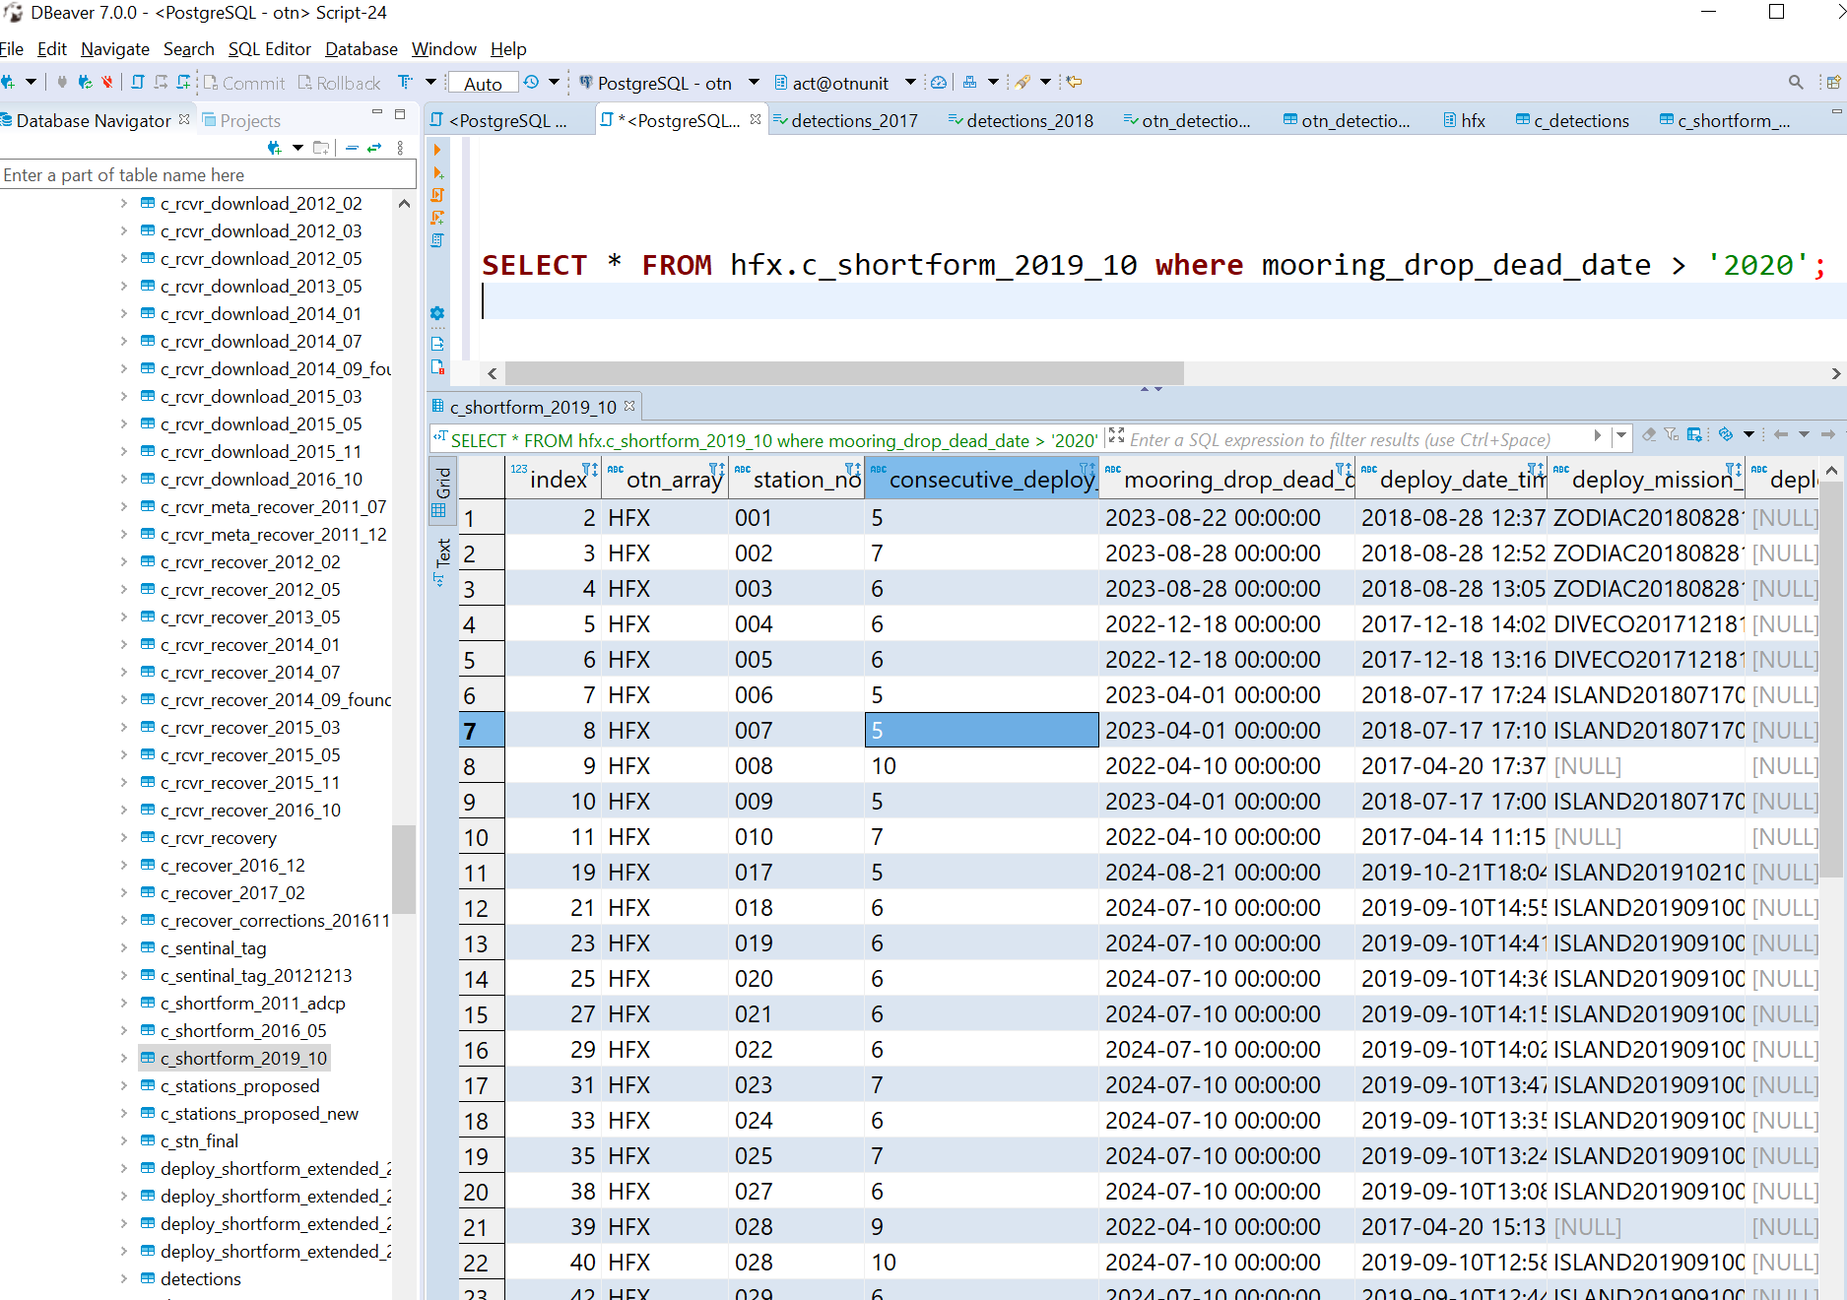
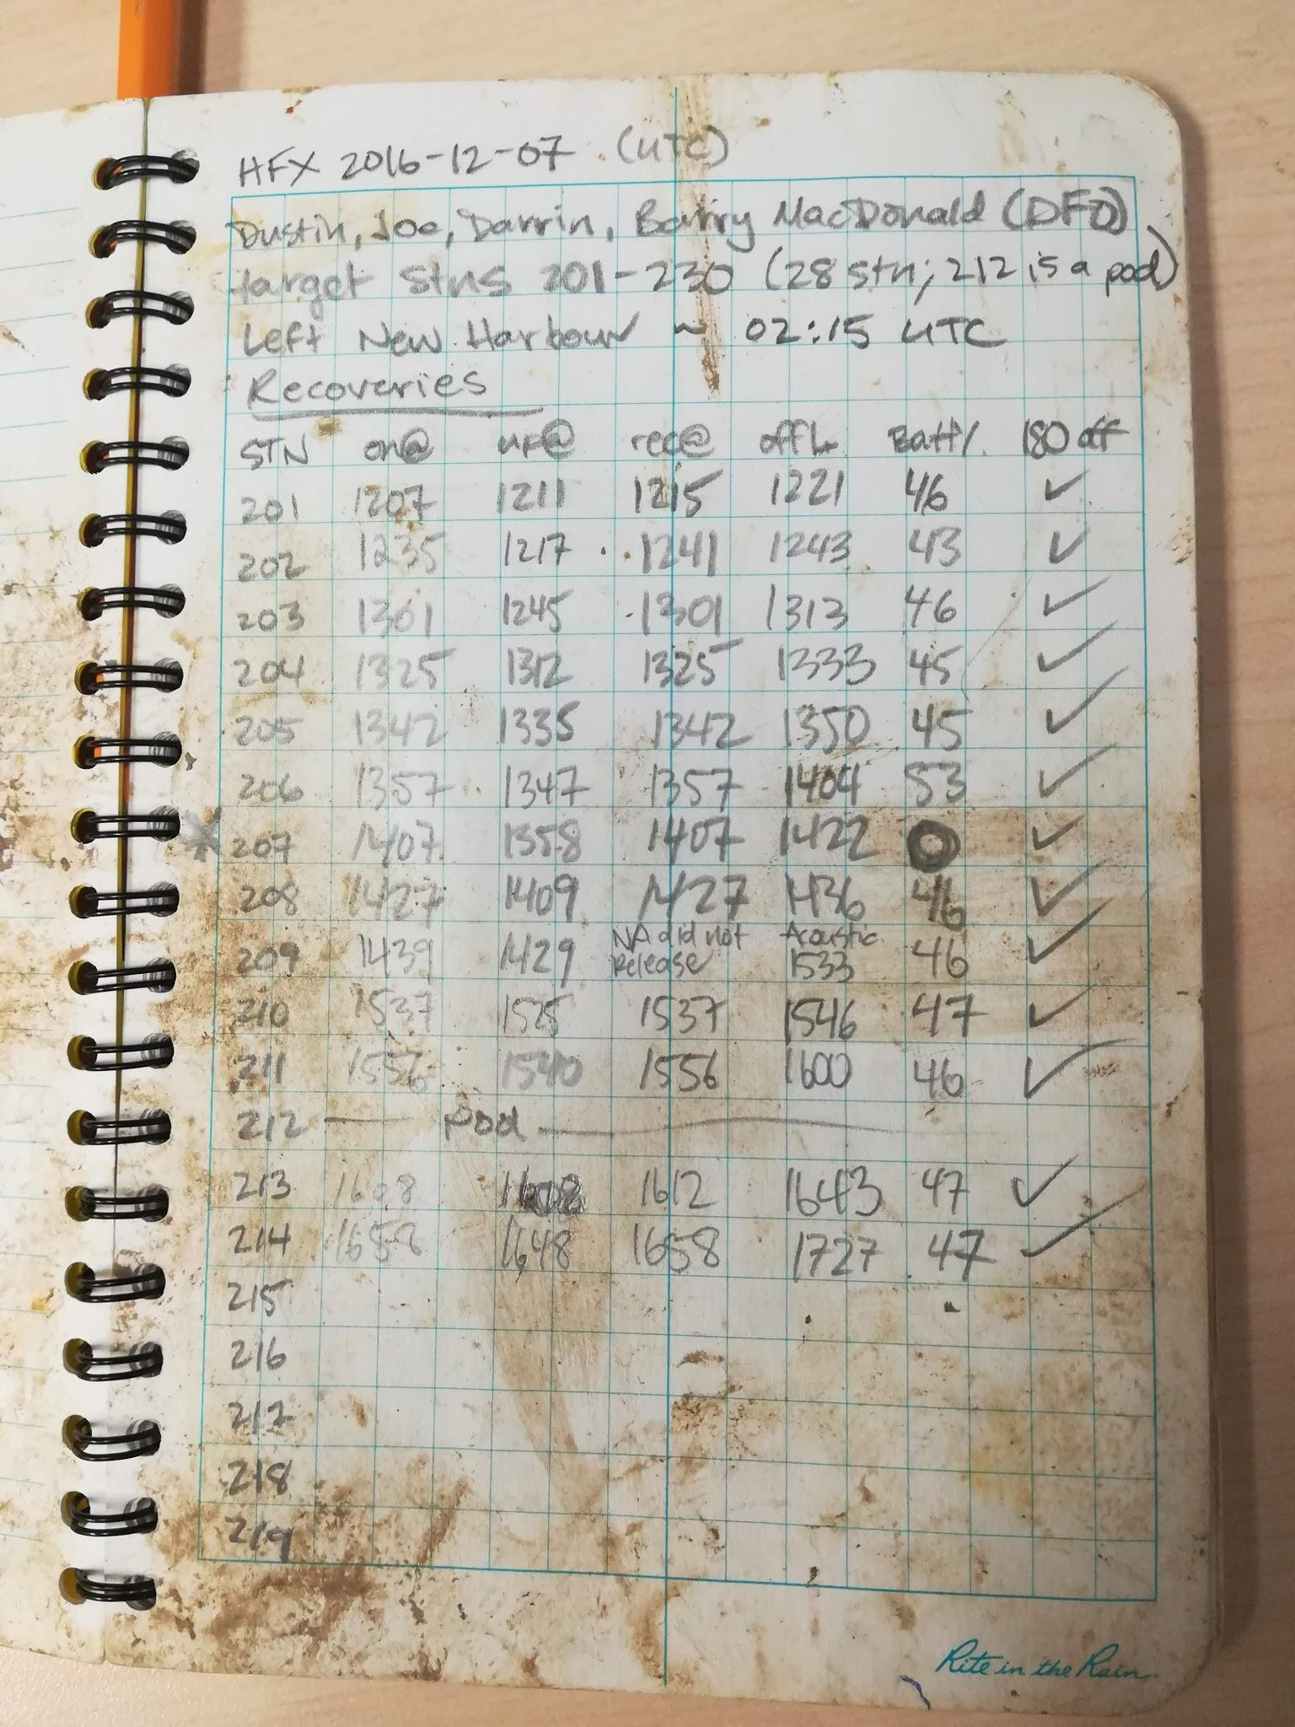
COMMON SPREADSHEET ERRORS
Computers are only so smart..
Null values vs. zeros
Multiple data type per cell
Datetime formatting
Excel vs CSV editor
Time zones
“Pretty” formatting
Column naming
Transcription, autofill and other errors
https://datacarpentry.org/spreadsheet-ecology-lesson/
OCEAN TRACKING NETWORK
Notes:
Structuring data in spreadsheets
The cardinal rule of using spreadsheet programs for data is to keep it “tidy”:
Put all your variables in columns - the thing you’re measuring, like ‘weight’ or ‘temperature’.
Put each observation in its own row.
Don’t combine multiple pieces of information in one cell. Sometimes it just seems like one thing, but think if that’s the only way you’ll want to be able to use or sort that data.
Leave the raw data raw - don’t change it!
Export the cleaned data to a text-based format like CSV (comma-separated values) format. This ensures that anyone can use the data, and is required by most data repositories.
https://datacarpentry.org/spreadsheet-ecology-lesson/02-common-mistakes/index.html
This being said: there are some common errors when completing/designing metadata sheets. Because (usually) you want to use the metadata sheet to programatically inform your analysis/stats you want to make sure a computer can read the sheets.
For you: a 0 might be the same as a blank value. However, 0 is a number and ‘blank’ is not - it means not recorded/not applicable. Please fill in all 0s as they occur and leave blanks or NAs in there
Another issue: having multiple data types in one cell. Ex: adding units into the cell so there are numbers and characters in there. Computers can't perform analyses on this type of cell because it cant pick out “just the number”. Keep all values in their own column, and put units in the header. The rule of thumb, when setting up a datasheet, is columns = variables, rows = observations, cells = data (values).
Excel is a proprietary software. This means it does weird things that are not compatible with other software. If you have a CSV file DO NOT open it in Excel because Excel will mangle the datetimes and other formatting, trying to convert to its proprietary versions. Open in Notepad++ or VSCode or R or another open-source program whenever possible.
Additionally: the internationally accepted datetime convention is YYYY-MM-DD (hh:mm:ss also if needed). Badly formed dates can cause real trouble. Also, know which timezone we’re in: our time zone changes from AST to ADT throughout the year. The best convention is to record all datetimes in UTC - Universal COordinated time. This is the international standards and is either 3 or 4 hours ahead of us.
If you make your formatting “pretty” - colours and merged cells etc - it can make it harder for a computer to read. Simpler is better!
Ideally, columns should be named with underscores (ex: DATETIME_UTC). The fewer spaces the easier it will be to manipulate these variables in different software packages without causing headaches. In Python “.” are used to call functions so this can be risky. Keep this in mind for naming best-practices

Slide 20
METADATA SCREEN-SHARING
Time for a walkthrough of the metadata sheets! Available here: https://members.oceantrack.org/data
OCEAN TRACKING NETWORK
Notes:
Having a really clear data loading and cleaning workflow is essential. People need to know what you did, and why, in order to recreate the steps and produce consistent data. I recommend everyone have a “data cleaning workflow” document, especially if those are steps you generally complete in Excel or some other format where the code isn't automatically saved.

Slide 21
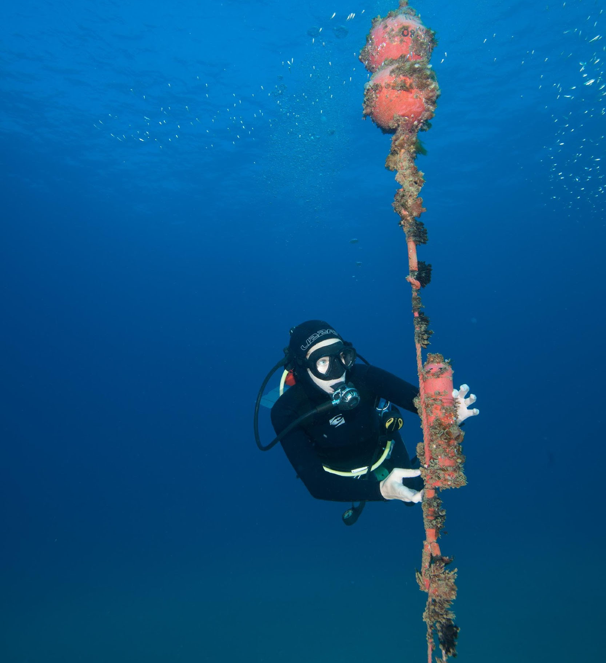
WHEN TO REPORT
Anytime the equipment is moved or downloaded
Important to know when it was out of the water
For “observation effort” statistics
To eliminate false/test detections while on land
OCEAN TRACKING NETWORK

Slide 22
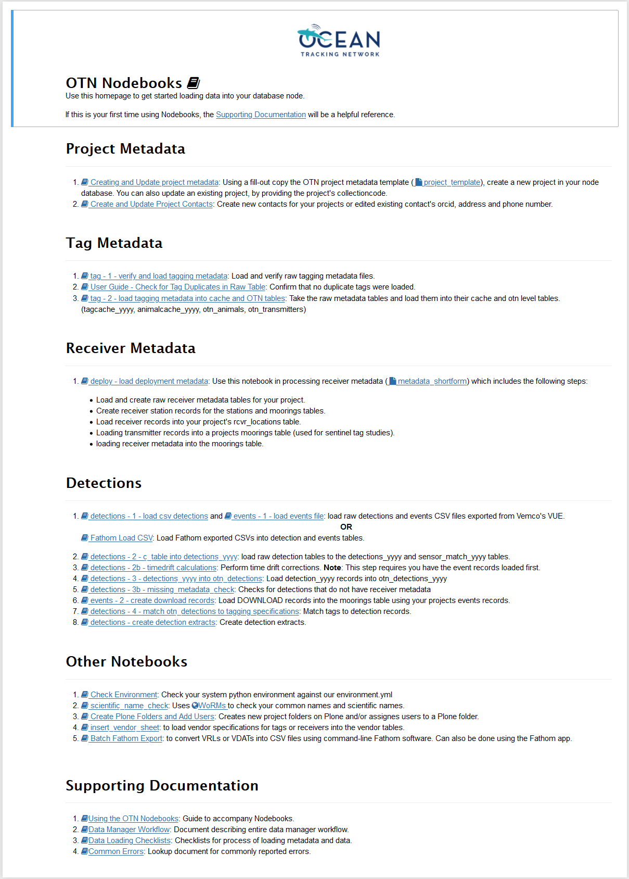
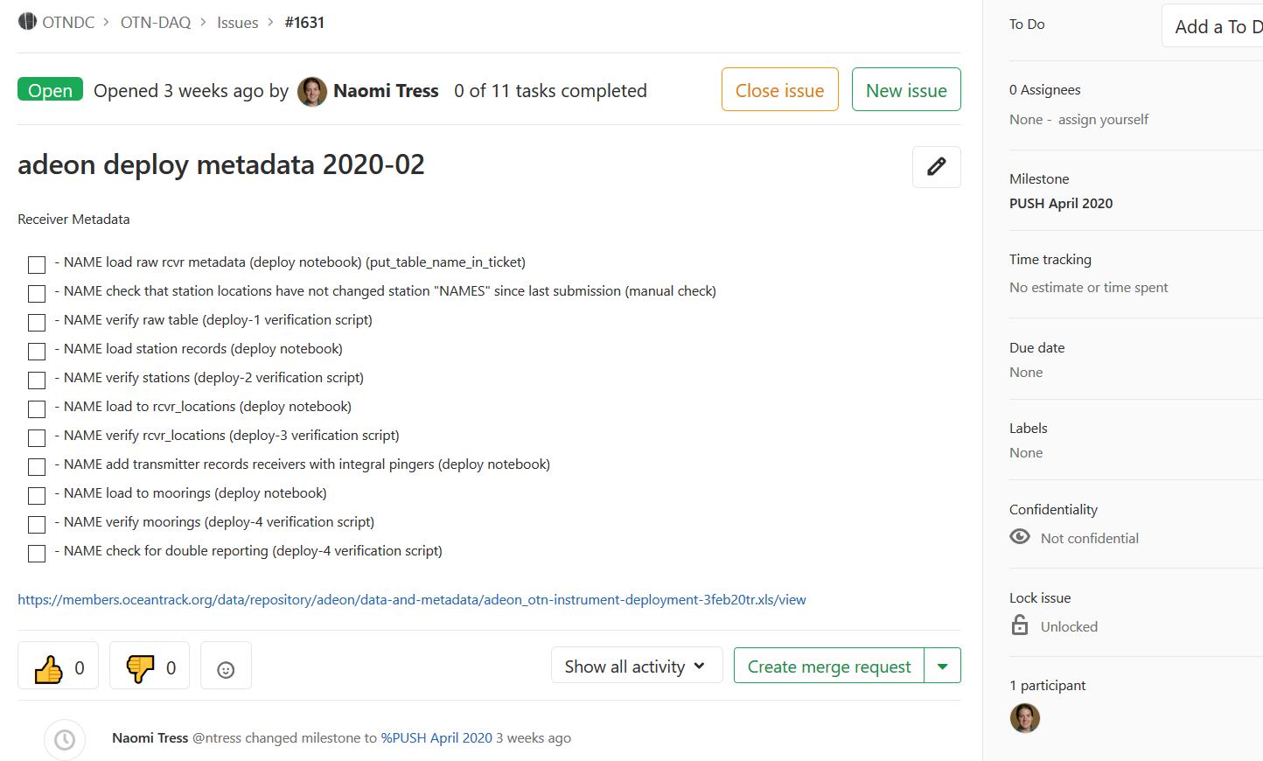
QUALITY CONTROL
Computers are only so smart
Support and tools for node managers
Final verification done by OTN
Periodic, synchronous “data pushes”
Is each receiver deployed in exactly one place at one time?
Are detections from when receiver was actually wet?
Are tags in no more than 1 animal at a time?
Is the detection from after a tag was released, and before the tag battery died; was the tag still in the fish?
OCEAN TRACKING NETWORK

Slide 23
OCEAN TRACKING NETWORK
Notes:
Once all the quality control is completed, your data ends up in the database. Here is a screenshot just showing what it looks like.
Having a really clear data loading and cleaning workflow is essential. People need to know what you did, and why, in order to recreate the steps and produce consistent data. I recommend everyone have a “data cleaning workflow” document, especially if those are steps you generally complete in Excel or some other format where the code isnt automatically saved.

Slide 24
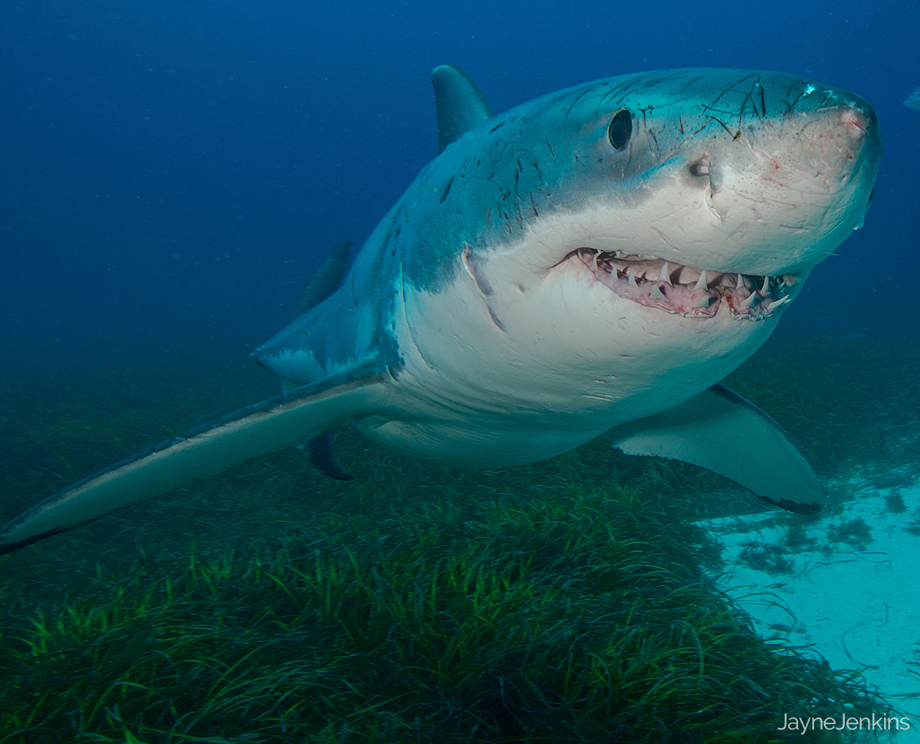
LESSONS LEARNED
Clear reporting formats and expectations
Sometimes the smallest miscommunication between partners is enough to cause major headaches!
Standardized data formats are essential to ensure smooth data sharing
If you know the expected formats before completing field work, you can ensure you’re recording the information you need
Darwin Core vocabulary, international standard
OCEAN TRACKING NETWORK
Notes:
Why do we have such extensive data cleaning protocols?
Ex: some American collaborators have their datetimes in the format: M/D/YY, but some have D/M/YYYY, and your data is in YYYY-MM-DD, and now its not machine readable
Ex: your colleagues sent you raw detection files, but they were corrupted by Excel and have lost the seconds from the detection time
Ex: your collaborator used a different coordinate system when recording receiver positions, and now its not plotting properly in your mapping tools
Ex: a colleague in reports all timezones in Atlantic, while you report yours in UTC. Now there is a 3-4 hour different, depending on Daylight Savings which you have to account for.

Slide 25
USING THE DATA PORTAL
OCEAN TRACKING NETWORK
Notes:
https://members.oceantrack.org/

Slide 26
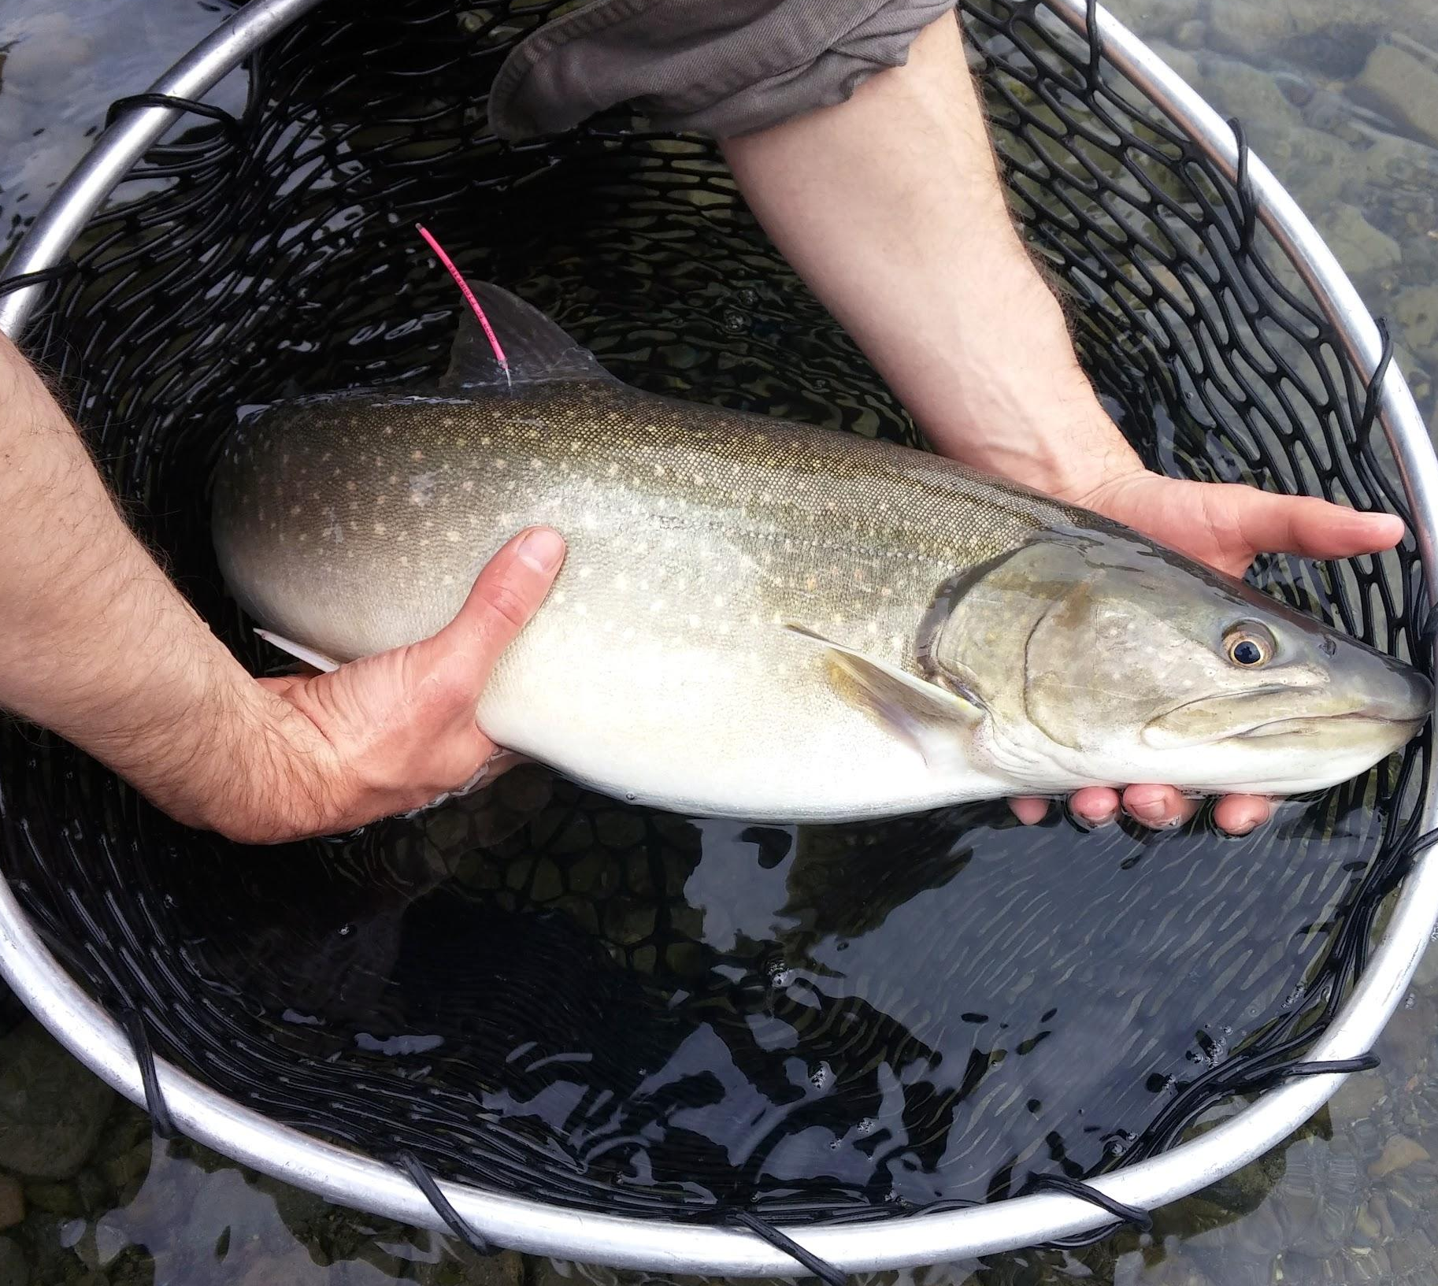
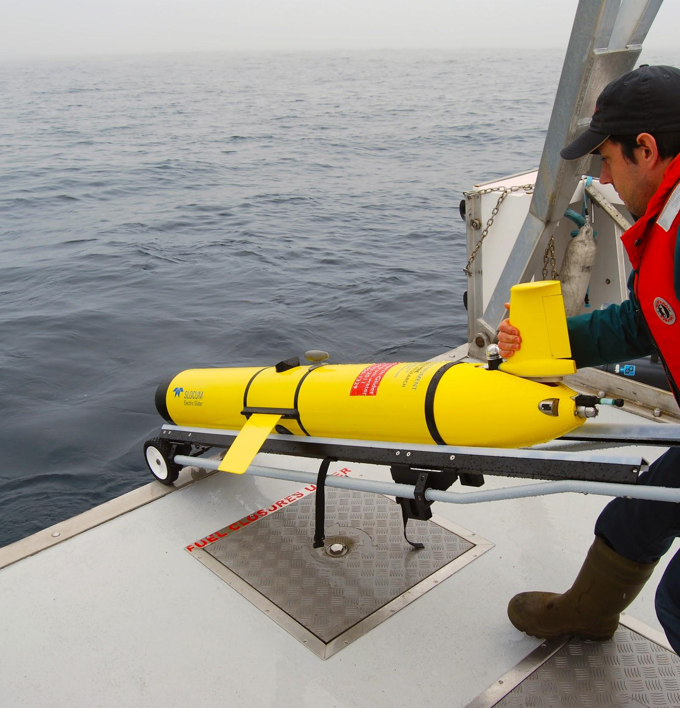
HOW TO REPORT
Contact OTNDC@DAL.CA for help
1. Upload to Data Portal
You have a secure document repository folder
2. Email to OTNDC or Regional Manager
Three things are needed:
Updated deployment metadata
ZIP folder with all VRLs
Updated tagging metadata
OCEAN TRACKING NETWORK

Slide 27
USING THE DATA PORTAL WEBSITE
The data portal is a lot like Dropbox or Google Drive
Sharing settings on every folder
Private document sharing/organization
Where researchers post metadata/data files
Share with your lab-mates and collaborators
Email notifications to the Data Manager when data is submitted
Where the Data Manager will post your tag-matches
OCEAN TRACKING NETWORK
Notes:
https://members.oceantrack.org/

Slide 28
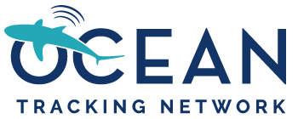
Notes:
https://members.oceantrack.org/
Use the menu on the left (once logged in) to add/edit folders or files

Slide 29
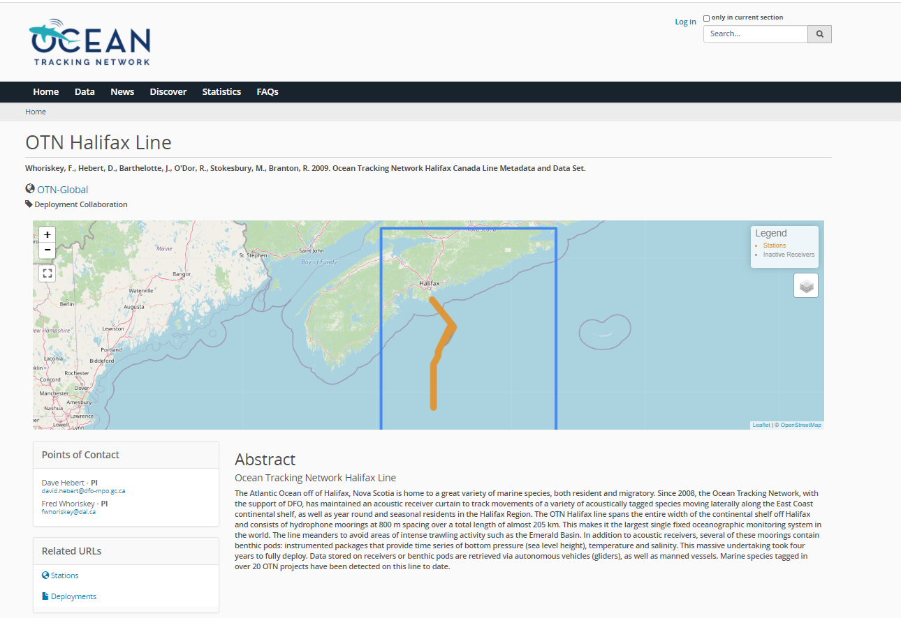
OCEAN TRACKING NETWORK
Notes:
Example PUBLIC webpage on the data portal - downloadable stations KML and Deployment CSV! Always available, always public.

Slide 30
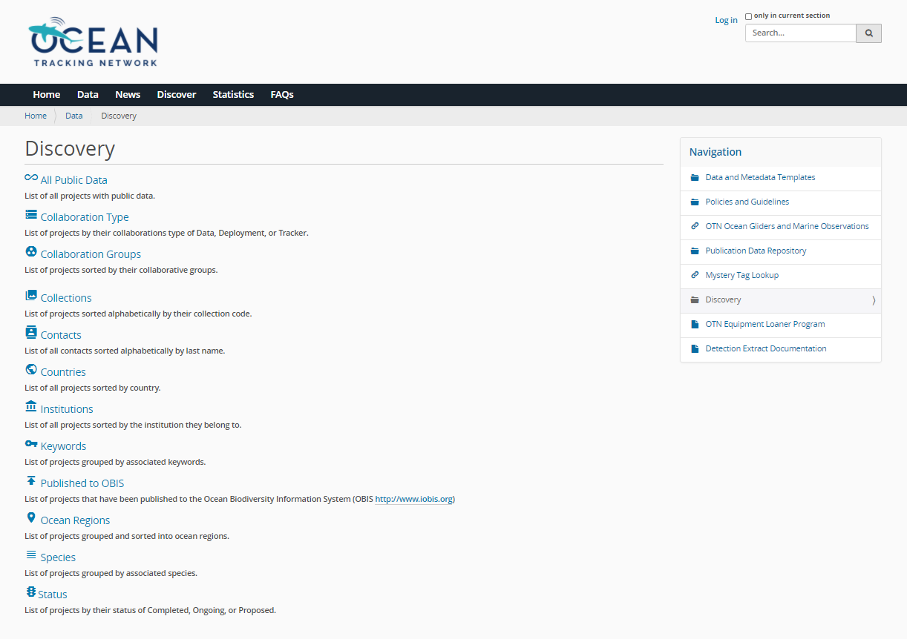
OCEAN TRACKING NETWORK
Notes:
Multiple ways to search our data portal website - we have lots of public information

Slide 31
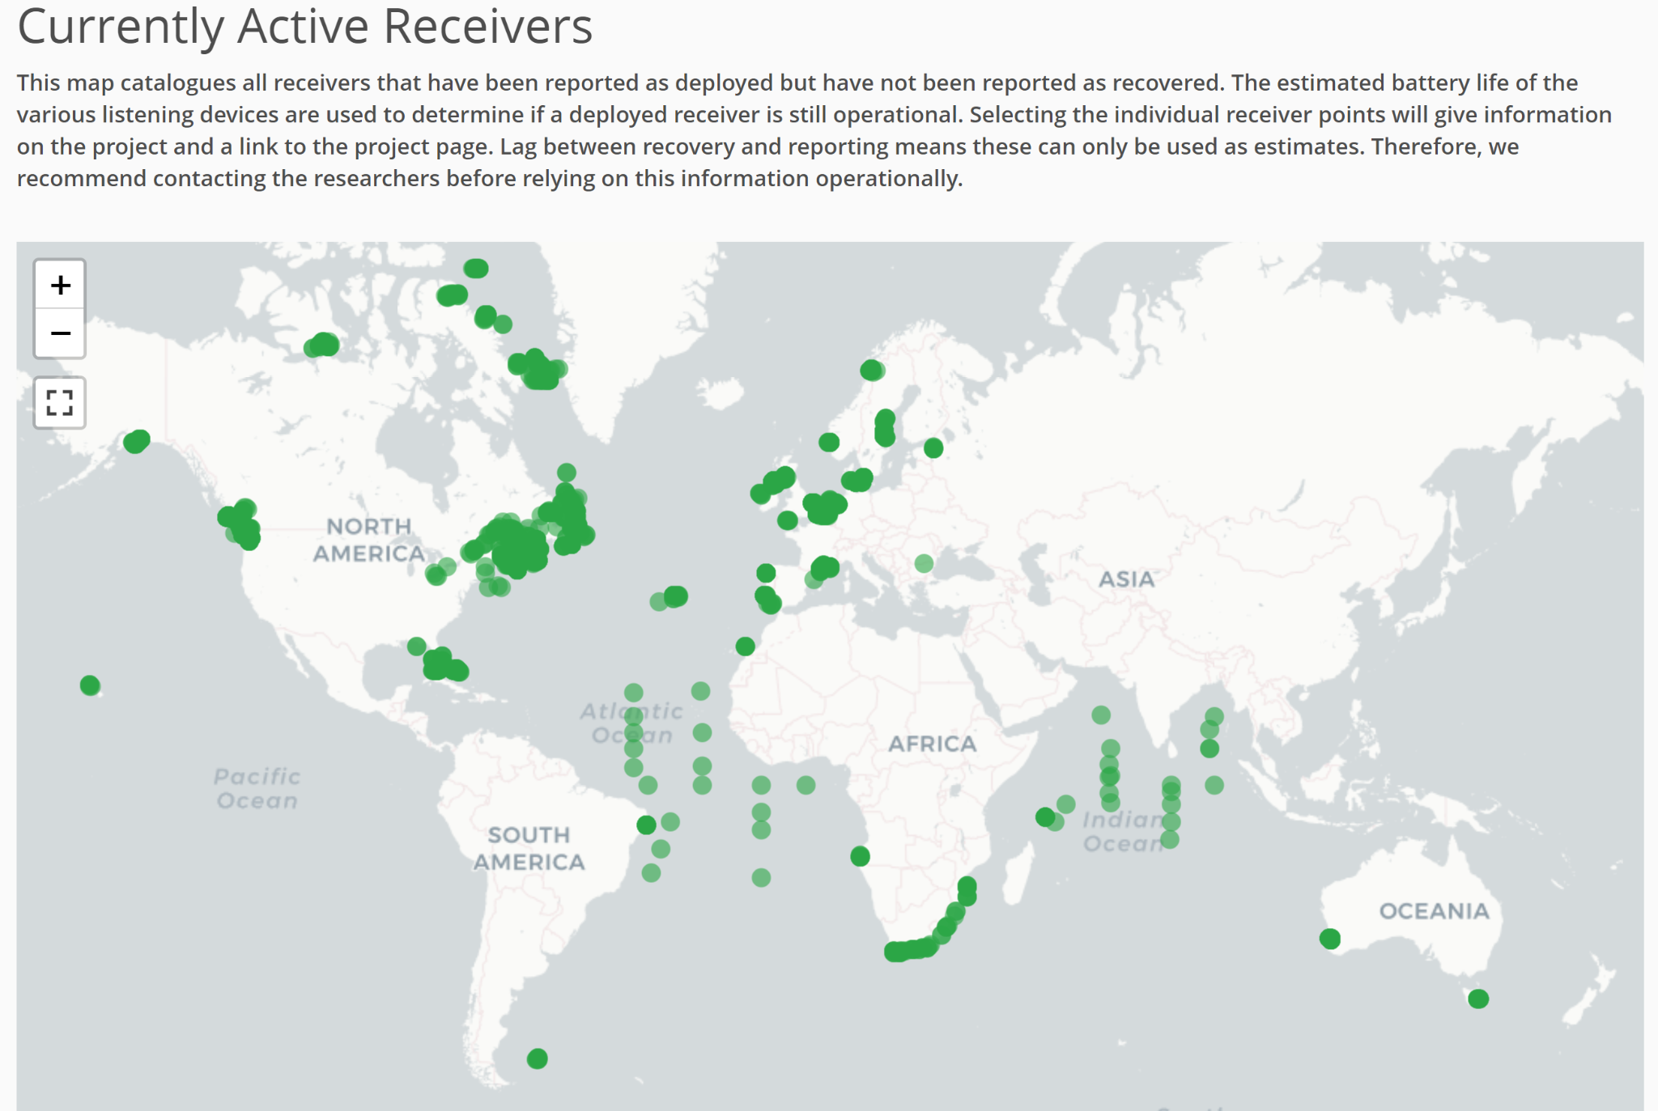
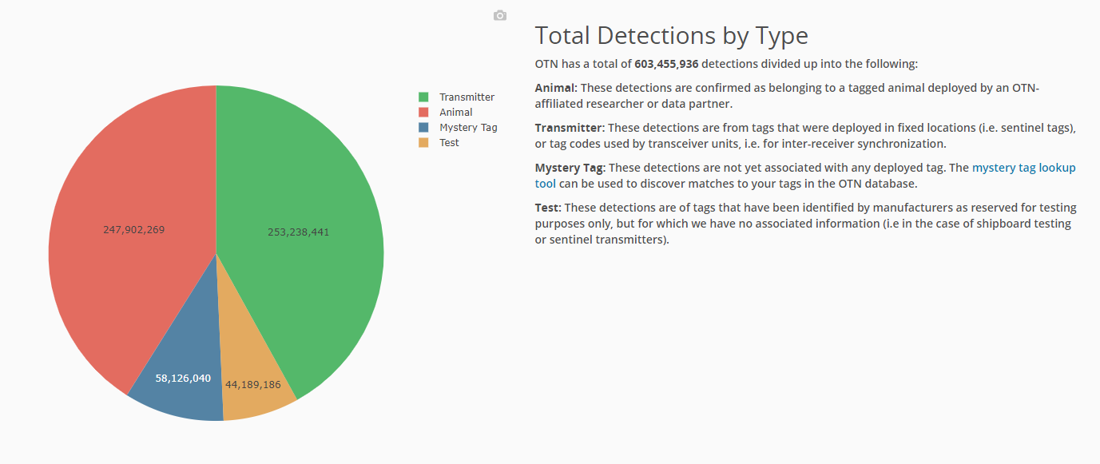
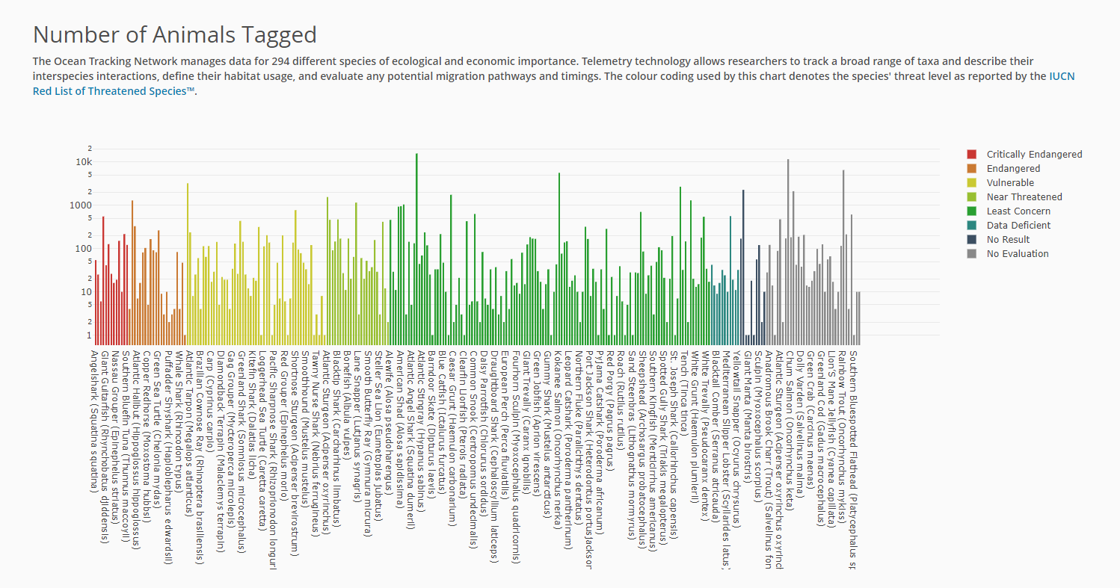
SUMMARY STATISTICS
OCEAN TRACKING NETWORK
Notes:
https://members.oceantrack.org/statistics Multiple ways to search our data portal website - we have lots of public information

Slide 32
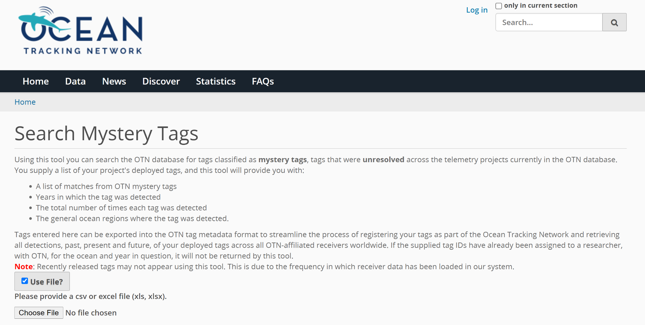
MYSTERY TAG TOOL
OCEAN TRACKING NETWORK
Notes:
https://members.oceantrack.org/@@mystery_tag - non-OTN users can also check to see if their tags were detected!

Slide 33
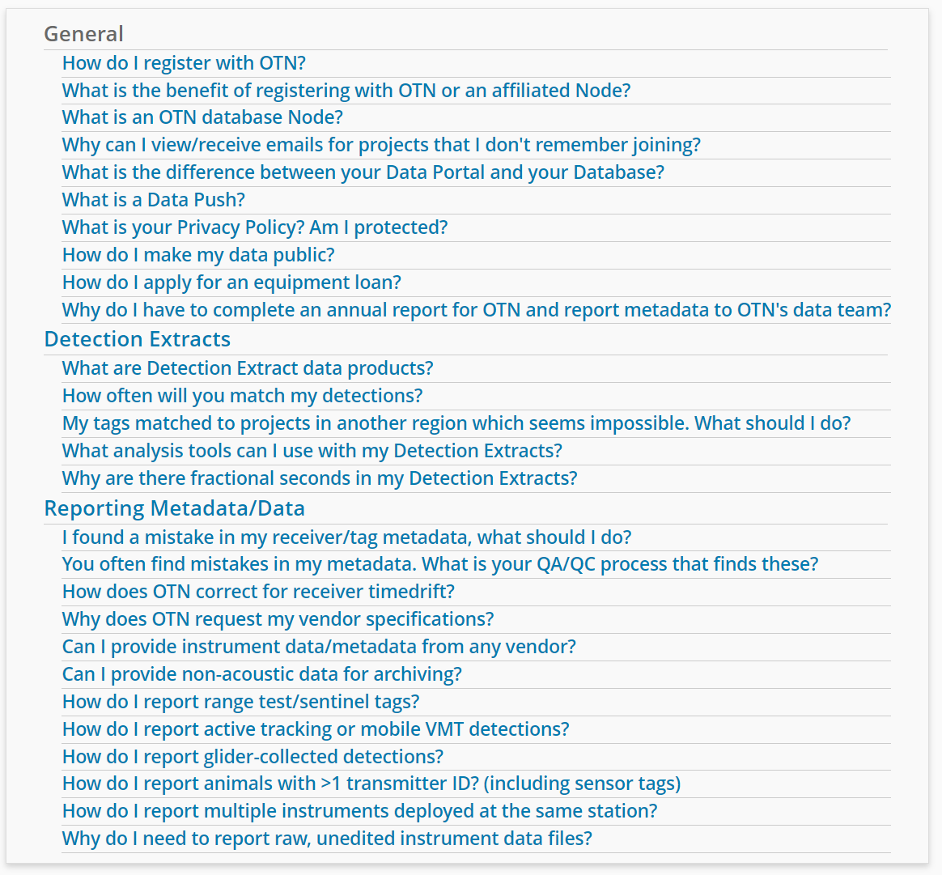
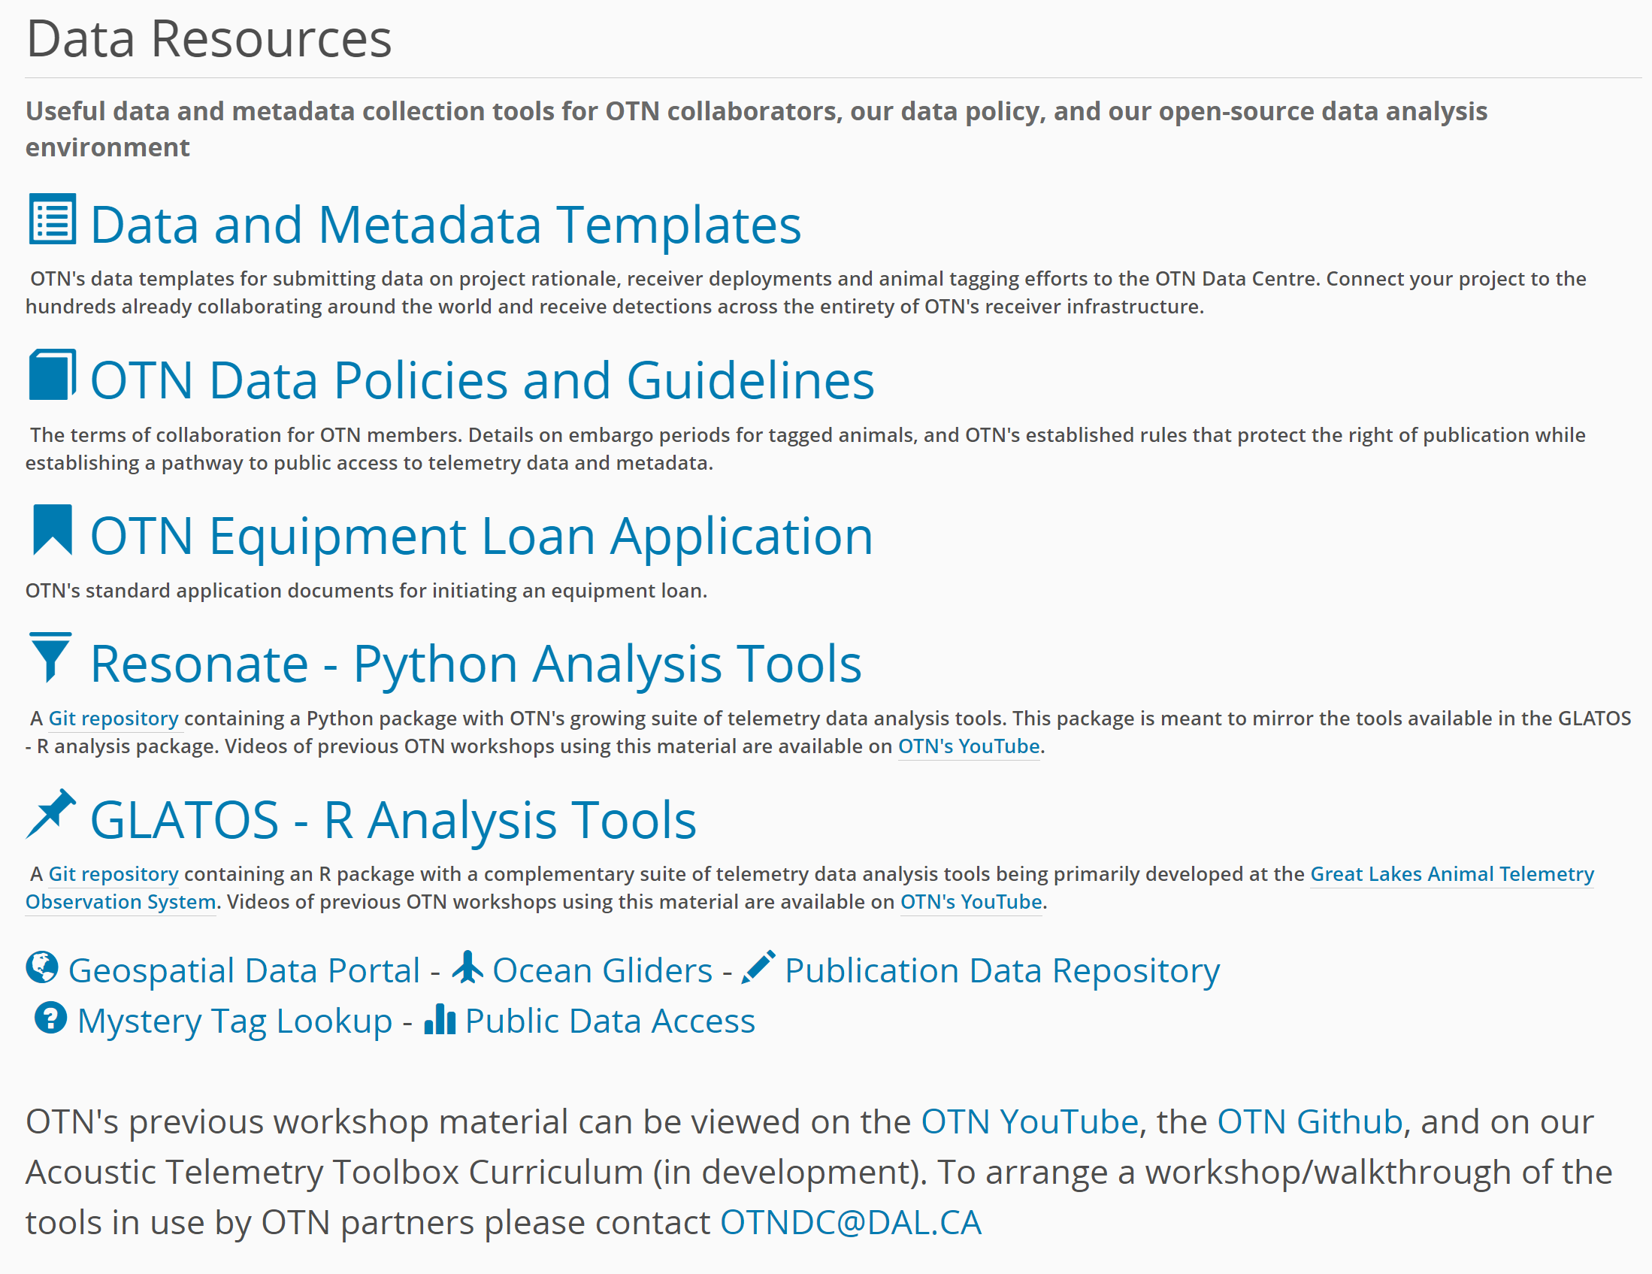
HELPFUL INFO
OCEAN TRACKING NETWORK
Notes:
FAQs, and other resources are publicly available

Slide 34
WEBSITE SCREEN-SHARING
Time for a walkthrough of the Data Portal! Available here: https://members.oceantrack.org/
OCEAN TRACKING NETWORK
Notes:
Pages to check out: project pages, “my projects tab”, repository folder, Data tab, Discovery tab, Stats tab, FAQ tab, mystery tag tool

Slide 35
DATA OUTPUTS AND ANALYSIS
OCEAN TRACKING NETWORK

Slide 36
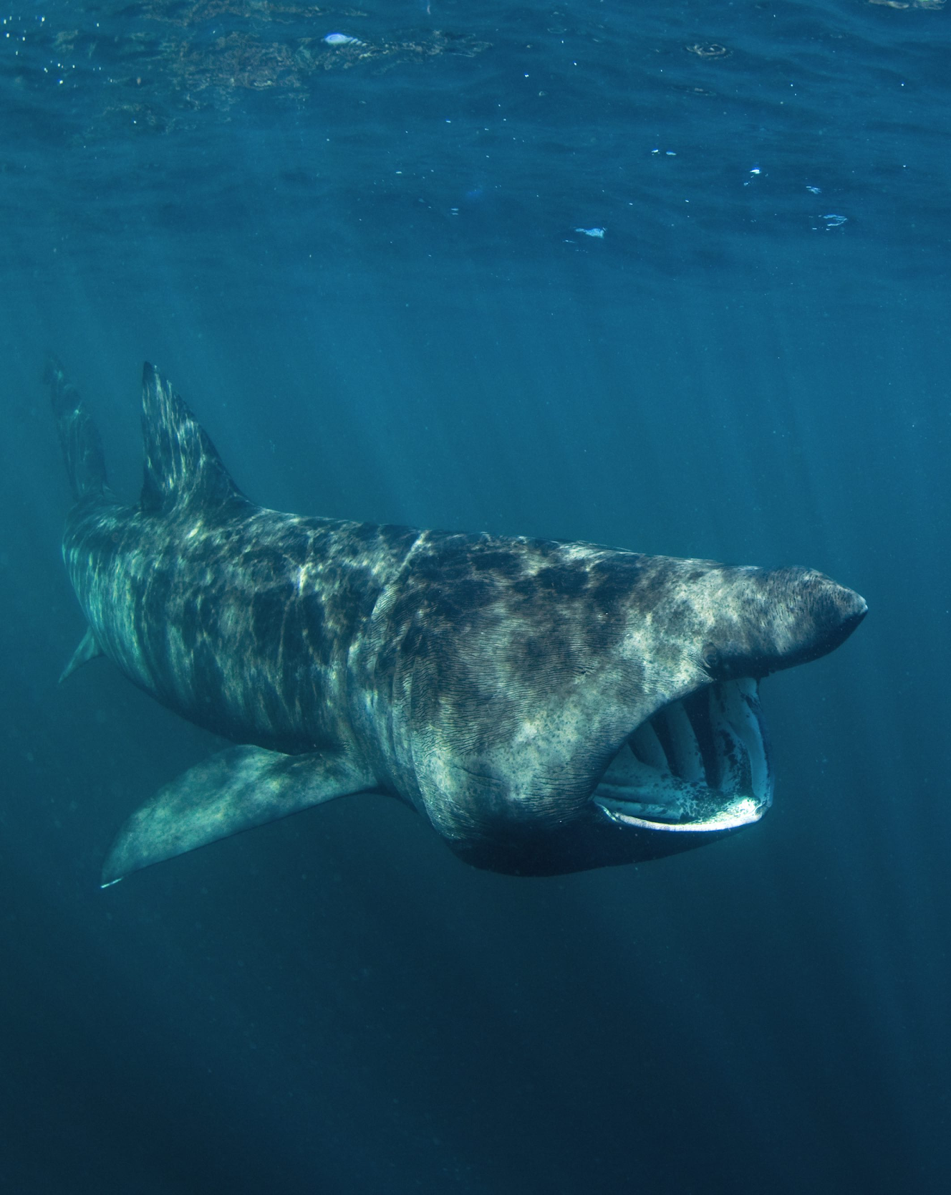
ANALYSIS PLANNING
Data sets are large and complex
Plan to take GREAT field notes
Plan to use something other than MS Excel
Expect redundancy in your detections: multiple detections of one fish at one location
Develop specific questions you hope to answer, and plan the analysis pathway
Identify individuals that are responsible for
1) Field work and metadata
2) Analyzing (and writing up) data
Can require a significant portion of a researcher’s time depending on scale of the study, and help eliminate confusion to assign roles
OCEAN TRACKING NETWORK

Slide 37
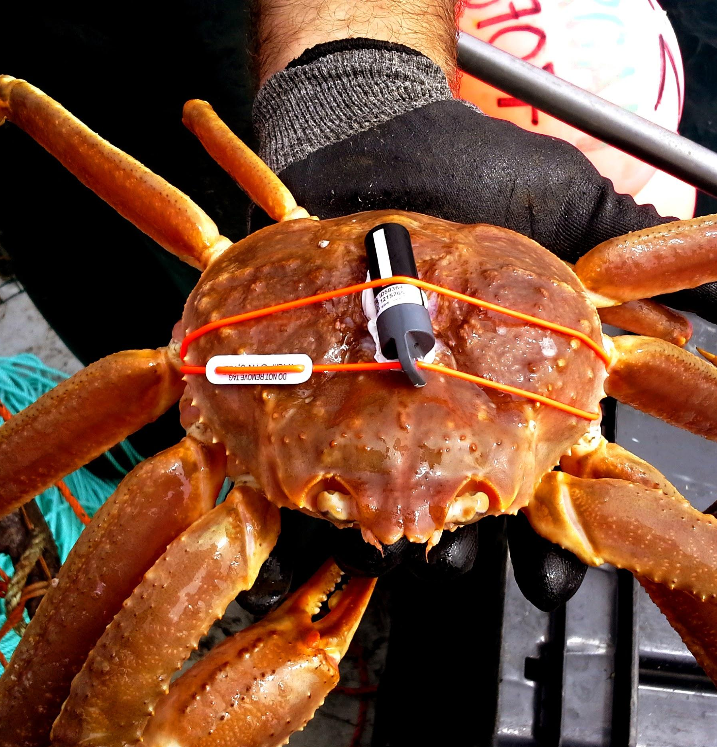
LIMITS OF DATA
Important pitfalls of acoustic telemetry data
Only presence data – NOT absence
Tag collisions and false detections
Environmental impacts on detection range
Array design impacts what questions can be answered
Migrations
Spawning sites
Intra- or interspecific interactions
OCEAN TRACKING NETWORK

Slide 38
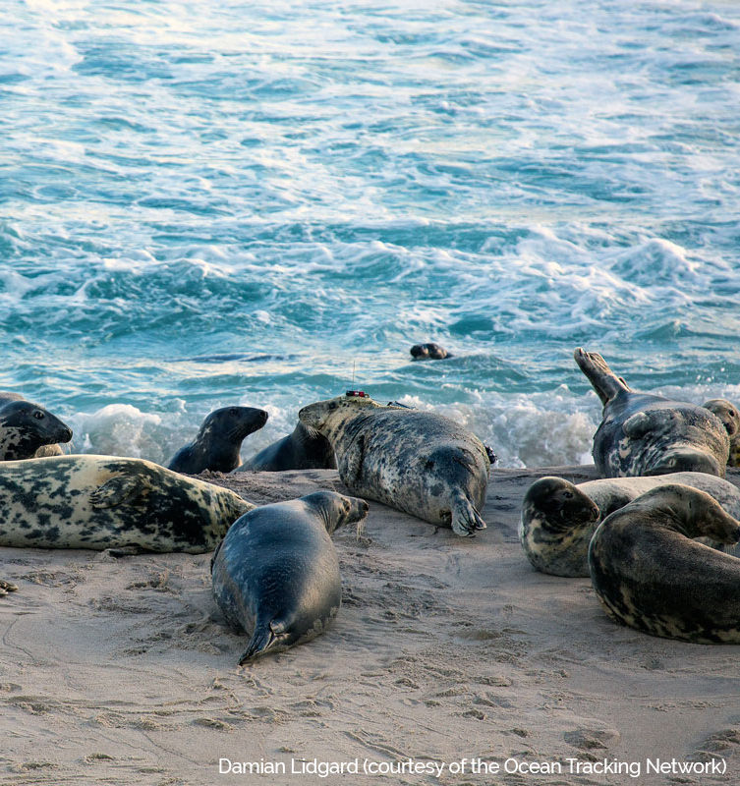
NODE OUTPUT
OTN will match any tags detected to their “owners”
You get to know which project and researcher released the tag
You get “Detection Extracts” – .CSV files showing all matched (qualified) and mystery (unqualified) tags you’ve detected
These .CSVs can be huge – open directly in coding software - not in Excel!
OTN supports R and Python packages which can directly intake these files for analysis!
OCEAN TRACKING NETWORK
Notes:
Unfiltered detections - includes those matches that are unlikely due to geography, but detection concurrent with tag release and battery life.
File is updated approximately every 3 months, assuming it has been modified. You should receive email notice from your node manager.
This is a “data push”: we coordinate data loading, verification and matching between all the nodes at once, so we can give an updated “snapshot” to everyone. If we sent out detection extracts everytime someone submitted new data, the extract would be out-of-date almost immediately, and we’d be emailing researchers weekly. We also update our website during a data push and do a large backup of the system. Its very extensive and usually takes a month or two.
Method for unmatching based on Researcher reporting. Detection goes back into the pool so it can be potentially matched in the future.

Slide 39
DETECTION EXTRACTS
Detection extracts contain only detections for the year corresponding to the filename
Tag Projects
Matched to Animals YYYY
ANYWHERE you animals were detected that year, across the world
Receiver Projects
Detections Mapped to Other Trackers YYYY
Any tags on your array which were tagged by another project, from anywhere in the world
You find out the tag-project and contact information for the tagger (not species info)
Unqualified Tag Detections YYYY
Detections made by your array that have not been matched to any tag, in any Node.
Sentinel Tag Detections YYYY
Detections of known non-animal tags on your array
OCEAN TRACKING NETWORK
Notes:
These will be reviewed later in the workshop
https://members.oceantrack.org/data/otn-detection-extract-documentation-matched-to-animals

Slide 40
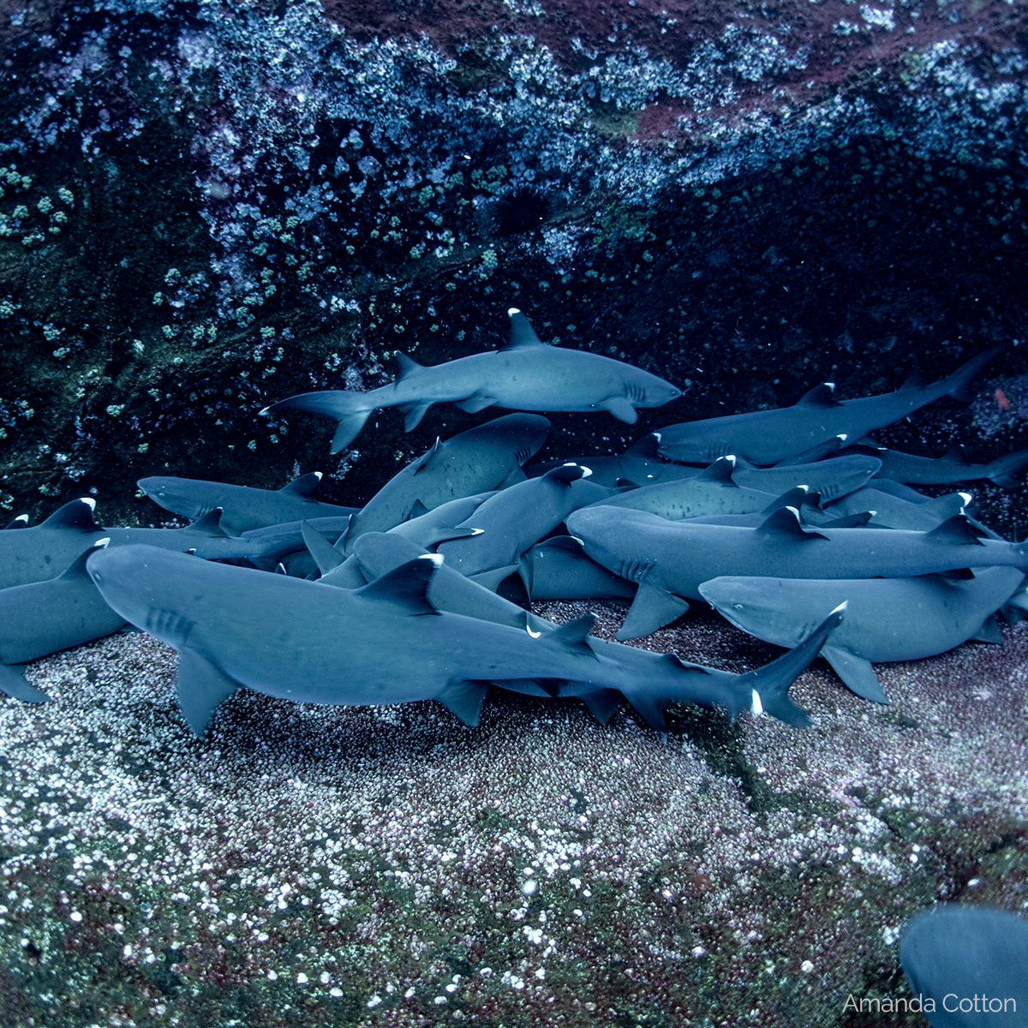
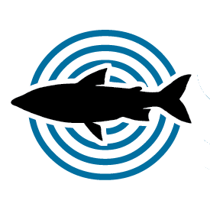
ANALYSIS PATHWAY
Detection extracts directly ingestible by the glatos R Package
Tools to summarize and filter, along with basic plots and animations
Glatos function exports data into an ATT object 🡪 directly ingestible by the VTrack R Package. Working on a link to Actel/RSP.
Tools for further plotting and statistics
Analysis
OCEAN TRACKING NETWORK
Notes:
Based on OTNs goal to create a global curriculum for telemetry analysis: we have recently helped integrate two fantastic telemetry packages together.
Currently, the detection extracts are ingested by GLATOS which filtering tools, plotting and animations exist. A recently developed glatos function now allows you to convert this data into ATT format, which is directly ingestible by Vtrack. This packages was built and is maintained by collaborators in Australia and has some really great stats tools and plotting functions.
Ideally, there will be a similar tool to get from Vtrack format back to glatos format, but that is a work in progress.
This analysis pathway will hopefully be expanded to include other packages just as Actel (great salmon / river package) etc., and will be merged into our universal curriculum.
In the meantime, for people on Slack, OTN has an R-support channel which is a great place to bring your analysis questions. And we are always looking for supporters who can help us build our curriculum!

Slide 41
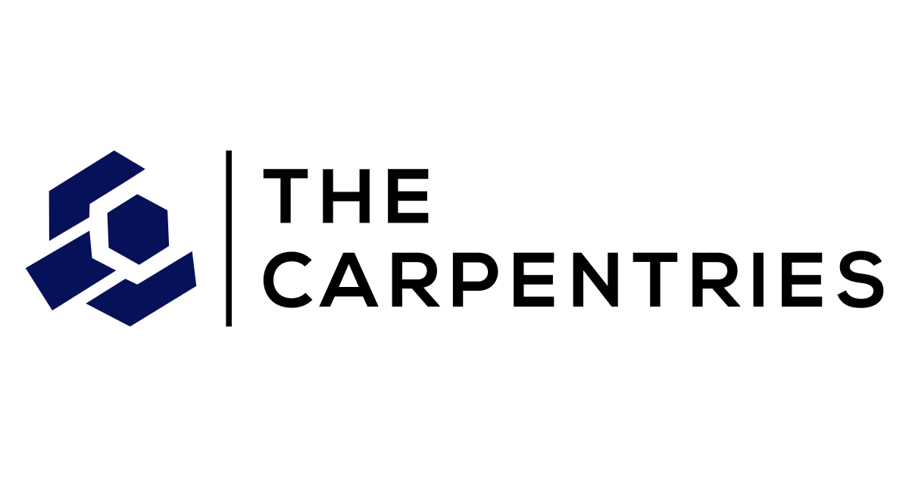
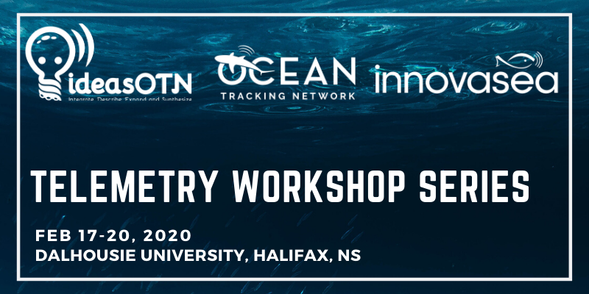
WORKSHOPS & TRAINING
OTN Node Manager Training
Workshops for Uni/Govt groups, and Nodes
IdeasOTN telemetry workshop series
OBIS training - biodiversity information system
Ongoing training & support
Intro to Python and R
Telemetry analysis tools – (glatos, vtrack, machine learning, false detections etc.)
Collaborative toolbox 🡪 in progress.
Weekly “study hall” sessions
Data rescue services!!
Give some extra hands to sort out and archive messy, historical data sets
OCEAN TRACKING NETWORK
Notes:
Many of our previous workshop curricula are online on the OTN GitHub. Reach out if you're looking for some specific material! We are available for remote workshops, quick chats, or can connect you with some online material.
OTN is a Tier 2 OBIS node (and recognized Associated Data Unit of IODE) and so we are responsible for the submission of (public) animal tracking data to this global database. OTN has some OBIS-trainers who can train other groups to become OBIS contributors themselves.
We also are guest-developers on the GLATOS R package for acoustic telemetry analysis (created by the GLATOS network) and teach workshops on this material as well. We’ve also recently begun an endeavor to centralize acoustic telemetry analysis tools and make them more easily accessible. This will be a Carpentries-style online repository of code and other tools. We’ve been building an online curriculum using code using packages such as GLATOS, VTRACK, YAPS and other custom code for HMMs, Network Analysis and machine-learning and would love to get additional tools added.
During the work-from-home order we’ve taken to hosting weekly “data study hall” sessions where researchers from across the globe can join and discuss their analysis problems, pitch ideas, learn about new tools etc. I recommend anyone to join if you are unsure about where to start with your analysis! We also have an r-support Slack channel which has been great for asynchronous help.
Finally, OTN also has completed some data rescue missions in the past. We can help get your records in order and into a format that can reported to your local node. This is also great for cleaning up and archiving your data. Because let's be honest, we’ve all seen some pretty messy historical records, and its important to keep a clean archive of your ENTIRE project in one location.

Slide 42
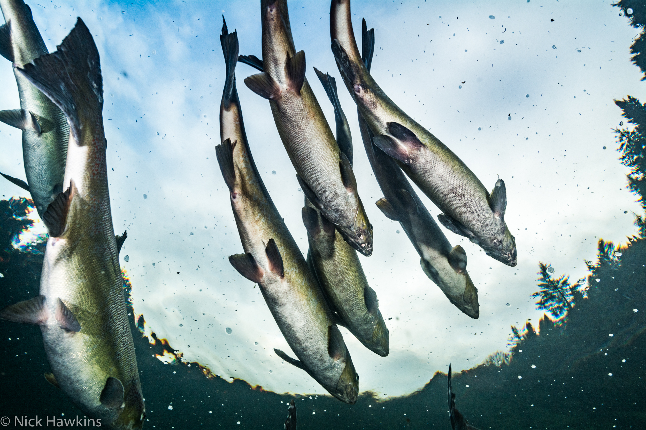
PUBLIC DATA
OTN supports direct links to public data
data portal project and discovery pages
Geoserver
ERDDAP
OBIS 🡪 GBIF and GOOS/MBON
Private: station locations and deployment metadata
Always public: project metadata
Under embargo: tagging metadata, all detections
Default 2-year embargo (after tag battery dies), can request extension or release early
OCEAN TRACKING NETWORK
Notes:
As outlined in FAIR data principles, we fully support publicly accessible data. There are several options to see your data and metadata in the public sphere: some automatic and some optional.
MBON/GOOS/OBIS are working together as of 2016, and OBIS is our way to help you contribute your data to that partnership. You’ll notice many Darwin Core terms in your Detection Extract, allowing us to easily push to OBIS when needed.
As per our data policy we have a default 2-year embargo on animal information. This can be extended or nulled.

Slide 43
YOUR PROJECT
OCEAN TRACKING NETWORK

Slide 44
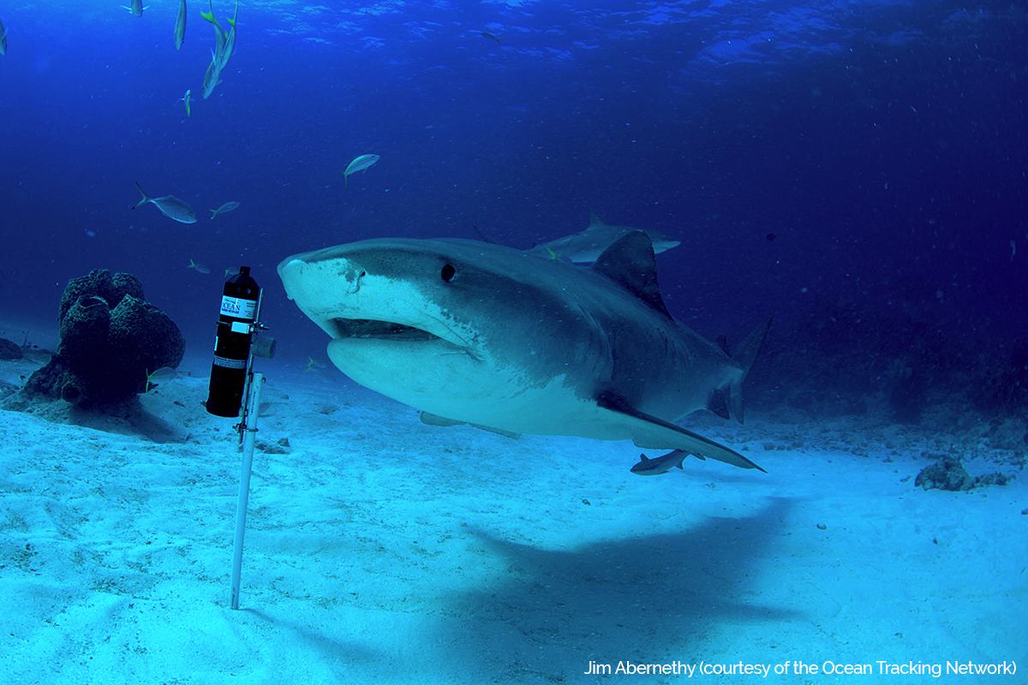
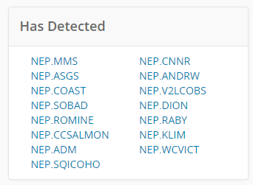
ONC Loan
Buoys of Opportunity – ONC (BOOONC)
Automated cross-node detection matching
Started in 2013
OCEAN TRACKING NETWORK
Notes:
More detail about how you fit into this system: In 2018 Alex Hearn contacted OTN to create a database Node, since the existing data-sharing system was difficult to maintain. since then, multiple projects have registered and are being matched to our global pool of detections!

Slide 45
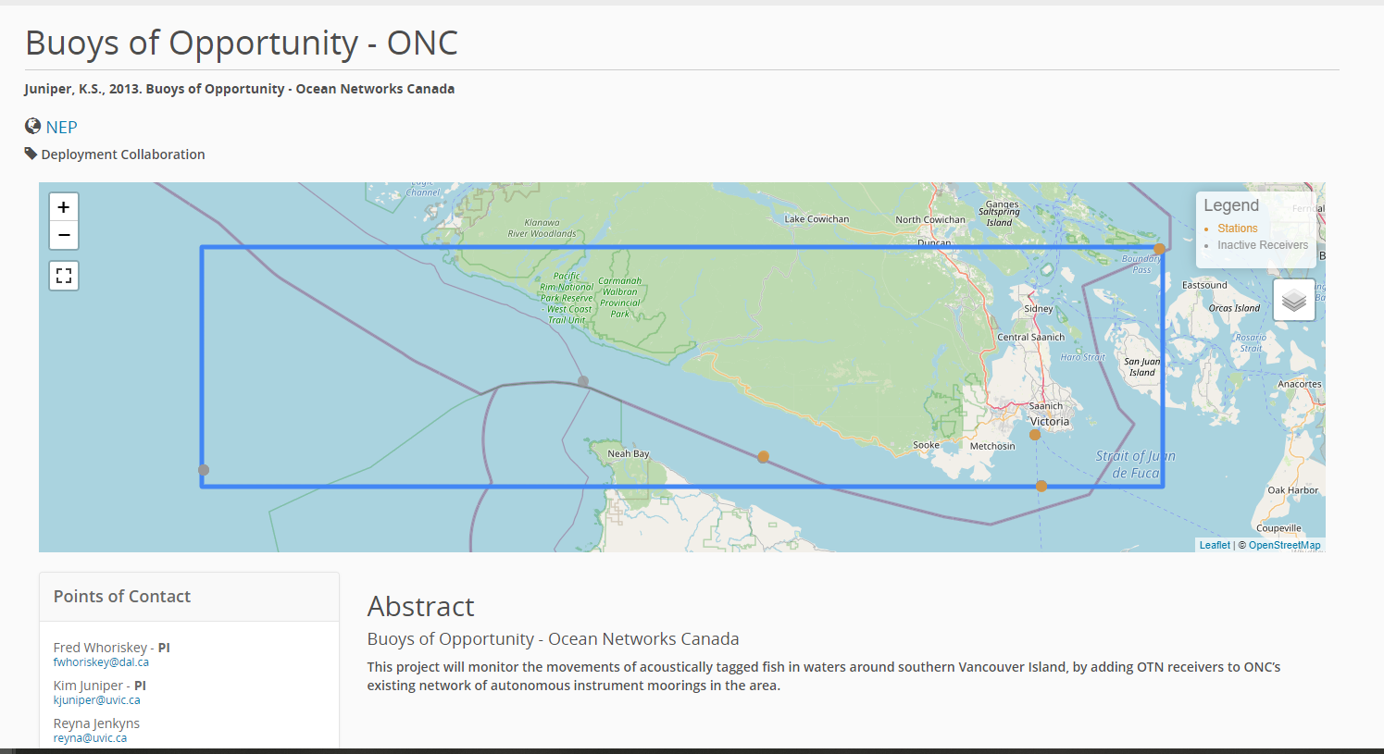
BOOONC
8 years of detections
24 stations
26 receivers
69 deployments
18 tag projects
6 species
OCEAN TRACKING NETWORK
Notes:
As of 2022-02-22

Slide 46
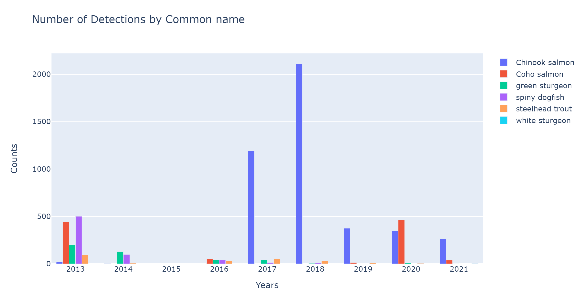
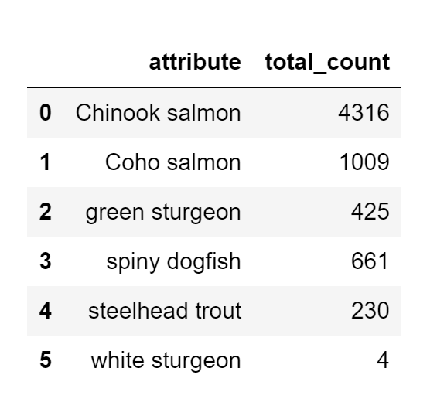
BOOONC
OCEAN TRACKING NETWORK
Notes:
As of 2022-02-22

Slide 47
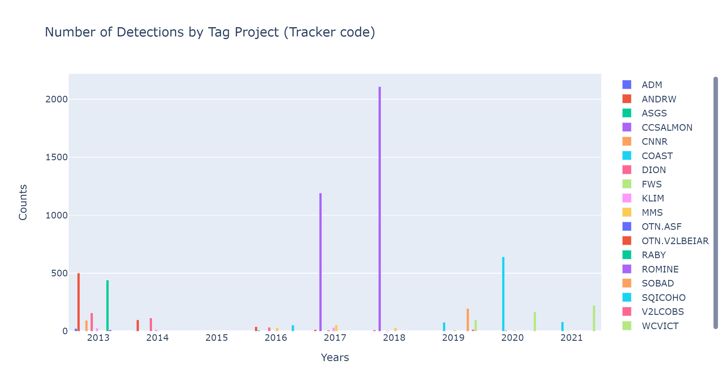
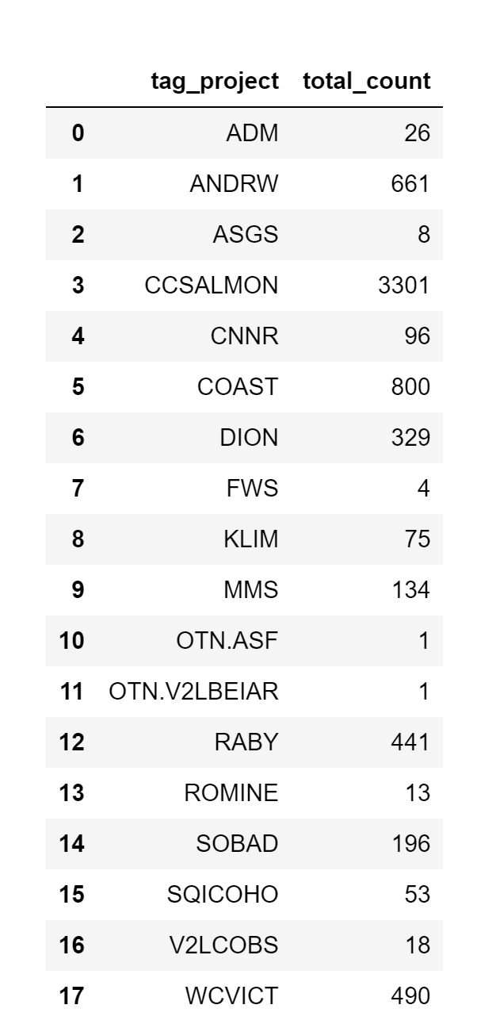
BOOONC
OCEAN TRACKING NETWORK
Notes:
As of 2022-02-22

Slide 48
NEXT STEPS
Update your project page
Ensure abstract, weblinks and contacts are adequate
Adjust data sharing workflows
Discuss the scientific plan with local Pis
OCEAN TRACKING NETWORK

Slide 49
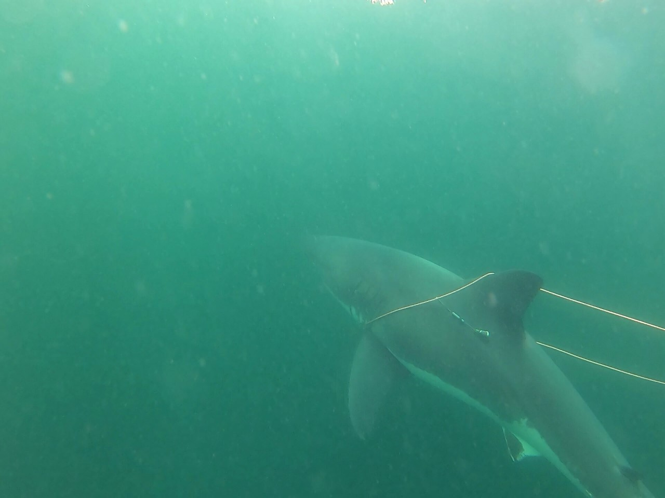
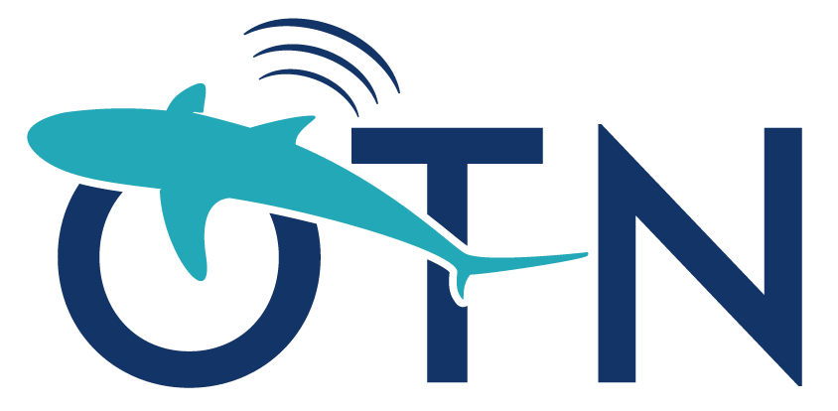
CHECK US OUT
https://members.oceantrack.org/
OCEAN TRACKING NETWORK
Notes:
Please explore our website, there is lots of interesting information on there, available with or without a password, along with helpful resources including the mystery tag tool ;) https://members.oceantrack.org/@@mystery_tag

Slide 51
https://members.oceantrack.org/
@OceanTracking

Slide 52
DISCUSSION
Have you ever noticed differences in “data-sharing cultures” - and how did you work through this?
What’s the best way to deal with missing data in a spreadsheet?
How do you approach big datasets?
Open floor! What questions do you have about OTN and/or biological data management?
OCEAN TRACKING NETWORK

Slide 53
ABOUT OTN
Global aquatic research, data management and partnership platform headquartered at Dalhousie University in Nova Scotia, Canada.
Since 2008, OTN has been deploying state-of-the-art ocean monitoring equipment and marine autonomous vehicles (gliders) in key aquatic locations.
OTN has established partnerships with a global community of stakeholders to document the movements and survival of aquatic animals in the context of changing ocean environments.
Knowledge generated by OTN is used by scientists, managers, policy-makers, industry, Indigenous and coastal communities and the general public.
OCEAN TRACKING NETWORK
Notes:
We deploy equipment, manage telemetry data, support partners using the same data management system.
We train HQP, data managers, general public.
OTN aggregated data is used to advise policy makers, industry, to support conservation efforts and to educate the public.

Slide 54
FUNDING
Supporting research through expertise and infrastructure
Canada Foundation for Innovation’s (CFI) Major Science Initiatives (MSI) Fund
Confirmed for 5 years (6th year added for good behavior)
Not research funding – judged by our ability to support and train HQP and partners
Expectation is renewal, unless we fail to meet our goals
OCEAN TRACKING NETWORK
Notes:
Big notes to hit are we were born under a 168m Science and infrastructure investment from nserc/cfi ,
cfi infrastructure money continues as a Major Science Initiative, 5 year renewable funding, expectation is always renewed unless we miss our goals,
our goals are connecting international networks and enabling collaborations.

Slide 55
GLIDERS
http://ceotr.ocean.dal.ca/gliders/
A whole extra set of considerations
Receivers that are MOVING
OCEAN TRACKING NETWORK
Notes:
We have a very large glider fleet of both slocum and wave gliders. We consistently run missions around Nova Scotia to track whales, offload receiver stations and listen for animals (VMTs).
They dont always have sat signal: they might only report their location every few hours. Need to interpolate across their path to “guess” where detections occurred.
Waveglider has thrusters: can interfere with VMT’s listening ability
Massive amount of co-collected oceanographic data: how to best exploit this so we can use it to make better conclusions about animal movements??

Slide 56
ROV: REMOTELY OPERATED VEHICLE
Saab Seaeye Falcon DR
Depth Rating up to 1000 meters
Edgetech 4205 Side Scan Sonar
Depth Rating up to 2000 meters
Film footage, habitat mapping
Other projects
New data types!
OCEAN TRACKING NETWORK
Notes:
We also have new toys: an ROV and side scan sonar. We hired an ROV tech and are open to collaborate / support researchers with this tech. New type of data to work with!
How to archive and annote HOURS of ROV film footage so that the species observations can be used for Science?
Side scan bottom mapping: how to store and disseminate this information to use to inform biology

Slide 57
TYPES OF TAGS
Acoustic
Radio PIT
Satellite
Floy
OCEAN TRACKING NETWORK
Notes:
We often see acoustic tags used in combination with satellite and/or external Floy tags… but there are also Radio tags and PIT tags: how do we capture all this information into one analysis to use for our species? Where should this data be stored and accessible?

Slide 58
ARRAY DESIGN
Certain arrays answer certain questions
Targeted site deployments
Presence at locations of interest (ex. MPA)
Receiver gates
Movements within corridors (ex. )
Conditional nature of configuration allows for calculation of detection probabilities
Receiver lines and curtains
Movements past a location, often along shoreline or at choke points between two regions of interest
Double lines - redundancy, estimation of line detection probabilities, and inform on direction of movements
Receiver grids
More uniform spatial receiver coverage (i.e., sampling effort)
Habitat use, movement among management zones, nearshore-offshore movements
Receiver spacing - spatial scale of the study objectives, detection range of transmitters, and movement behavior of the fish
OCEAN TRACKING NETWORK
Notes:
No detections doesn't mean no animals
Tags can collide, environmental factors can limit the detections. Noise can create false detection events.

Slide 59
RANGE TESTING
To determine the optimal, maximum distance at which receivers should be placed for a study.
Range testing should at a minimum include tags at the same power as those to be deployed in the study of interest, but if multiple tags of different power outputs are available, it is recommended to collect data from them as well.
OCEAN TRACKING NETWORK
Notes:
Alternatively, if you have different tags but not many receivers, you could do the experiment in the reverse order, where you have one receiver in a fixed location and different tags at different distances to see the detectability range for each different tag for that specific receiver

Slide 60
TAG COLLISIONS
Lots of noise in the water can cause tags signals to overlap
Tag collisions occur when a transmission from a second tag begins before a transmission from another tag is complete.
This might be a “real” tag ID (false detection) or may be impossible to decode (no data). Both mean that neither transmitter is logged
OCEAN TRACKING NETWORK
Notes:
A common error with the equipment is when two tags ping at the same time and their sound waves “collide”. When the receiver hears a tag collision it can either 1) hear a 3rd, unique tag ID from the two colliding, which is not real or 2) hear nothing at all since it is too jumbled. You want to get tags with “random” ping rates so that hopefully you never have tag collisions in your data set. Instruments that ping on a regular schedule are more likely to collide.
https://support.vemco.com/s/article/What-are-tag-collisions
Use the FDA tool in VUE:
From VUE manual…
3.2.2 Reviewing “Questionable” Data
It’s important to note that FDA analysis does not conclusively determine that the “questionable detections” are false, only that the data requires further scrutiny. Some things to consider when looking at questionable data are:
1. Detection activity. If there are many tags around a receiver, tag collisions can happen and can cause false detections. Single detections, or multiple detections spaced far apart recorded in the presence of other tags should be viewed very cautiously as they are most likely false.
2. Detections of a certain ID number on other receivers may provide you with enough confidence to classify a questionable detection as real, assuming the timing makes sense.
3. Fixed tags or range test tags – if you have deployed tags for a range test and they are on the edge of the detection range, it will be normal for them to fade in and out during the range testing. Depending on the range performance these could look like detections that are separated by long intervals and thus flagged as questionable even though they are legitimate detections.
4. The short and long intervals are set up by default as 30 minutes and 12 hours respectively. This works well with normal tag delays (e.g. 30 sec to 5 minute delays). If your tags have very long random delays – tens of minutes and longer – you may not detect any short intervals and thus they are flagged as questionable even though they are valid detections. The default interval times can be changed as required (see below).
5. High Residency situation – if you have a large number of tags resident around a receiver, you may expect to see longer intervals between tag detections due to tag collisions. It may be necessary to stretch out the minimal interval for the FDA analysis to allow for these longer intervals.
6. Finally, when in doubt call us. We are happy to have our team of experts review your data and provide guidance on whether to accept detections as real.

Slide 61
TAG COLLISIONS
Lots of noise in the water can cause tags signals to overlap
Signal code collisions are influenced by number of tags and transmitter delay
Transmitter delay = time between sequential transmissions. Programmed into tag upon purchase
OCEAN TRACKING NETWORK

